Slide 1
VALUE-BASED HEALTHCARE APPROACH TO ENHANCING EFFICIENCY AND REDUCING COSTS
Redefining Success in Cancer Care: Beyond Survival
Zofia Das-Gupta, PhD
Senior Director, ICHOM
May 2025

Slide 2

The Status Quo Prevents
Patient-Centered Healthcare
Focus on Processes, Not Outcomes: The current payment and quality measurement system emphasizes processes, procedures and treatments, rather than the actual health results for patients.
Fragmented Data: Lack of standardized outcome measurements and their use leads to inconsistent care and prevents comprehensive assessments of treatment effectiveness and resource utilization.
Limited Accountability: Without outcome measurements, accountability focuses on processes and costs only, without impact on health outcomes. This hampers any ability to create incentives for or measure progress on actual results of care.

Slide 3
More people are surviving cancer – but are we measuring what truly matters to them?
Traditional health systems prioritize cure and survival as primary outcomes
However, side effects from cancer and its treatment often persist long after remission
Health-related quality of life (HRQoL) is frequently overlooked in post-treatment care
Advances in treatment have created:
A growing population of cancer survivors
A new population living longer with incurable cancer

Slide 4



VISION
Defining global Sets of Patient- Centered Outcome Measures that matter most to patients
Driving adoption and reporting of these measures worldwide
Creating better value for all stakeholders through data for action
Improved health, and safe, equitable health care, transformed by measuring outcomes that matter to patients.
MISSION
Standardize and drive global adoption of patient-centered outcomes measurement as the benchmark of health and value.

Slide 5
Our Thesis: Outcomes Are the Key Element of Value
Value =
Patient health outcomes achieved
Cost of delivering those outcomes
Value-Based Healthcare encourages:
Holistic measurement of outcomes that matter to patients
Emphasis on supportive care, symptom management, and long-term well-being

Slide 6
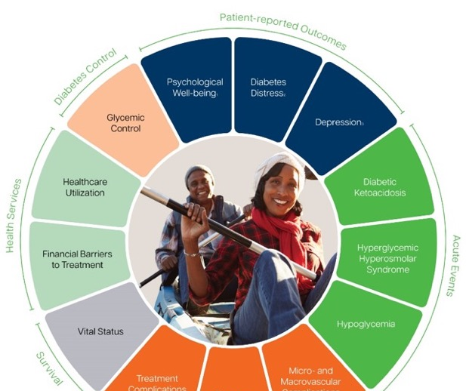
Sets of Patient-Centred Outcome Measures include PROMS, Clinical Measures, and relevant demographic data
Created with Patients.
Focused on Results of Care.
Comprehensive AND Prioritized.
Based on Science and Real-World Use.
Established Global Standard.

Slide 7




47 Sets address over 60% of global disease burden
ICHOM Set Families
Oncology
Cardiometabolic
Ophthalmological
Life-Course
Mental Health
Neurology
Congenital Anomalies
Gastrointestinal
Breast Cancer
Stroke
Cataracts
Older Person
Depression & Anxiety
Parkinson’s disease
Congenital Heart Disease
Inflammatory Bowel Disease
L. Prostate Cancer
Coronary Artery Disease
Macular degeneration
Overall Adult Health
Depression & Anxiety CYP
Dementia
Pediatric Facial Palsy
Renal, Urogenital
A. Prostate Cancer
Atrial Fibrillation
Musculoskeletal
Overall Pediatric Health
Chronic Kidney Disease
Psychotic Disorders
Epilepsy
Congenital Upper Limb Anomalies
Lung Cancer
Heart Failure
Adult Oral Health
Personality Disorders
Lower Back Pain
Infectious Disease
Craniofacial Microsomia
Overactive Bladder
Colorectal Cancer
Heart Valve Disease
Maternal & Child health
Hip & Knee O.A.
Addiction
COVID-19
Cleft Lip & Palate
Hypertension
Hand & Wrist
Pregnancy & Childbirth
Autism spectrum
Published in high impact journals, including:
Diabetes
Preterm & Hospitalized Newborn Health
Inflam. Arthritis
Eating Disorders
Venous Thromboembolism
Major Injury
Neurodevelopmental Disorders
Adult Obesity
In development:
Kidney stones
Liver Disease
Bladder Cancer
Spinal Muscular Atrophy (SMA)

Slide 8
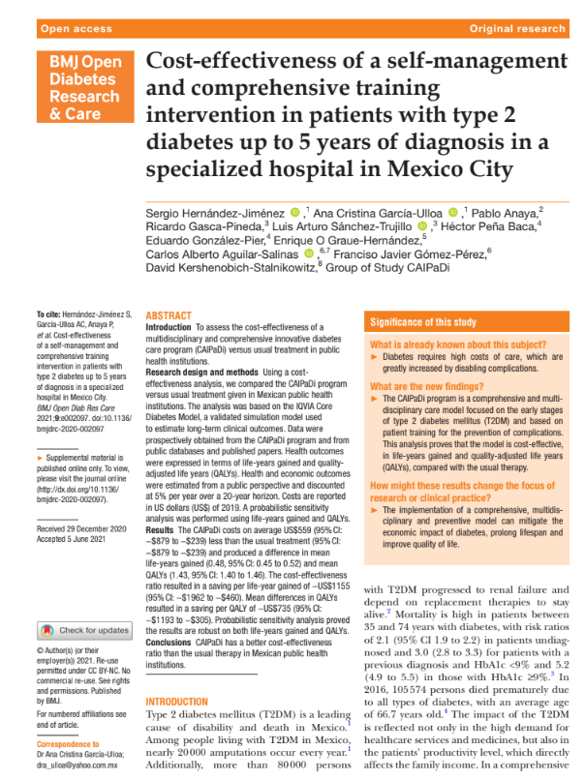
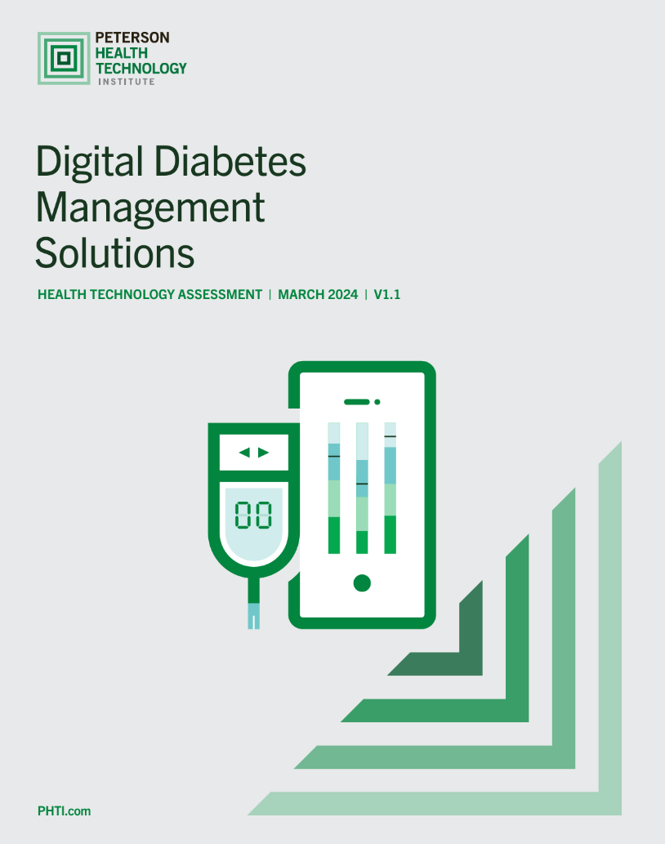
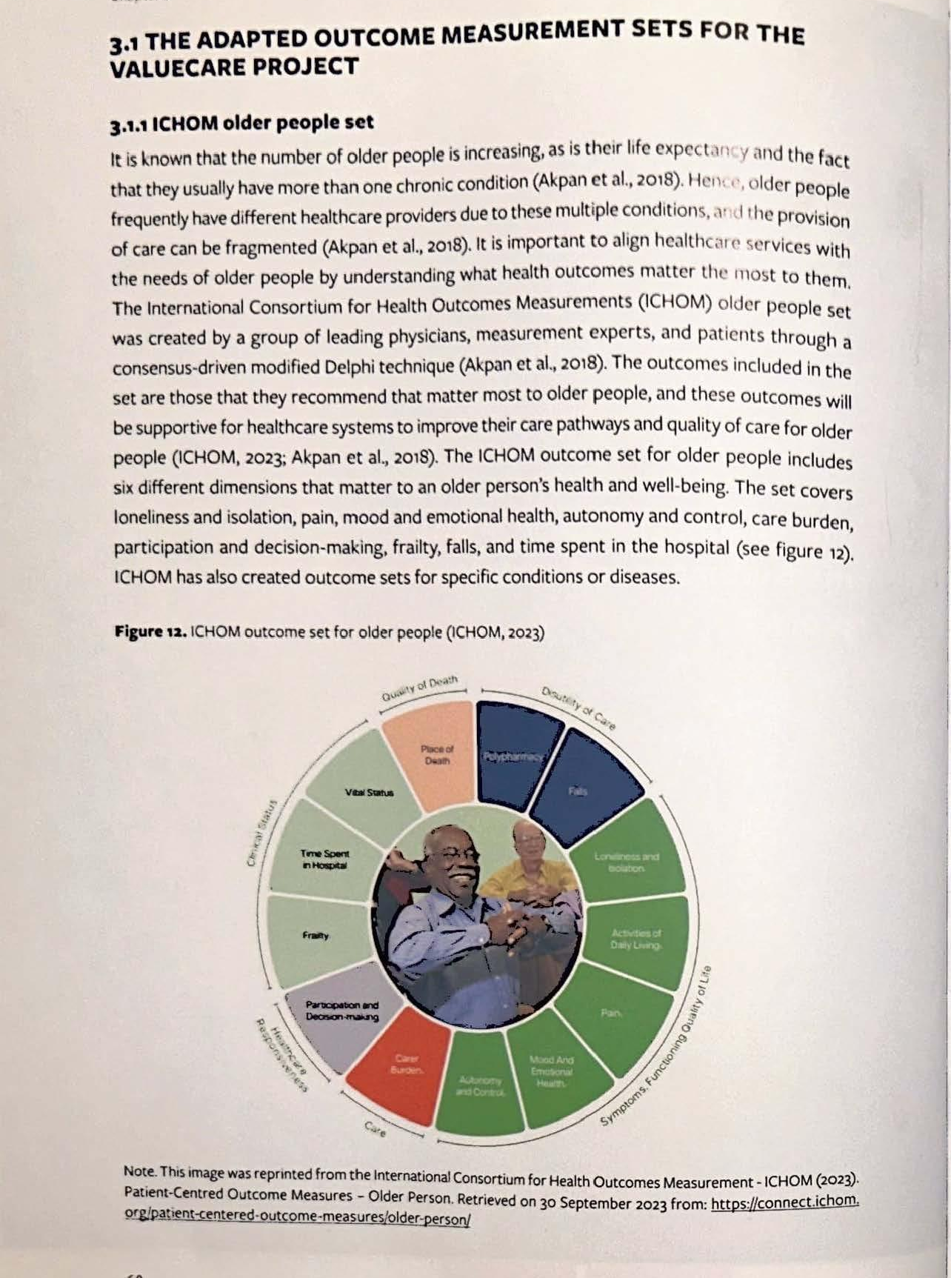
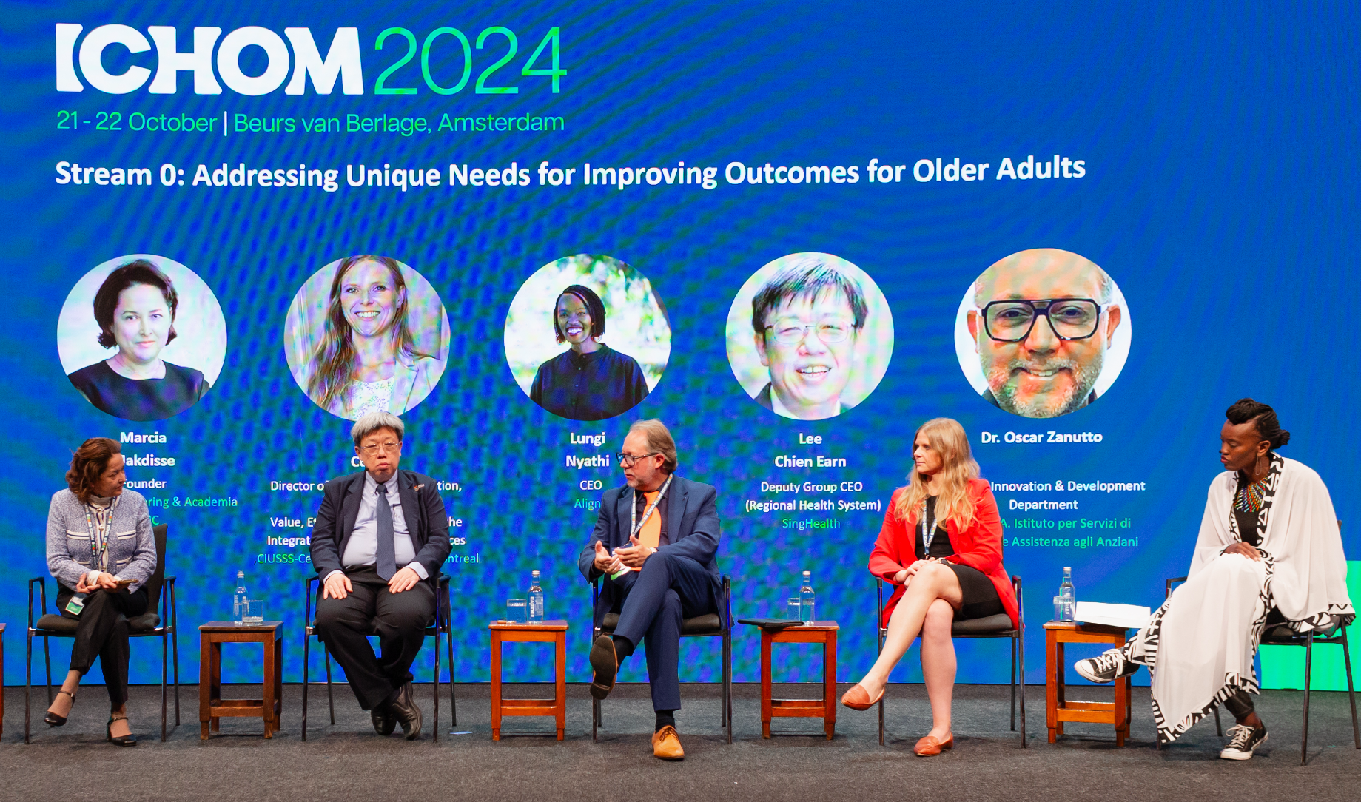

12 Years of Evidence and Impact
46+
Sets of
Patient-
Centered
Outcome
Measures
60+ Countries
500+ Hospitals
30,000
Member Network
Notes:
Making the case for ICHOM/VBHC through objective data & implementation.

Slide 9
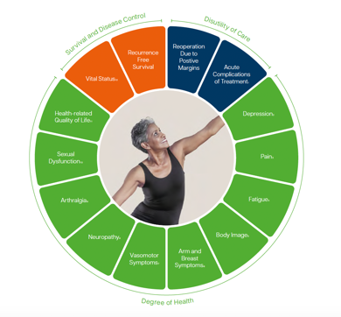
Example of ICHOM Set – Breast Cancer
Patient-reported outcome measures (PROMs)
Tracked via European Organization for Research and Treatment of Cancer Quality-of-Life Questionnaire Core (EORTC QLQ-C30)
European Organization for Research and Treatment of Cancer Quality-of-Life Questionnaire –Breast Cancer Module (EORTC QLQ-BR45)
Subscale within BREAST Q Version 2.0 (BREAST Q)
Subset of questions from the Endocrine Subscale of the Functional Assessment of Cancer Therapy (FACT-ES)
Case-mix variables
Sociodemographic factors (age, sex, education, race/ethnicity, relationship/marital status)
Clinical factors (comorbidities, body mass index, menopausal status; AJCC 7 TNM stage, tumour grade, histological type, hormone receptor status, number of nodes involved)
Treatment factors (treatment type)

Slide 10
The Breast Cancer primary subset:
What is a primary subset?
For a given condition, a subset of the full ICHOM Set measures with the ‘essential, must have’ data elements to be collected to facilitate meaningful VBHC analysis. Collecting more than the primary subset enables more robust analytics, including longitudinal time-series to better understand patient outcomes relative to various index events.
The full ICHOM Breast Cancer set includes 129 outcome variables. The primary subset includes 29 of these outcome measures along with the case-mix and treatment variables. These can be used as a starting point for collecting the measures needed to begin participating in the learning collaborative.
The measures to be included in the primary set were developed using a rigorous Delphi-driven consensus process involving previous working group members, patient representatives, and current users of the set.

Slide 11
The Breast Cancer primary subset:
Case Mix + Treatment Factors + Essential patient and clinically-reported outcomes
66 Case Mix (29 clinical, 37 patient)
28 Treatment Factors (all clinical)
25 patient-reported outcomes
4 clinically-reported outcomes
Measure | Patient Population | Reporting Source
(Reconstructive) Surgery | All patients | Clinical
Radiotherapy
Chemotherapy
Hormonal therapy
Targeted therapy
Immunotherapy
Outcomes domain | Measure | Patient Population | Reporting Source
Survival and Disease Control
Vital Status | Vital status | All patients | Clinical
 | Date of death
 | Death attributable to breast cancer
Recurrence free survival | Recurrence | Patients with curative intent | Clinical
Degree of Health
Overall wellbeing | EORTC-QLQ-C30 (Q29-30) | All patients | Patient-reported
Physical functioning | EORTC-QLQ-C30 (Q1-5)
Ability to work | EORTC-QLQ-C30 (Q6-7)
Emotional functioning | EORTC-QLQ-C30 (Q21-24)
Endocrine therapy symptoms | EORTC-QLQ-BR45 (Q54-56, Q63-69)
Satisfaction with breasts | EORTC-QLQ-BR45 (Q74-75) | Patients with surgery/radiotherapy
Primary Subset
Q29
Full Breast Cancer Set
Q129

Slide 12







ICHOM Learning Collaborative Breast Cancer Participants
A Learning Collaborative is a network of healthcare providers, clinical researchers and patients, who have agreed to collaborate to assess, learn, innovate and improve clinical practice
We are seeking participants to join Phase 2 of ICHOM Breast Cancer Learning Collaborative!

Slide 13
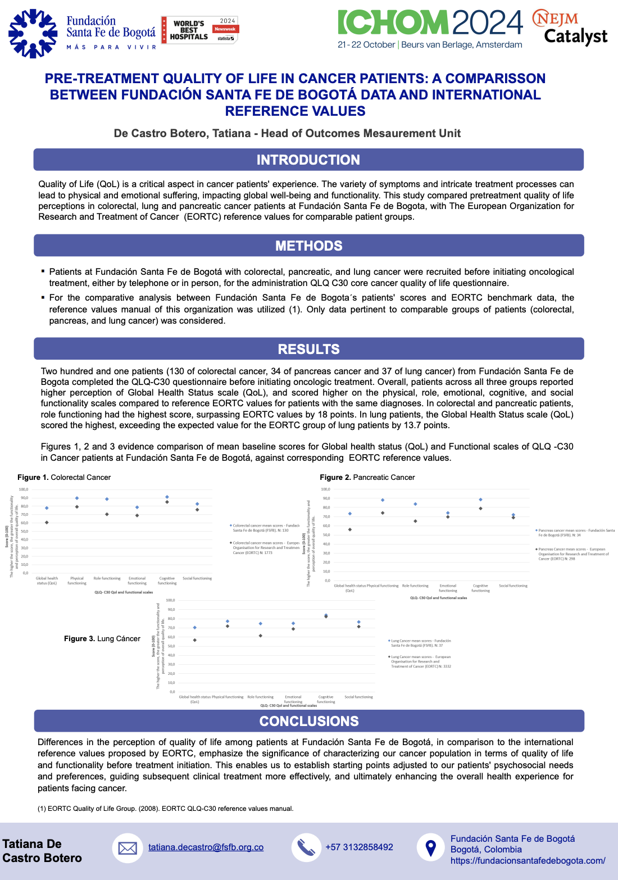
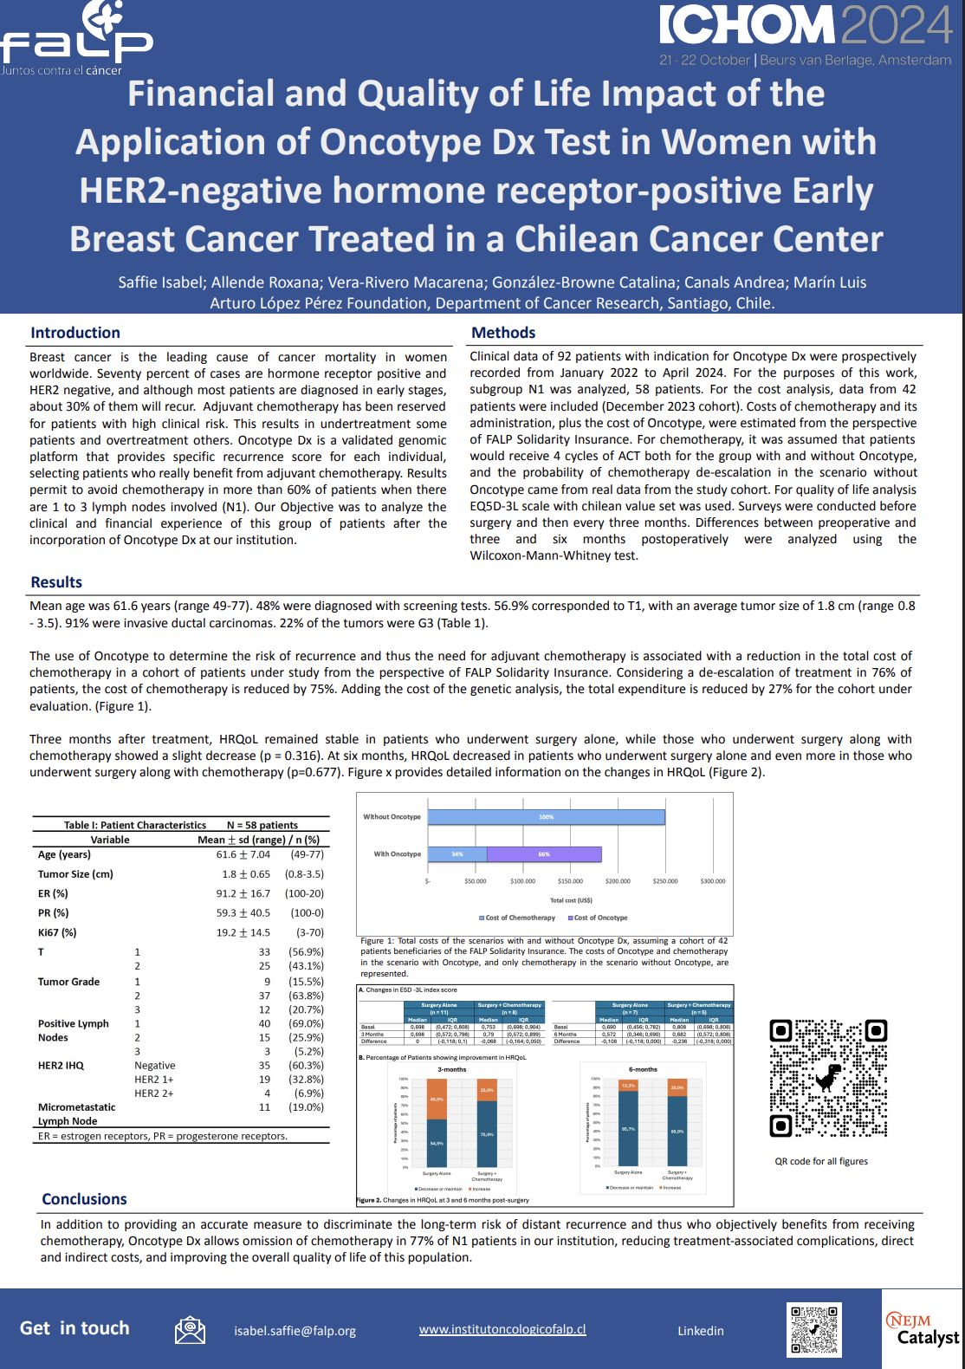
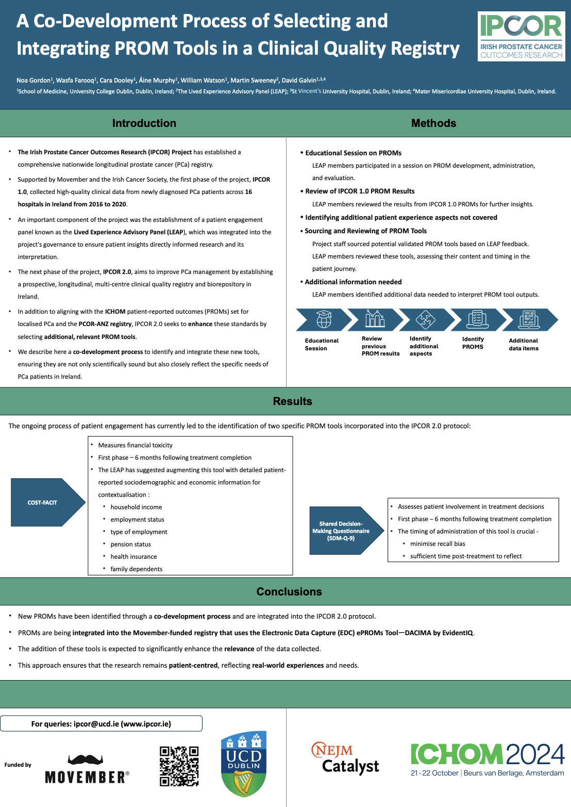
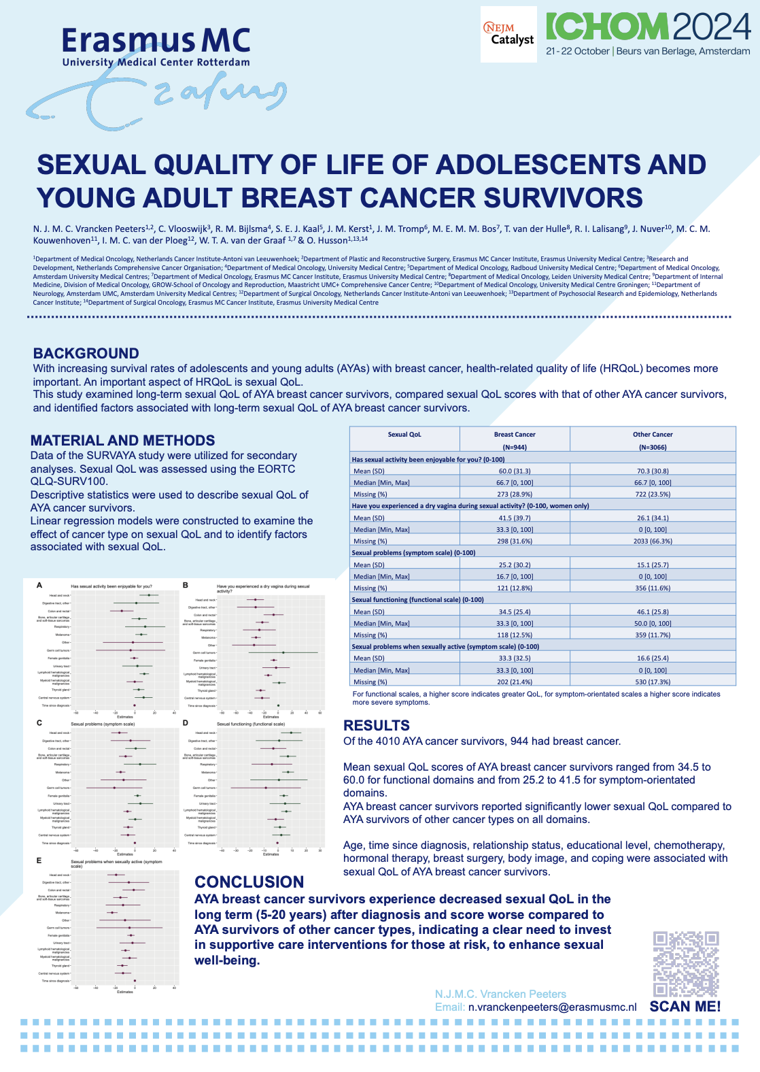
ICHOM Oncology Sets in Use Across Diverse Clinical Settings
ICHOM Abstract Gallery 2024

Slide 14
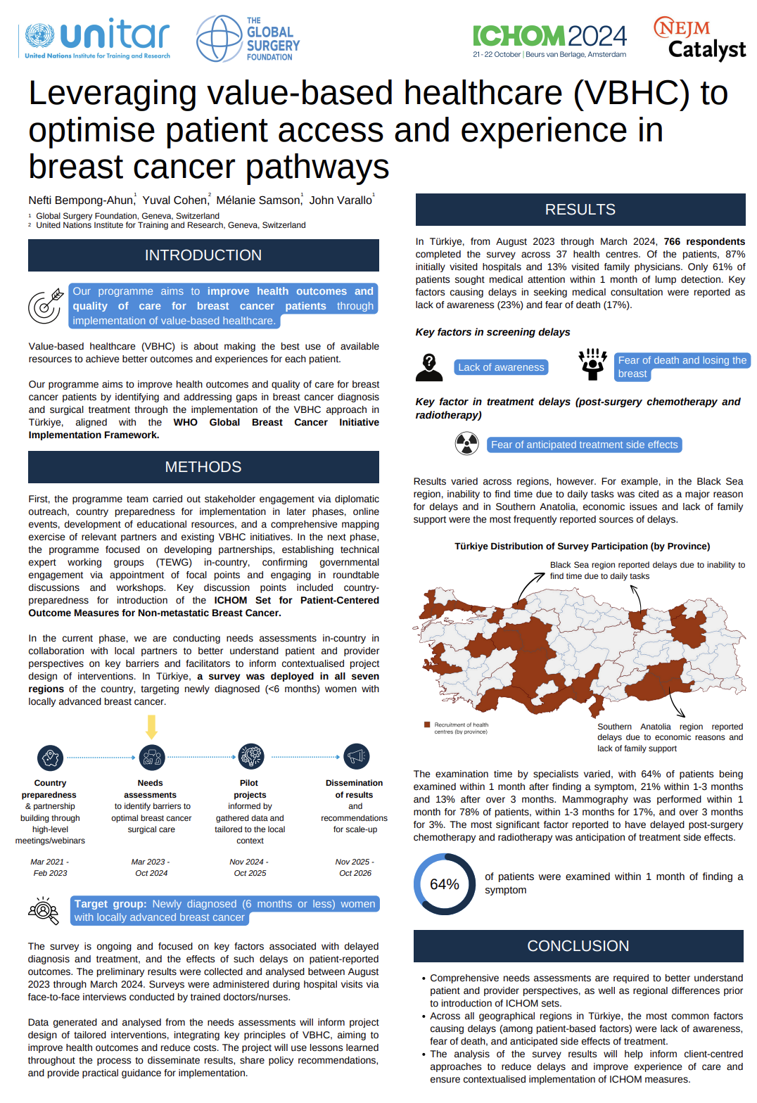
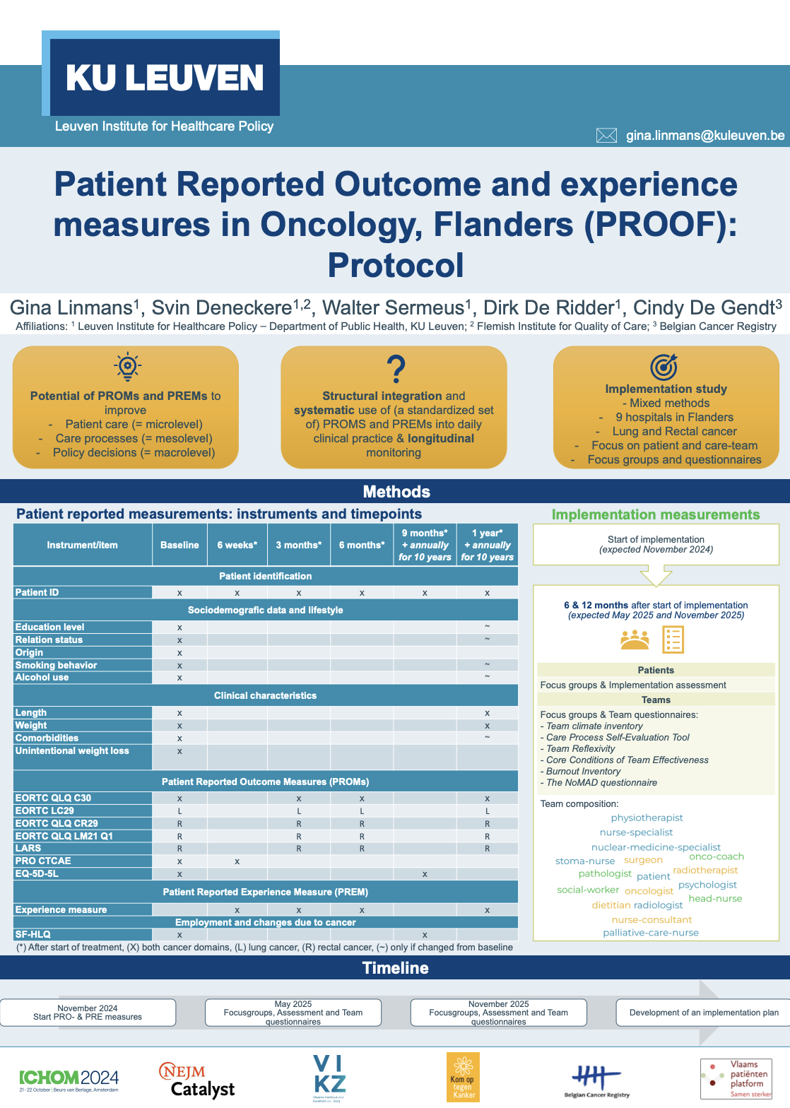
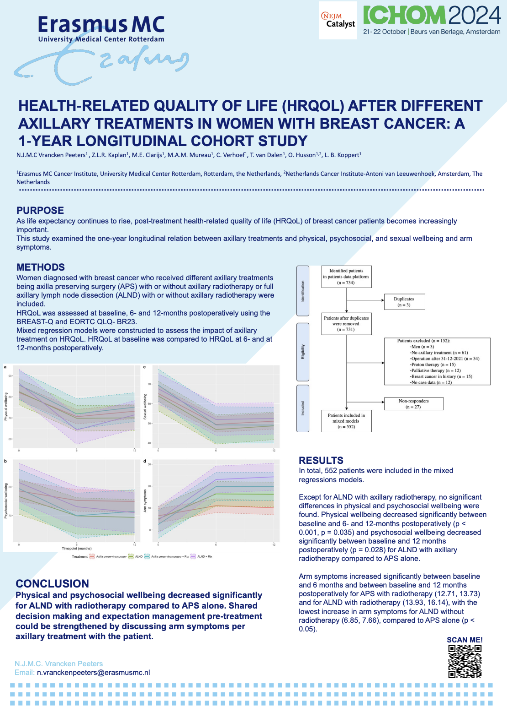
ICHOM Abstract Gallery 2024

Slide 15
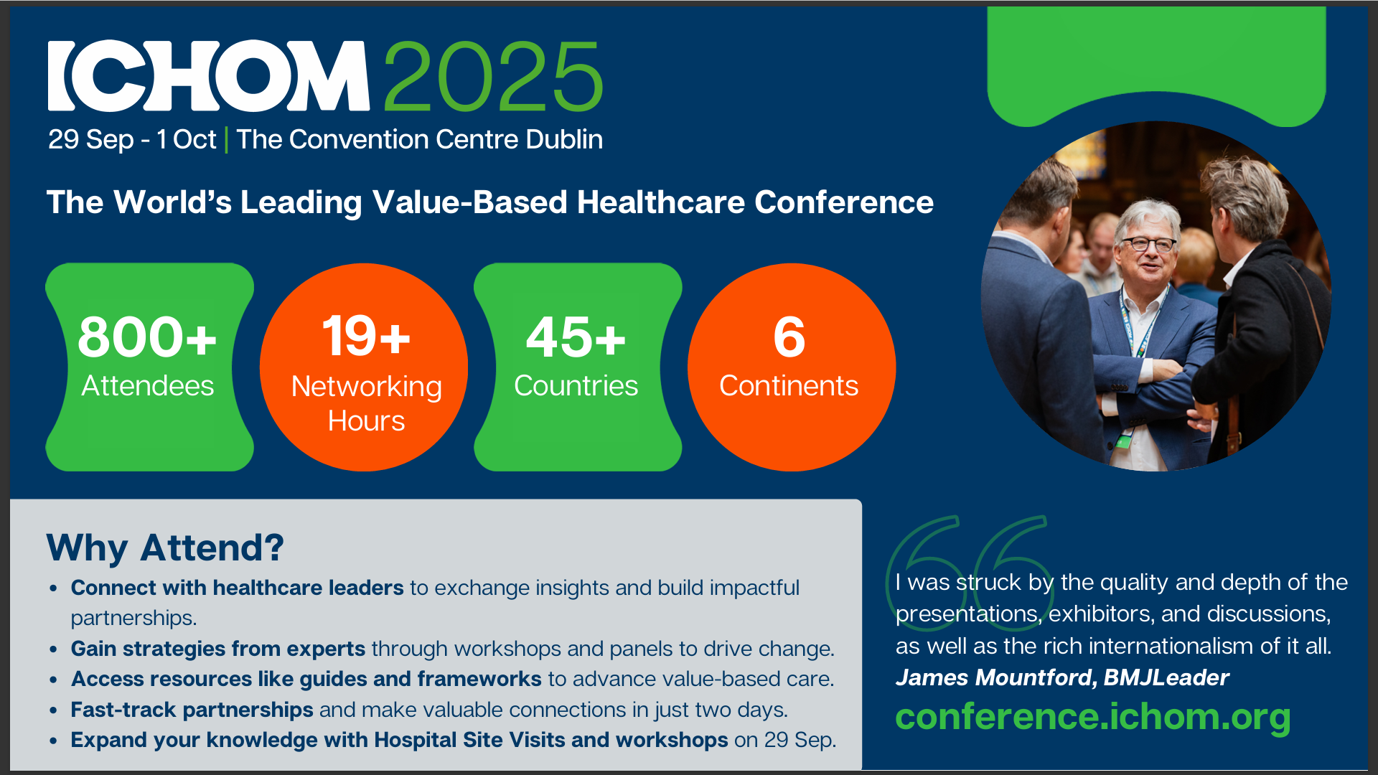

Slide 16





Thank You
Zofia Das-Gupta, PhD
Senior Director
z.das-gupta@ichom.org
www.ichom.org
https://vimeo.com/ichom
https://twitter.com/ICHOM_ORG
https://www.facebook.com/ichomteam/
https://www.linkedin.com/company/international-consortium-for-health-outcomes-measurement-ichom-/

