Slide 1

Broadcasting in Germany
and the amended WDR law
in North Rhine-Westphalia
Dr. Marc Jan Eumann, State Secretary for Europe and the Media,
State Chancellery of North Rhine-Westphalia
Latvia, Riga, April 22, 2016

Slide 2
Outline
Dual Media Order in Germany
Key media location North Rhine-Westphalia
The WDR – Westdeutscher Rundfunk
The WDR Law
Media policy news

Slide 3
I. Dual Media Order in Germany
The Dual Media Order
Public Service Broadcasting
22 TV Channels,
70 Radio Channels
Private
Broadcasting
403 TV Channels,
282 Radio Channels
plus
Web TV and
Web Radio
Responsibility: 16 federal states
(NW, BW, BY, BE, BB, HB, HH, HE, MV, NI, NW, RP, SL, SN, ST, SH, TH)

Slide 4





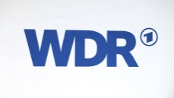


















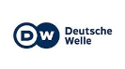







I. Dual Media Order in Germany
The Diverse German Broadcast Landscape (Selection)
Public Service Broadcasters
Private
Broadcasters
Internationally a unique feature

Slide 5
Lessons from the past:
Broadcasting freedom is a fundamental right
No state control
Special financing of the public service broadcasters
Old model:
→ Device-related licence fee per person and broadcast receiver (e.g. radio, tv, pc)
→ Acceptance problems
New Model (since 2013):
→ Licence fee = “Household fee”: one residence – one fee
→ Successful changeover
I. Dual Media Order in Germany

Slide 6
I. Dual Media Order in Germany
Aims
of the Dual Broadcasting System
Preventing predominant control the media and
public opinion
Safeguarding
media pluralism and freedom of opinion

Slide 7
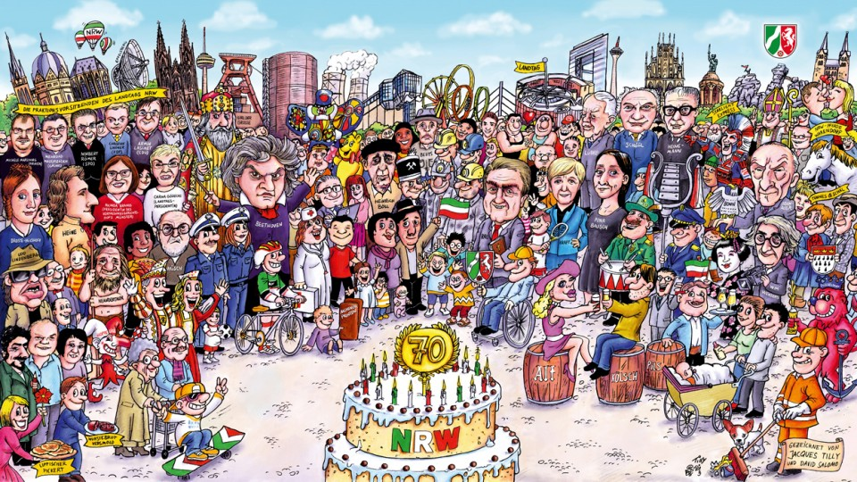
II. Key media location
North Rhine-Westphalia

Slide 8
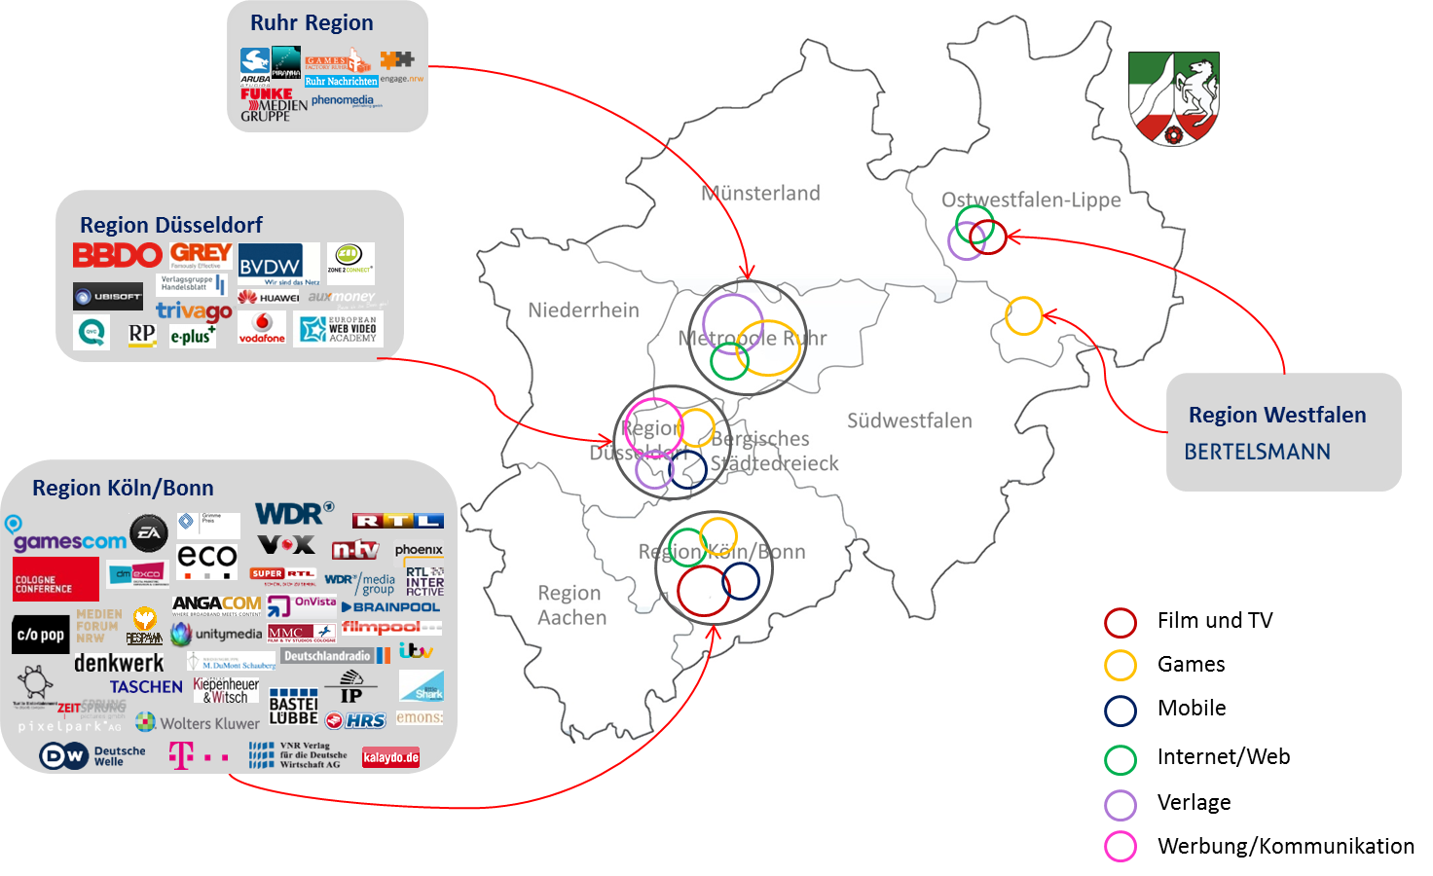
II. Key media location
North Rhine-Westphalia

Slide 9

€122 billion turnover
II. Key media location
North Rhine-Westphalia
18 million inhabitants / largest federal state
24,000
media and communication companies
Television capital Cologne
412,000 employees
Pub-lishers
Producers
International media groups
Broad-casters
Creative people
Start-ups

Slide 10

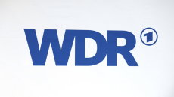





II. Key media location
North Rhine-Westphalia
Broadcasters in North Rhine-Westphalia (Selection)
Public Service Broadcasters
Private
Broadcasters
29 private TV Channels, 45 private Radio Channels,
16 public service broadcasting Channels, plus Web Radio

Slide 11
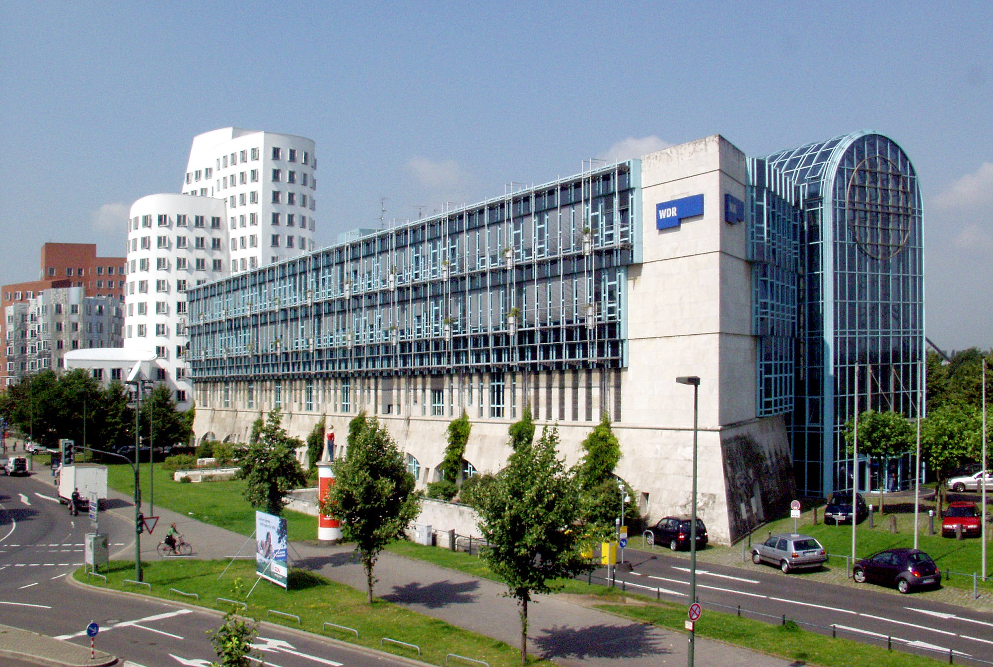
III. The WDR – Westdeutscher Rundfunk

Slide 12

III. The WDR – Westdeutscher Rundfunk
Headquarter in TV Capital Cologne
Germany’s largest public service broadcaster
Diverse range of programmes
Director has a strong position

Slide 13
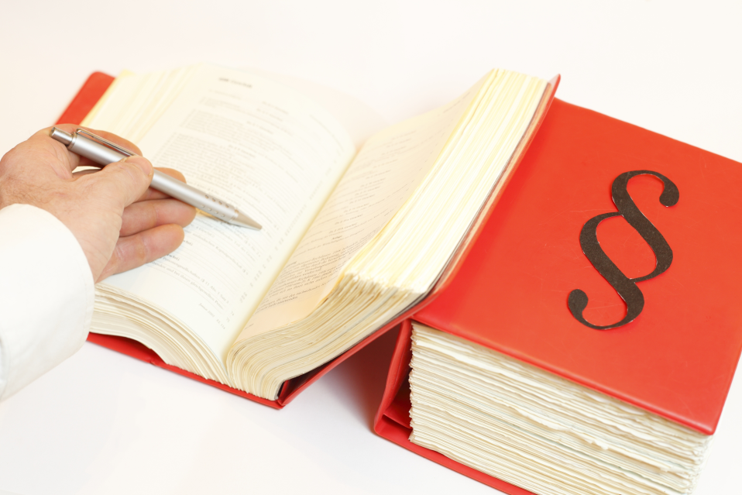
IV. The WDR Law

Slide 14
The WDR Law
The WDR law defines the public service mandate of the WDR and provides guidelines for its actions.
Even before the amendment it was a solid and legally watertight media regulation.
Why the need for an amendment?
→ Provision of even more media pluralism and freedom of opinion → Equipping the WDR for the digital future
IV. The WDR Law

Slide 15
What exactly has been changed?
IV. The WDR Law

Slide 16

1. The WDR has been made fit for the future.
Previously:
Traditional public service mandate primarily for radio and television
Now:
Clear public service mandate also for the internet
IV. The WDR Law

Slide 17

2. The supervisory bodies have been strengthened.
Previously:
Broadcasting Commission: 49 members from important social groups (trade unions, creatives, church, etc.) no government representatives programme-related supervision
Now:
Broadcasting Commission: More pluralism new social groups (e.g. citizens’ initiative for Europe, gay/lesbian associations) applications from individuals are possible fewer state representatives (share now below 22%) programme diversity guaranteed by diverse members
IV. The WDR Law

Slide 18
Previously:
Administrative Board: 9 members
7 from the Broadcasting Commission
2 from the Employee Committee no government representatives control of financial matters
Now:
Administrative Board: More professionalisation panel of experts financial oversight requires professional expertise
IV. The WDR Law

Slide 19
3. More openness, transparency and participation has been established.
Now:
Greater public acceptance
More options to participate and take actions
Additional disclosure obligations of the WDR
Public access to meetings of the Broadcasting Commission
IV. The WDR Law

Slide 20
4. Cooperation with third parties has been made possible.
Now:
Higher quality of journalism
Enabling of cooperations (e.g. with other private and/or public service broadcasters and/or publishers)
More quality through the creation and strengthening of synergies → e.g. “Panama Papers” a worldwide success (research cooperation between Westdeutscher Rundfunk, Norddeutscher Rundfunk and Süddeutsche Zeitung)
IV. The WDR Law

Slide 21
Result:
The most up-to-date media law in Germany
IV. The WDR Law

Slide 22
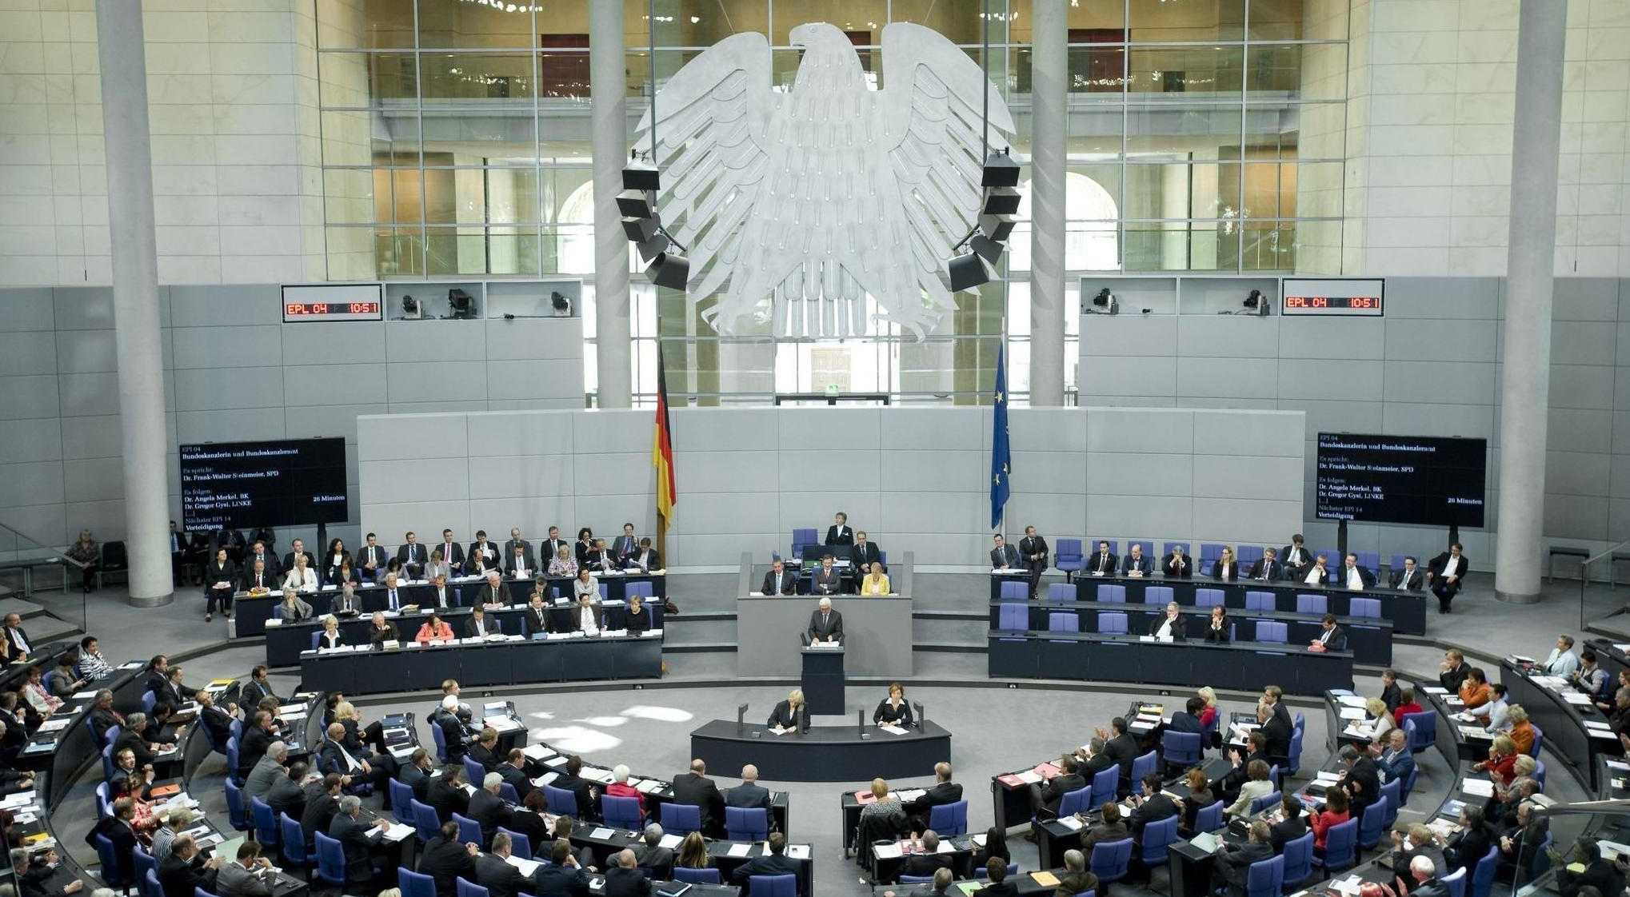
V. Media policy news

Slide 23
1. Structure debate on the financing of public service broadcasting
Establishment of a cross-state political working group
“Remit, structure and financing of the public service broadcasters”
Remit:
Development of reform proposals for fundamental structural changes
Aim:
Prevention of an imminent increase in the licence fee from 2021
V. Media policy news

Slide 24
2. Federal state working group for media convergence
Media convergence = interdisciplinary issue
Federal responsibility for telecommunication law
Federal state responsibility for media law
→ special commitment of NRW to the topic of platform regulation (Joint Chairmanship with the Federal Ministry of Economics)
Remit:
Development of reform proposals for the topics of intermediaries, net neutrality, platform regulation
Aim:
Ensuring media pluralism, global competitiveness and a level playing field for German media companies in the digital world
V. Media policy news

Slide 25

Thank you for your attention!
Dr. Marc Jan Eumann
@marc_jan_eumann
MarcJan.Eumann@stk.nrw.de

