Slide 1

Impacting on the price of alcoholic beverages as a policy option
Jürgen Rehm & Peter Anderson
Alice Rap
With some help from Petra Meier
jtrehm@gmail.com

Slide 2



Introducing interventions to tackle non-communicable disease risk factors: identifying 'best buys'
For harmful use of alcohol:
  Raise taxes on alcohol
  Restrict access to retailed alcohol
  Enforce bans on alcohol advertising
Very cost-effective: US $ per DALY prevented < GDP per person
Implementation costs: very low (< US $ 0.50 per capita)
Feasibility: high

Slide 3
The rationale of taxation for alcoholic beverages
Taxation: a means by which governments finance their expenditure by imposing charges on citizens and corporate entities.
A Pigouvian tax is a tax applied to a market activity that is generating negative externalities (costs for somebody else). The tax is intended to correct an inefficient market outcome, and does so by being set equal to the negative externalities. In the presence of negative externalities, the social cost of a market activity is not covered by the private cost of the activity. In such a case, the market outcome is not efficient and may lead to over-consumption of the product.

Slide 4
Justification of a Pigouvian tax for alcohol:
Social cost in Europe 2010 in billion €
Own calculations for 2010, based on Anderson & Baumberg, Alcohol in Europe 2006: total tangible costs to the EU € billion 155.8, equivalent of 1.3% (0.9% - 2.4%) of GDP

Slide 5
Effectiveness of different alcohol policy measures in Europe
Source: World Health Organization 2009

Slide 6
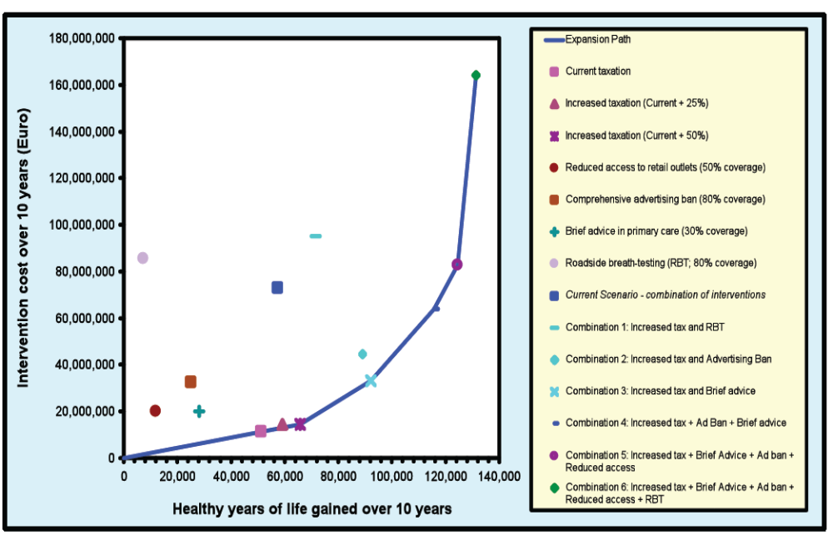
…and for Latvia (WHO Choice)

Slide 7
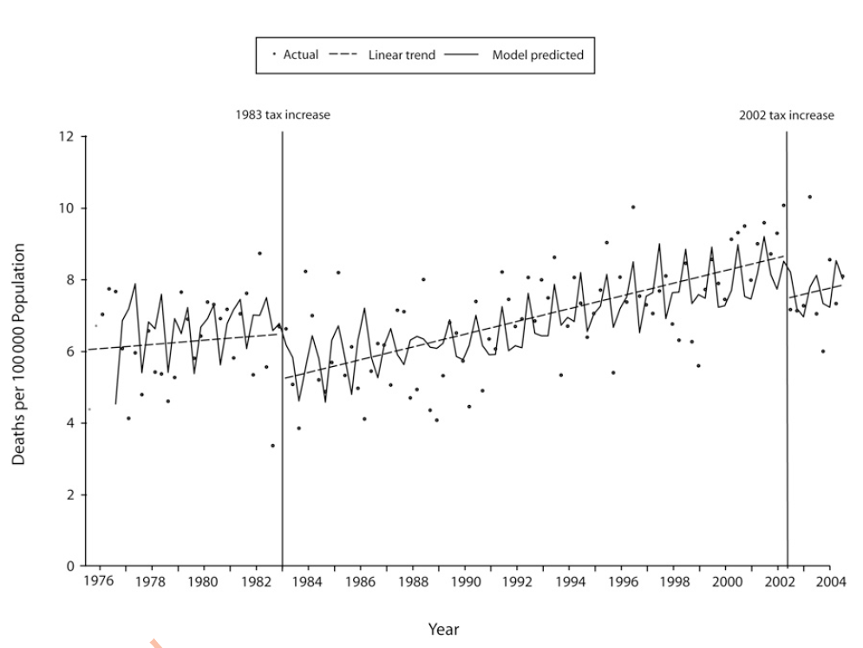
Impact of Taxation on deaths
(Example of Alaska, 1976-2004)
Wagenaar et al 2009

Slide 8
Effects of price increases on other outcomes but health
Taxation impacts on consumption via price and consumption has been shown not only to impact health, but also other consequences of alcohol (as shown in the cost overview)
Effects on crime and unemployment were proportionally even larger (Brennan et al., 2008)

Slide 9
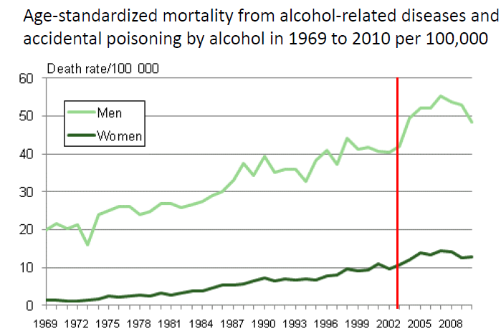
Models, models, models… and the “reality” -> effect of lower prices in Finland
Red line:
Tax decrease
in SF

Slide 10
Changes in deaths/100,000 person years adjusted for age and economic activity men and women aged 30-59 years
And the change was mostly affecting the poor
Herttua et al 2008

Slide 11
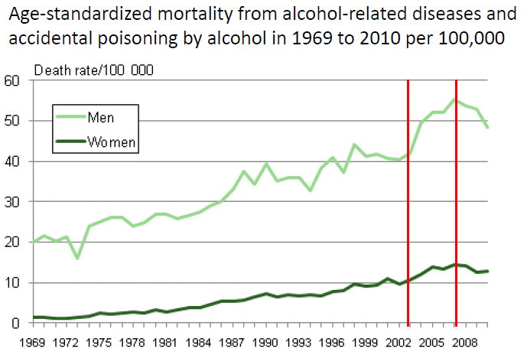
But with tax increases the mortality trend could be reversed….

Slide 12
Taxation may be a best buy, and justified by economic reasons, but it is not popular….
Even though it gives the government additional revenue and decreases the harm
Sometimes, a minimum price may be more acceptable in such situations (but may run into legal problems….)

Slide 13
A simulation on different taxation systems for the UK
(all lead to a reduction of mortality by 4.3% ; Meier et al., submitted)
Current (UK) Tax Increase (CT) Raise current alcohol taxes¹ (comprising excise duty + VAT) for all beverage categories by 16%.
Sales Tax (ST)² Introduce an additional 4% alcohol-specific sales tax on product value (after excise duty is applied but before VAT)
Volumetric Tax (VT) Replace current excise duty with a duty of £0.22 per unit for all beverage types (UK unit = 10ml ethanol).
Minimum Unit Price (MUP) Introduce a floor price of £0.50 per unit within the current tax system
¹ In the UK, duty rates for wine and cider are charged per hectolitre of product (not linked to alcoholic strength); beer, spirits and spirits-based drinks are taxed by ethanol volume. A general sales tax of 20% VAT is applied to alcohol prices including excise duty.
² For a product currently sold at £1.20, £1 is the price after duty and £0.20 is existing value added tax (VAT) . In this policy, a 4% sales tax is applied to the £1 price giving £1.04, and then 20% VAT is applied to give a revised price of £1.25.

Slide 14
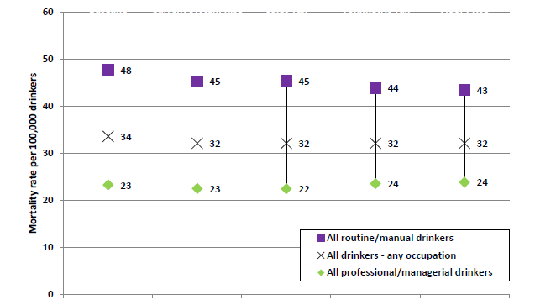
Differential effects of different taxation strategies on all drinkers by SES
Current situation
CT: Current system taxation rise
ST: alcohol sales tax rise
VT: Volumetric tax rise
MUP: Minimum unit price

Slide 15
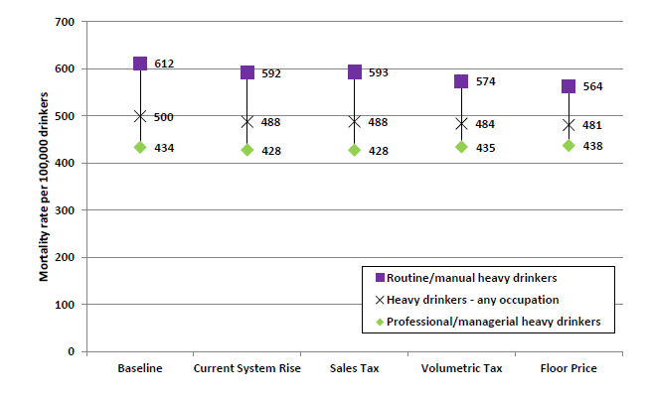
Differential effects of different taxation strategies on heavy drinkers by SES
Current situation
CT: Current system taxation rise
ST: alcohol sales tax rise
VT: Volumetric tax rise
MUP: Minimum unit price

Slide 16
Closing the gap among heavy drinkers

Slide 17
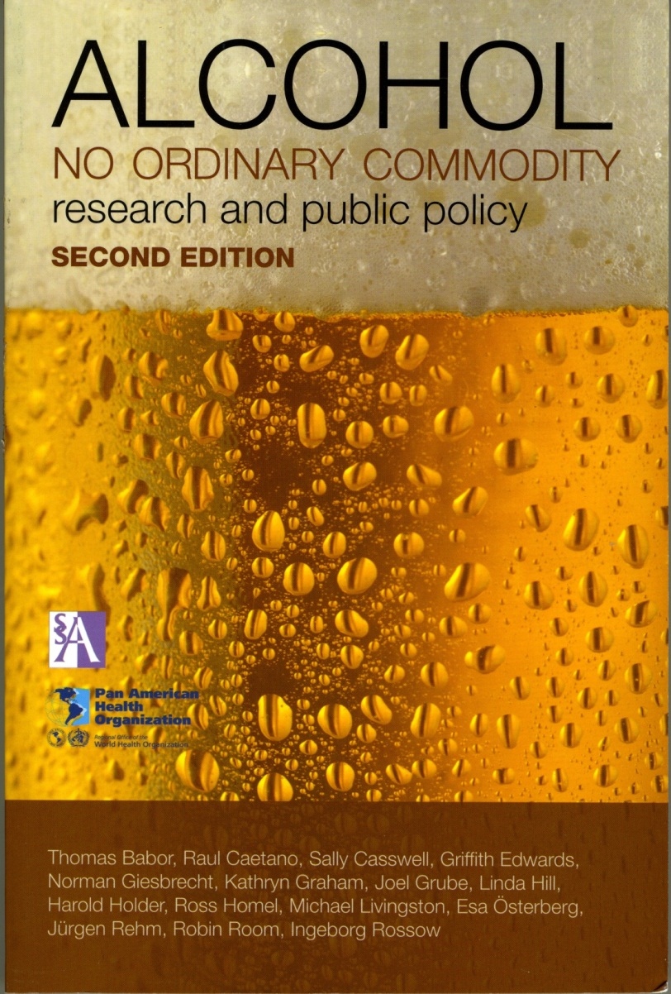
Need for interventions
Prevention is important
WHO “best buys” for
cost-effective prevention ->
  Taxation
  Reduction of availability
  Marketing ban
Let us not forget interventions
for heavy drinking including
brief advice and treatment

