Slide 1
EU Beating Cancer Plan on National Political Agendas:
Four Years On
Ivars Ijabs, MEP

Slide 2
EU’s Beating Cancer plan (2021)
An integrated, multi-stakeholder, health-in-all-policies approach
Four pillars: prevention, early detection, diagnosis and treatment, quality of life of cancer patients and survivors
Cross-cutting themes: research and innovation, digital and personalized medicine, reducing inequalities, paediatric cancer
10 flagship initatives and 32 actions
1.25 bn EUR budget from EU4Health (+other EU programmes, HE, RRF et al)
Additional factors: lessons from COVID-19, working with Horizon Europe Cancer mission

Slide 3
Flagship actions
Research and innovation:
=> Cancer Knowledge centre, Imaging initiative
Saving lives through sustainable cancer prevention:
=> HPV vaccination
Improving early detection:
=> Screening scheme, screening recommendations
Ensuring high standards in care:
=> EU Network of Comprehensive Cancer centres
The quality of life for cancer patients, survivors and carers:
=> Cancer Survivor smart card
Reducing inequalities:
=> European Cancer Inequalities registry
Putting childhood cancer under the spotlight:
=> EU Network of Youth cancer survivors

Slide 4
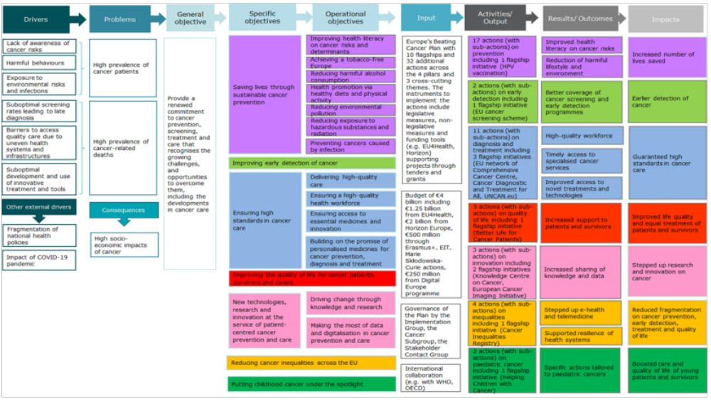

Slide 5
Where are we now?
EU4Health:
10 cancer-related Joint Actions by MSs funded
468 applicants in successful project applications
26 procurement contracts
Horizon Europe:
898 cancer-focused projects selected (36 – “Widening”)
RRF, Cohesion funds
Technical Support instrument (e.g., Latvia and Slovakia: cancer-specific support)

Slide 6
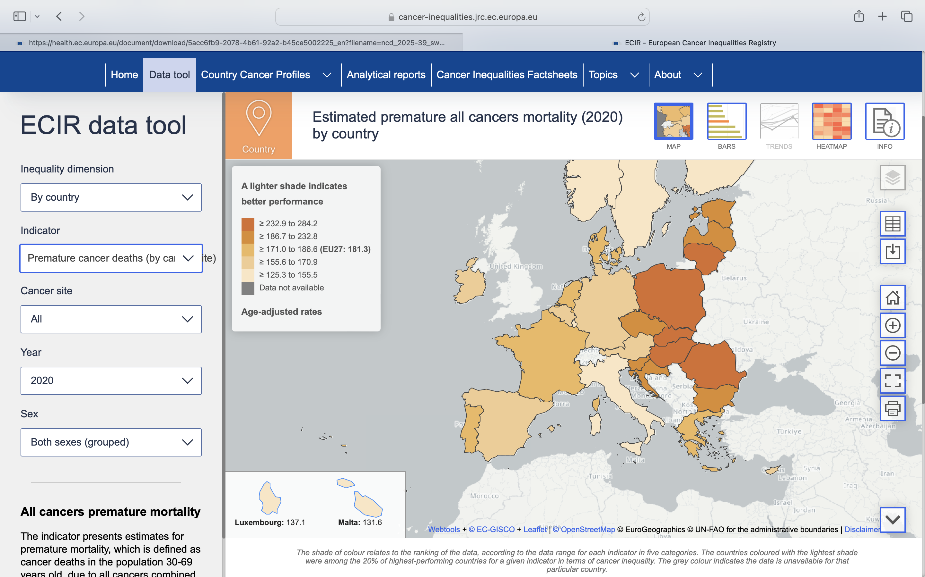
Inequalities

Slide 7
Challenges
Financial barriers: lack of specific resources allocated to strategic objectives of national cancer plans
Shortage of healthcare workers
Barriers for R&D for industry: innovative techiques and medications
EU: stronger emphasis on implementing, monitoring and evaluating the Cancer plan

Slide 8
Thank you!

