Slide 1
Digital Single Market
Perspectives and considerations from Estonia
Mait Heidelberg
Ministry of Economic Affairs and Communications
Estonia

Slide 2
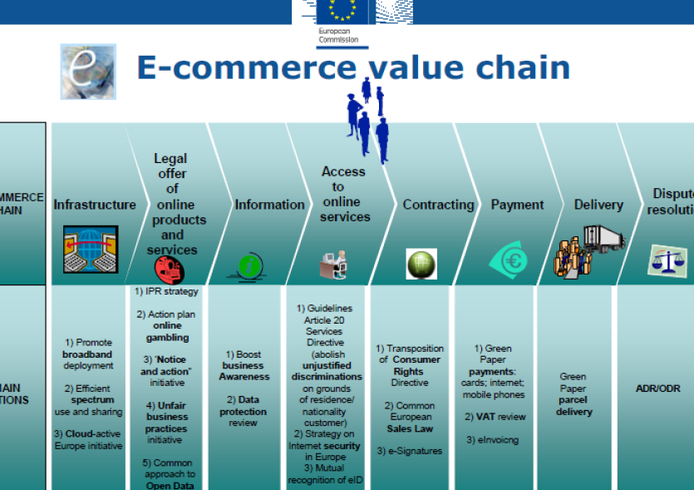

Slide 3
Digital infrastructure
Broadband Internet for all
  National BB plans, CEF, SF
Telecom environment
  Connected continent, frequencies
International connections
  Redundancy, investment attraction

Slide 4
Enablers for Internet economy
Electronic identity and digital signatures
  eIDAS regulation, services directive, practical cooperation
Cross-border e-Government services
  EU service platforms (CEF), e-Sens, regional cooperation

Slide 5
Legal framework for digital single market
Copyright
Privacy
Payments
Consumer protection
Taxation
…

Slide 6
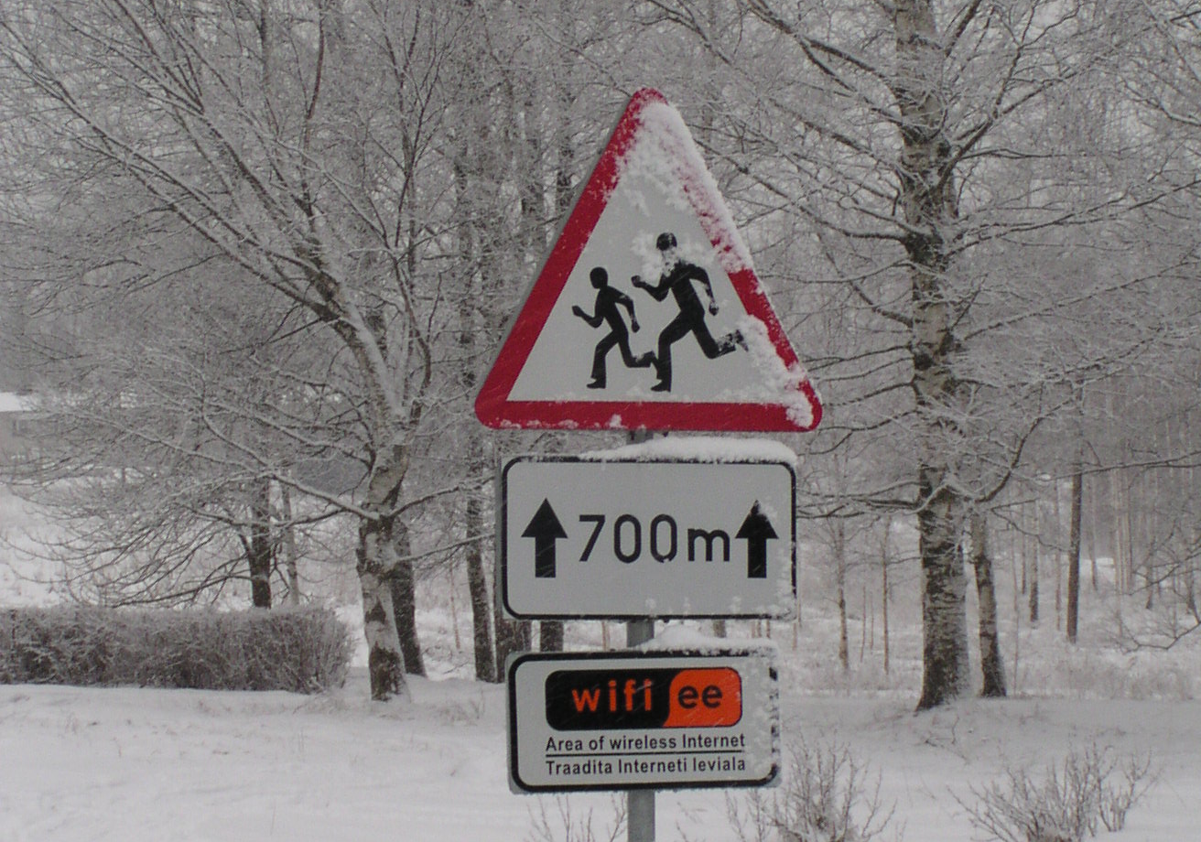
Thank You!

