Slide 1

PROACTIVE AND Knowledge Based Approach in Combating organised Crime.
VAT related Fraud
Andris Vilks
Minister of Finance
Republic of Latvia

Slide 2
Priorities of FinancE Police in Combating organized crime
  Tax evasion (Art 218, Criminal Code)
  VAT Fraud (Art 177, Criminal Code)
  Legalization of Illegal Proceeds
  (Art 195, Criminal Code]
  in relation with organised crime and/or corruption in the area of state revenue

Slide 3
Investigation of fraud by Finance Police
  In case if a person by using falsified documents or otherwise is deceiving the officials of the State Revenue Service by claiming the right to the refund of allegedly overpaid tax, this offence should be qualified as fraud.
3

Slide 4


VAT Fraud Scheme
Actually working companies evading taxes, clients of organised crime groups.
Contract on the supplies of non-existing services or goods. The value of transaction + VAT is transferred
OCG organises establishing of bogus companies, agree on future activities
«Buffer» companies whose officials agree with OCG to register them to their own names and submit the reports to the SRS.
Organised crime group
(Ocg)
Establish fictitious companies,
Organisers of money laundering schemes
Transactions with bogus companies are shown in the reports to the SRS
Bogus companies registered to the persons without permanent residence, the companies are not doing real business, they do not submit reports to the SRS
Money resources are transferred to accounts in foreign banks
In foreign countries money is taken out of the accounts and delivered to the «client»

Slide 5
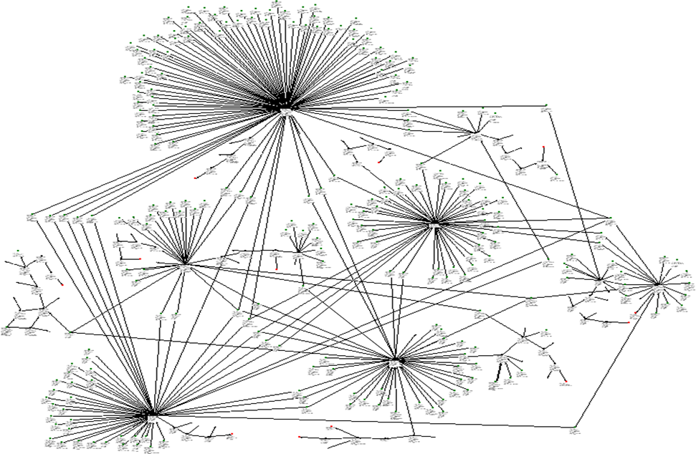
Transaction scheme of organised crime group

Slide 6
Effective result indicators
  Criminal proceedings initiated under Art 177 of Criminal Code:
  In 2011 – 36
  In 2012 – 28
  In 2013 - 27
  Criminal proceedings forwarded for prosecution under Art 177 of the CC
  In 2011 – 36
  In 2012 – 37
  In 9 months 2013 - 27
  Interrupted activities of organised crime groups:
  In 2011 – 13
  In 2012 – 10
  In 9 months of 2013 - 9

Slide 7
Trends of organised crime
1. Officials of bogus companies:
much more educated, often non-citizens of the EU;
well trained for contacting law enforcement bodies, tax administration;
confirm fictitious transactions as truly happened;
provide the OCG with good lawyers.
2. The organised crime groups:
hire highly qualified accountants, lawyers, IT specialists;
make use of more and more complicated cash flow schemes;
use most modern IT solutions and means of communication.

Slide 8
Future objectives in combating VAT fraud
To continue focusing on the OCG clients – «the true beneficiaries»;
To keep investigators informed about the progress of the cases in prosecution and in court;
To strengthen the cooperation/information exchange with other EU Member States, CIS countries;
To ensure constant opportunities of increasing the skill levels of investigators and analysts including the taking over of best practice of services in other countries;
To inform the society about the harm inflicted by VAT fraud to the state budget;
To continue strengthening the capacity of technical support units.

Slide 9
INCREASED MOTIVATION OF THE EMPLOYEES OF THE SRS AND FINANCE POLICE
In accordance with Art 42 of the law «On State Budget 2013» 1,985 million lats were channelled for the motivation of the officials and employees of the institutions involved in fighting the shadow economy.
1,58 million lats were earmarked for the State Revenue Service.

Slide 10
COOPERATION WITH PROSECUTOR’S OFFICE AND JUDGES
In order to facilitate the education and specialization of Finance Police officers, prosecutors, and lawyers in the area of tax fraud, joint training events are organised.
The SRS Finance Police Department has made an agreement with Mr. Ē.Kalnmeiers, the Prosecutor General, regarding the participation of the officers of the SRS FPD in the European Commission project training sessions organised by the Latvian Judge Training Centre with the objective of training of judges, prosecutors, lawyers and police officers in the investigation of economic crime.

Slide 11
Thank you for your attention!

