Slide 1
The impact of health system structure on cancer treatment inequalities
Dr Dheepa Rajan, European Observatory on Health Systems and Policies
Béatrice Durvy, European Observatory on Health Systems and Policies and Technical University of Berlin
Divya Ramroop, Technical University of Berlin
20 May 2025

Slide 2
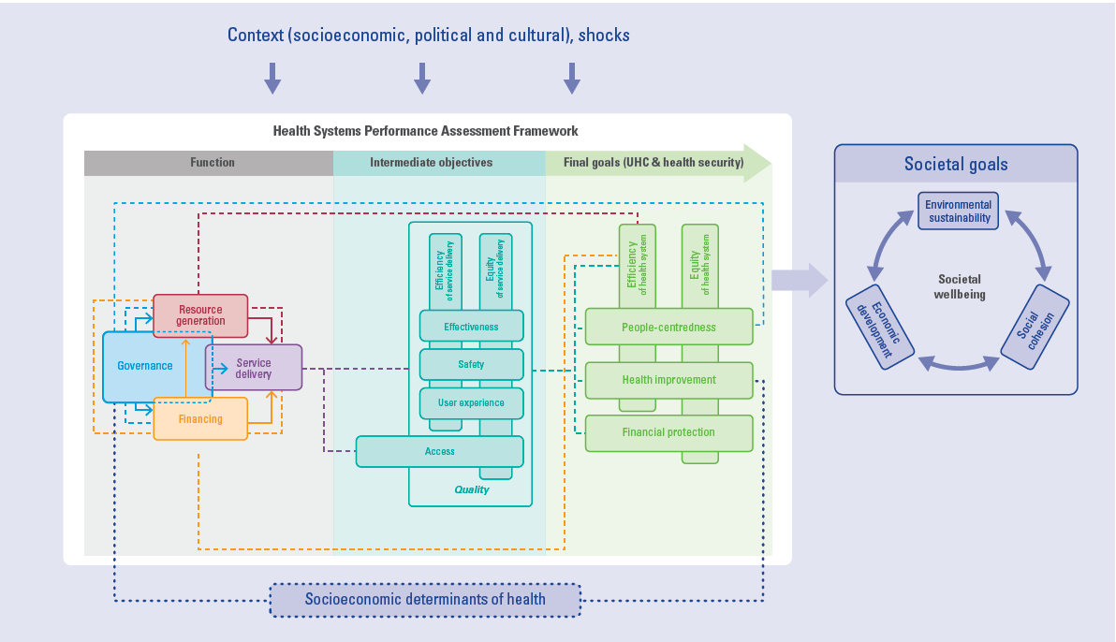

Slide 3
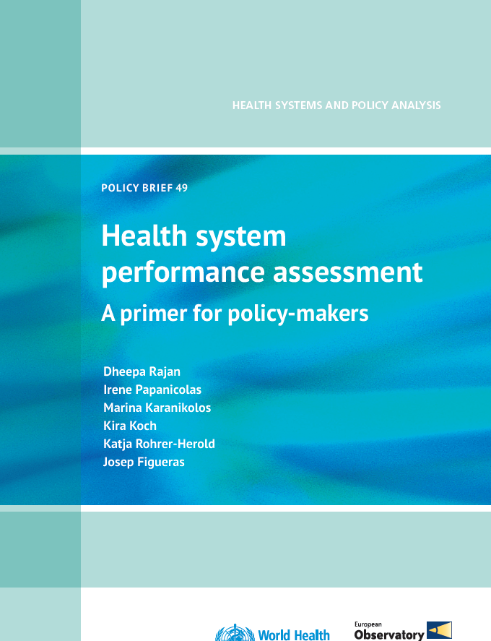
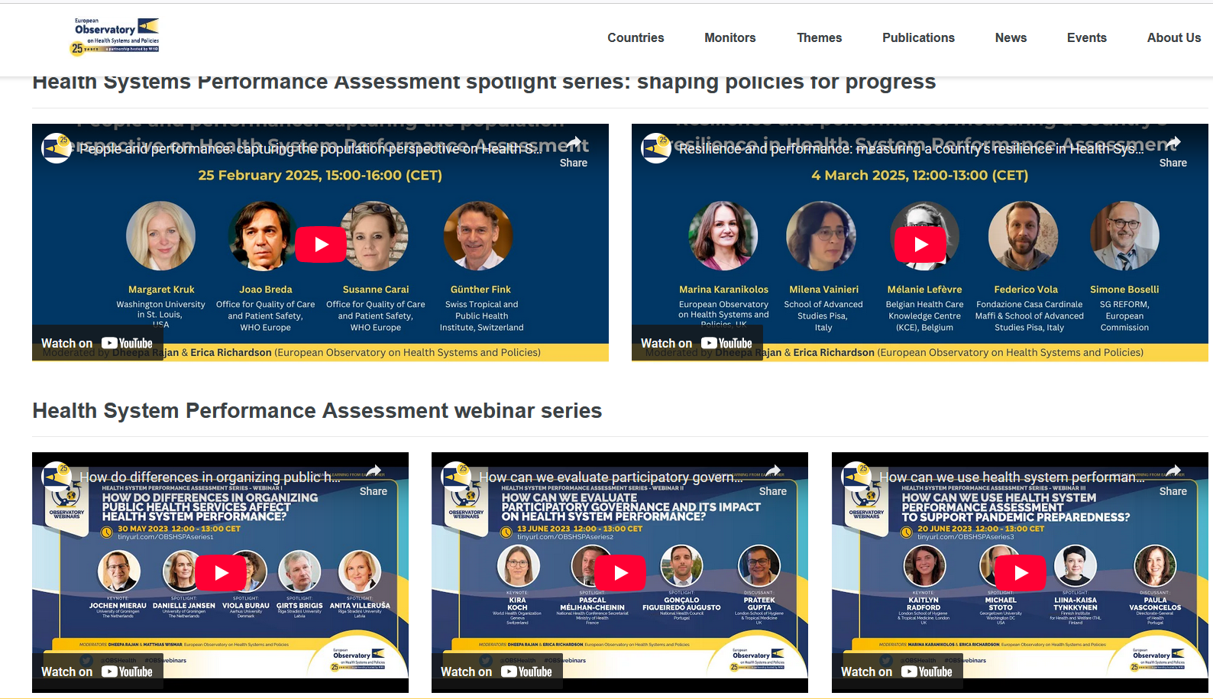



Slide 4
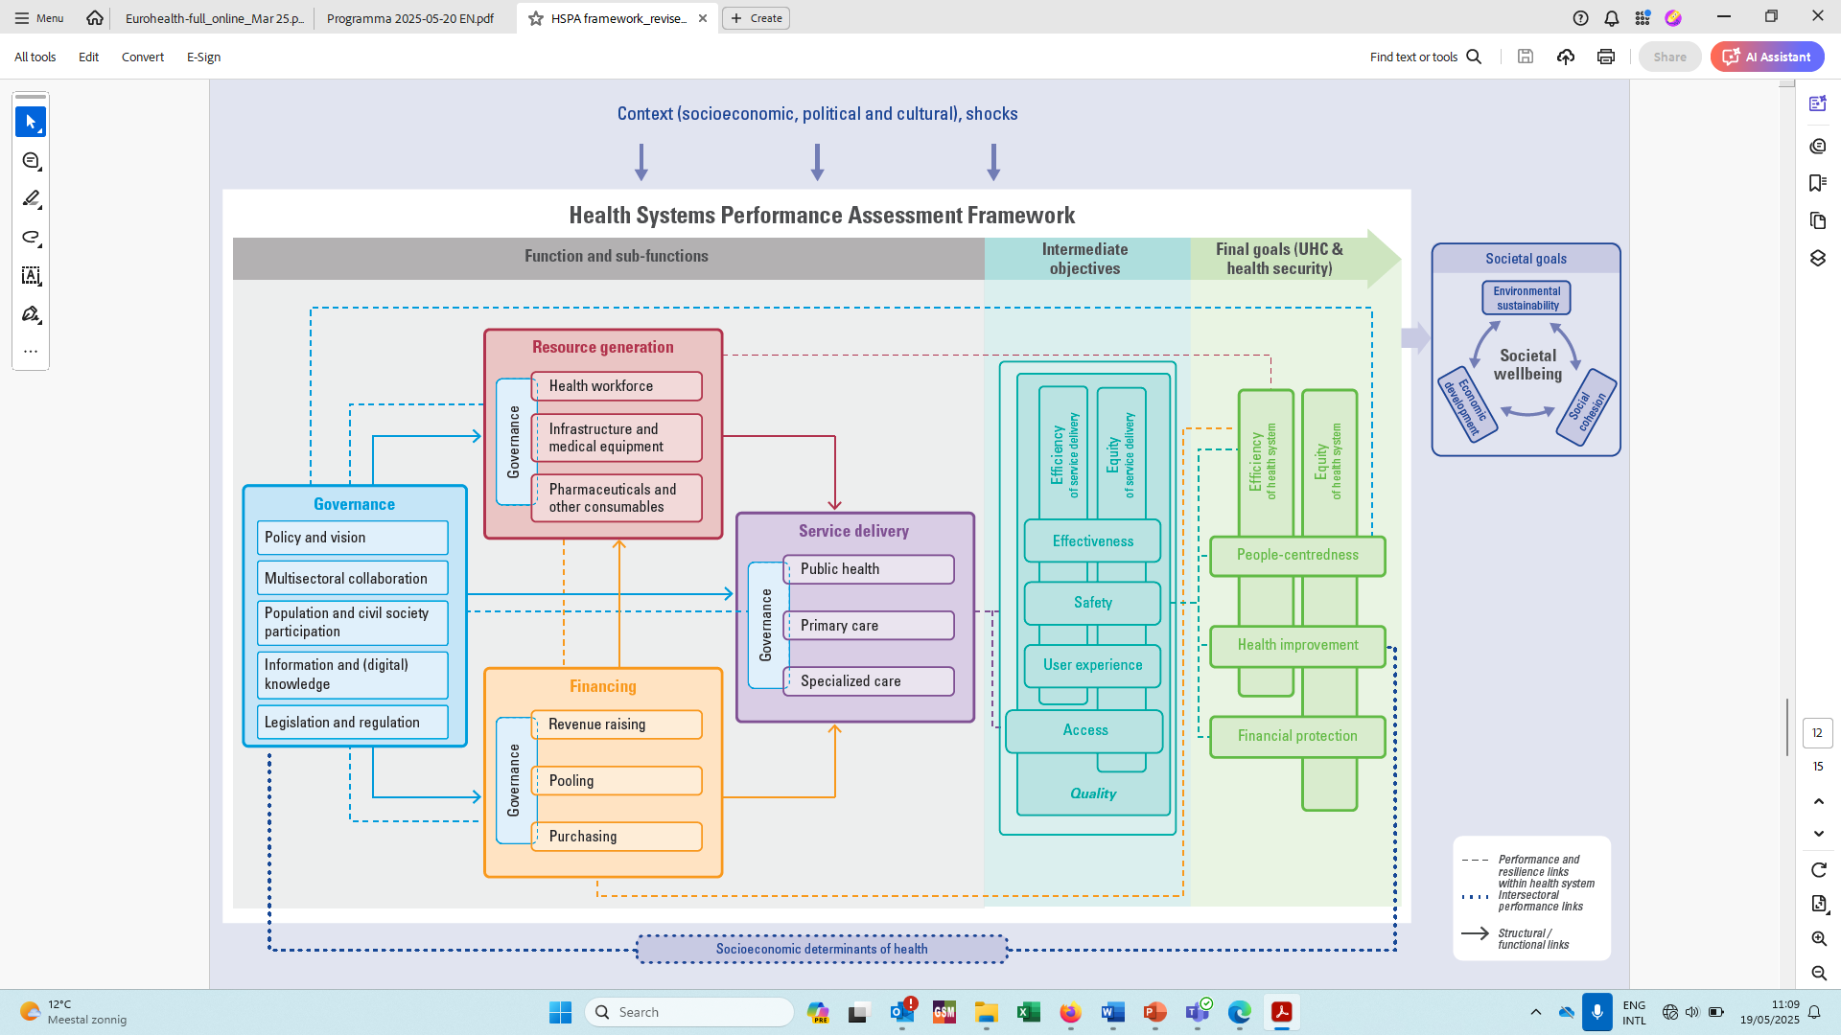

Slide 5

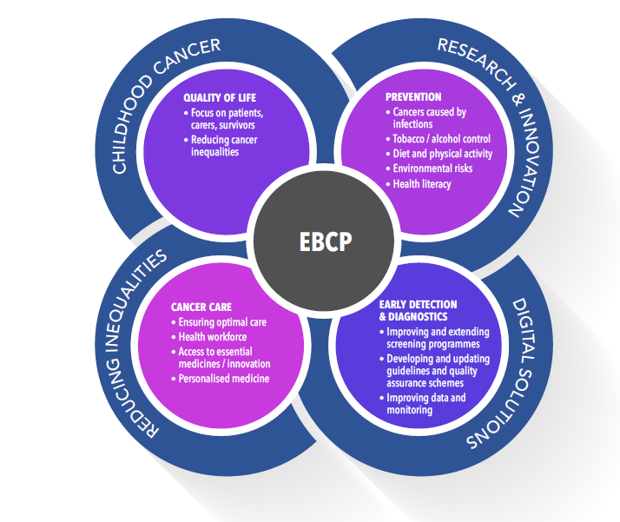
Learning From Progress Addressing Cancer in Europe (OBS-PACE)
OBS-PACE aims at improving the understanding of national cancer control situation and policy actions in EU Member States.
Funded by DG SANTE, it builds on Europe’s Beating Cancer Plan’s dimensions, collecting case studies across the entire cancer care continuum. Case studies are on innovative actions in the cancer field implemented at the national, regional, or local level, which provide insights into health system’s enablers and barriers.
OBS-PACE has two key objectives:
Collecting innovating actions implemented in the cancer field
Identify emerging themes across the cancer field along with health system components

Slide 6
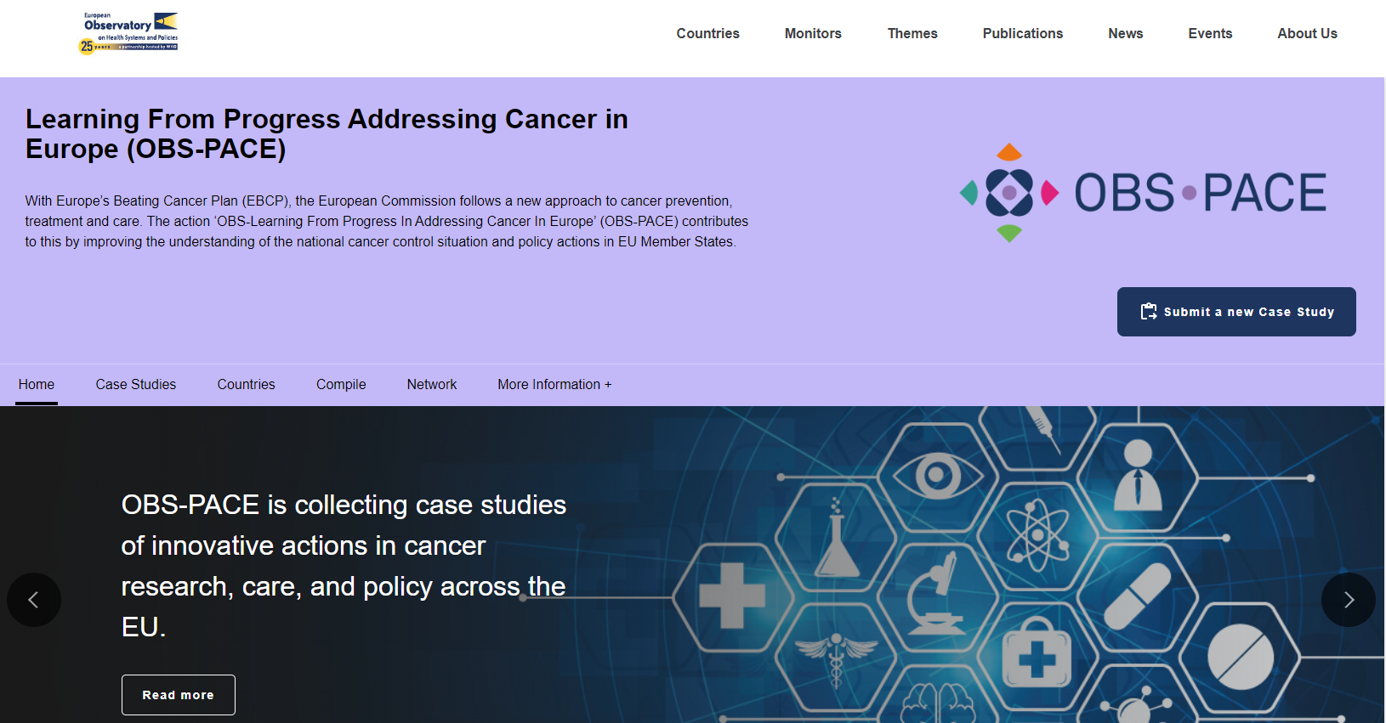

Learning From Progress Addressing Cancer in Europe (OBS-PACE)
OBS-PACE activities are building on the collaboration of a newly established network of cancer experts from all EU countries.
Case studies and cross-cutting analyses can be found on our website.
https://eurohealthobservatory.who.int/monitors/pace/home

Slide 7
A dedicated directorate to improve cancer care pathways (Malta)
Governance
Problems:
Delays at various junctures of the cancer care pathway
Limited coordination of care
Patients facing difficulties in navigating the system
Solution: Creation of the Directorate for Cancer Care Pathways (DCCP) in 2014 to promote advancement in quality cancer care and enhance support, advice, timely access, coordination, and continuity of care for cancer patients.
Outcomes: Several key actions introduced across the cancer care continuum, in research and innovation (e.g. creation of a Research Unit), prevention (e.g. educational activities), early diagnostics (e.g. GP fast-track e-referral system), cancer care (e.g. nurse navigation system), quality of life (e.g. creation of Survivorship Unit), and digitalisation.
Enablers:
Adequate and sustainable government funding
Governance framework aligned with NCCP and EBCP
Recruitment of Quality Assurance managers
Lessons learned: Successful implementation requires
Clear identification of needs
Meticulous planning
Alignment with NCCP and EBCP
Securing sustainable funding
Stakeholder involvement
Transparent governance
Barriers:
Shortages of health care workforce
Resistance to change among health professionals

Slide 8
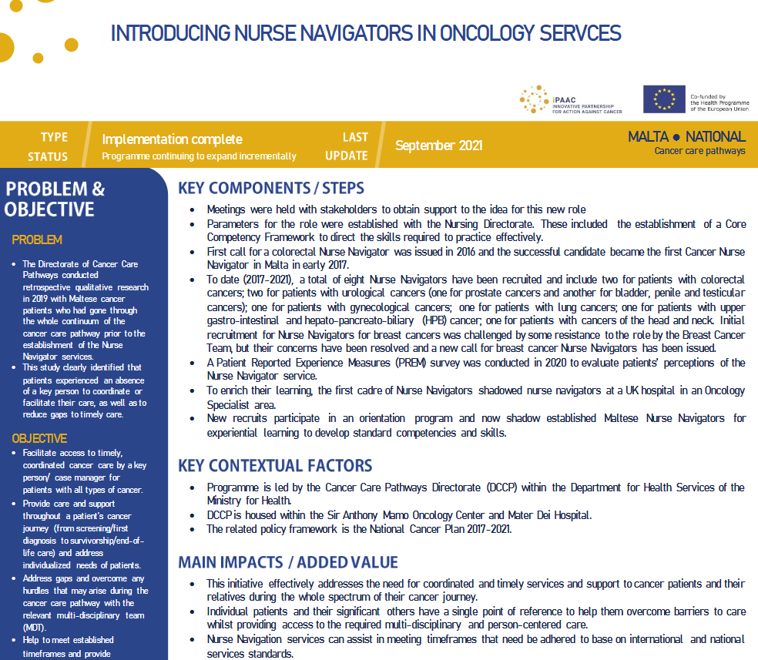
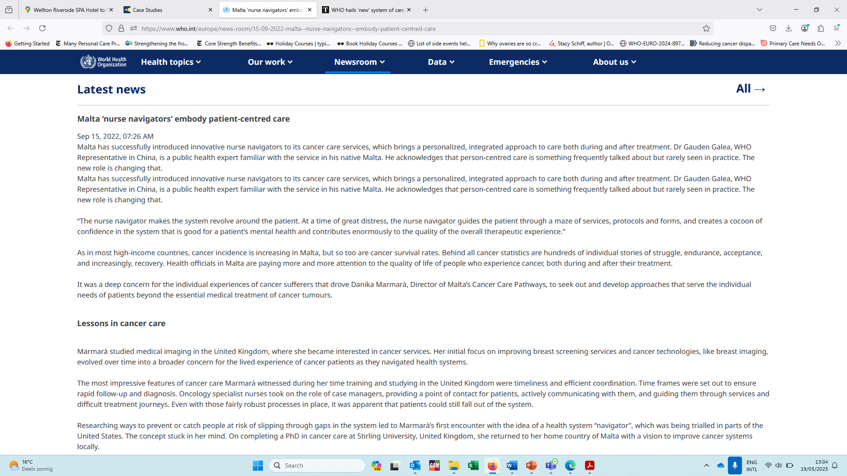

Malta: nurse navigator system for cancer care
Governance (population & civil society participation), service delivery (primary care, specialist care), resource generation (health workforce)

Slide 9
Amendments to reimbursement decision-making process for better access to innovative cancer drugs (Slovakia)
Financing
Problems: Reimbursement of new cancer drugs has been gradually decreasing since 2011, which led to an average innovation gap of five to seven years in Slovakia compared to the EU average in 2021.
Solution: In collaboration with health insurance companies, medical and oncology experts, patient advocacy groups, and local pharmaceutical industries, Slovakia passed in 2022 amendments to streamline medicines reimbursement decision-making processes.
Outcomes: The reform:
Tackled bureaucratic delays
Introduced clearer evaluation criteria
Refined the approach to pricing negotiations and reimbursement processes
This led to an increase in the reimbursement of innovative cancer drugs, faster approval times, and greater transparency, while also fostering trust among stakeholders.
Enablers:
Strong political commitment
Stakeholder engagement in a transparent decision-making process
Data-driven implementation monitoring
Lessons learned: Successful implementation requires
Political will, cross-sector collaboration, and strong stakeholder engagement
Flexibility and adaptability in changing existing processes
Continuous monitoring
Balancing speed and sustainability
Adopting a patient-centred and evidence-based approach
Barriers:
Requires extensive negotiations to align the interest of diverse stakeholders
Budget constraints and challenging long-term financial sustainability

Slide 10
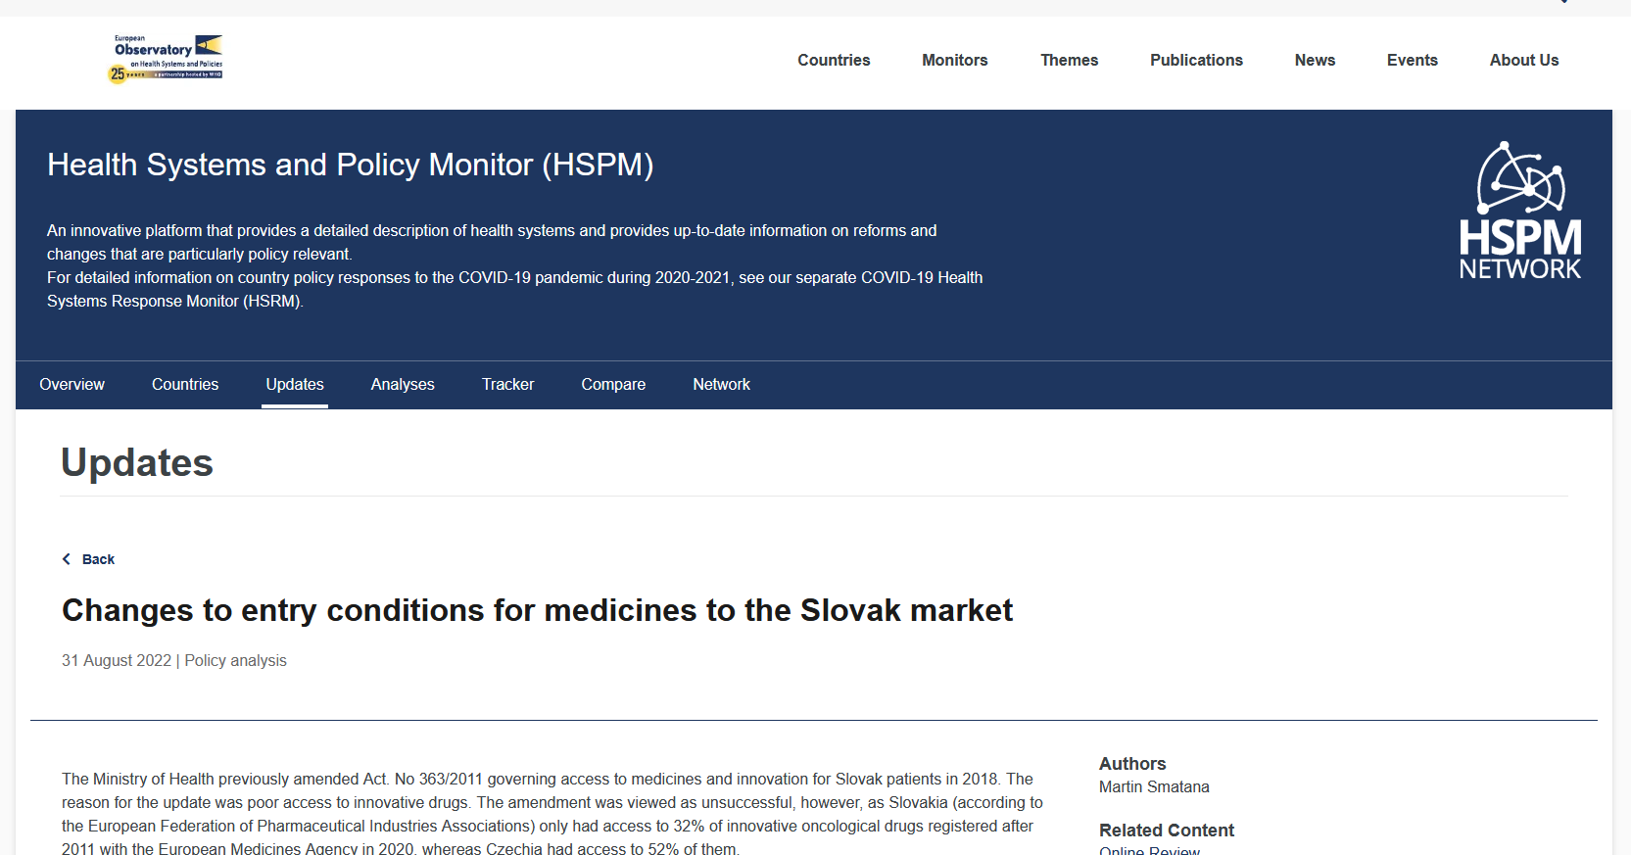
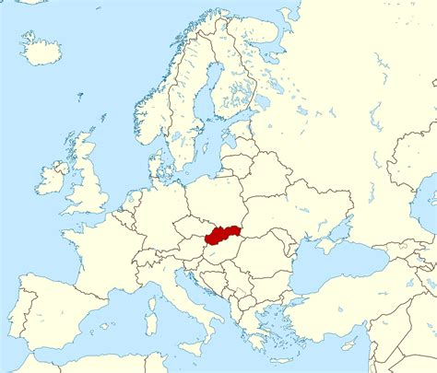

Slide 12
Cross-cutting analyses: Preliminary findings (1)
OBS-PACE collected close to 30 case studies, with 18 published from 12 EU countries
Case studies span across the entire care continuum:
  Across the cancer care pathway: 5 case studies on Prevention; 8 on Early detection and diagnostics; 11 on Cancer care; and 4 on quality of life
  Across cross-cutting topics: 3 on Research and innovation; 1 on Childhood cancers; 3 on Digital Solutions; and 11 on reducing inequalities
Mix of top-down (e.g. Malta case study) and bottom-up (e.g. Netherlands case study) approaches. Other recurring cross-cutting themes include the use of cancer registry data and movements towards better standardisation of care.

Slide 13
Cross-cutting analyses: Preliminary findings (2)
Recurring lessons for health systems emerge:
GOVERNANCE: Strong political commitment with clear strategy, established implementation responsibilities, and enhanced multidisciplinary collaboration are key, while frequent shifts in political priorities and fragmented governance are recurring barriers to successful implementation. Strategies relying on piloting before scaling and participatory mechanisms, while including strong monitoring and evaluation processes, have higher chances of success.
FINANCING: Securing sustainable funding, including through joint EU investments, is a critical prerequisite to success and adequate funding for administrative and data collection costs should not be overlooked.
RESOURCES:
  Information systems: Cancer registries represent key assets to data-driven decision-making, but data protection, interoperability, and resistance to new technologies remain challenging.
  Healthcare workforce: Investment in specialised roles can improve patients’ experience, and emphasis should be placed on multidisciplinary expertise, creation of dedicated roles and specialised training programmes, but disparities in geographic distribution and health workforce shortages still represent important challenges.
SERVICE DELIVERY: Patients’ experience and health outcomes are enhanced by multidisciplinary care, standardised patient pathways, provider networks, and clear referral systems, but these also require formal agreements, the existence of collaboration mechanisms, and avoiding administrative complexity.

Slide 14
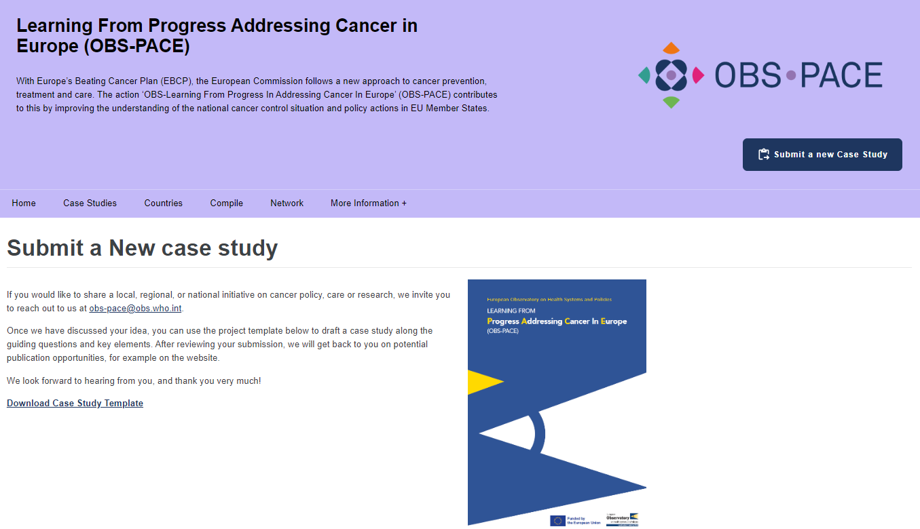
THANK YOU!

Slide 15
EXTRA SLIDES

Slide 16
Acute Haematology Oncology Nursing Service (Ireland)
Resource generation (health workforce)
Problems:
Overcrowded emergency departments with long waiting times
Limited capacity in day units for unplanned urgent care
Gaps in service delivery for patients undergoing systemic anticancer therapy
Solution: Creation of the Acute Haematology Oncology Nursing Service in 2020 to provide timely and appropriate management for cancer patients, optimising patient safety and treatment continuity across Ireland's 26 SACT centres.
Outcomes: Several key services introduced across the cancer care pathway, including dedicated telephone triage (SOS Hotline with UKONS triage tool), specialised workforce (clinical nurse specialists and advanced practitioners), digital enhancements (video-enabled consultations), and standardised patient information in multiple formats and languages.
Enablers:
Strong governmental support through national health strategies
Well-trained workforce
Integration of digital triage tools and video consultations
Lessons learned: Successful implementation requires
Multisectoral collaboration
Standardised triage tools
Recognised value of patient-centred approach
Data-driven strategy for quality improvement
Sustained investment in staffing and infrastructure
Barriers:
Limited 24/7 access due to restricted operational hours
Variations in available resources across centres impacting service consistency

Slide 17
Advocacy for access: Expanding advanced sequencing diagnostics and enhancing care for patients with cancer of unknown primary (Netherlands)
Service Delivery
Problems: Cancer of Unknown Primary (CUP) represents one of the deadliest cancer forms in the Netherlands, characterised by long diagnostic delays, poor clinical outcomes, and extremely limited treatment options (no access to genomic sequencing diagnostics).
Solution: The patient advocacy group "Missie Tumor Onbekend" successfully campaigned for change, resulting in nationwide reimbursement for whole genome sequencing diagnostics after a pivotal parliamentary hearing in 2021.
Outcomes: Following nation wide reimbursement, the patient advocacy group’s success also led to the establishment of 8 specialised CUP clinics with molecular tumour boards, development of diagnostic protocols and guidelines by professional organisations, overall resulting in improved treatment options with 80% of CUP patients who benefited from molecularly guided therapy.
Enablers:
Data-driven advocacy using national cancer registry information
Development of national protocols based on a collaborative process
Patient voice was represented effectively in policy discussions
Lessons learned: Successful implementation requires
Decision-makers recognising the value of integrating patient advocates in health policy-making
Advocacy that build on an evidence-based approach
Capitalising on registry data to build compelling cases
There is potential for similar approaches in other regions and diseases
Barriers:
Funding constraints for diagnostic services
Need for workforce development and skills enhancement

