Slide 1
The PE:ER Project
Prostitution Exiting: Engaging through Research
EXITING PROSTITUTION:
RESEARCH & PRACTICE
Latvia, October 2015
Julie Bindel, Safety Compass Project

Slide 2
WHAT IS THE PEER PROJECT?
Joint research project - Eaves and LSBU;
2-year grant from Big Lottery Fund;
Multiple ethical approvals; including Camden NHS REC
Feminist research methodology and practice;
Largest study of its kind.

Slide 3
KEY RESEARCH AIMS
Enhance women’s experience of support
Examine the exiting process
Track the process of change over time
Give a voice to women who wish to exit

Slide 4
THE PE:ER SAMPLE
114 first round interviews (83 in London)
50 second round interviews; (35 in London)
35 stakeholder interviews; (9 in London)
3000 community surveys across 3 sites (1 in London)

Slide 5
Key findings (*sample not representative of entire sex industry. Percentages are for illustration purposes only. Not to be quoted out of context.)
32% had entered prostitution before the age of 18;
“Looking at it now, how do you put a 12 year old girl on crack? Do you know what I mean? It’s sick. I didn’t think that at the time obviously but I do now…He was having sex with me, so really he was a paedophile wasn’t he?”
79% reported physical and / or mental health problems whilst involved in prostitution;
“I’m damaged goods, I’ve been damaged terribly, I’m looking for help and support and I don’t seem to be getting it from nowhere… all way along they’re saying it’s nothing, I’m ‘unruly’, what’s the word for it…’Dysfunctional’

Slide 6
Continued… (*sample not representative of entire sex industry. Percentages are for illustration purposes only. Not to be quoted out of context.)
Over two-thirds (72%) suffered childhood violence;
“I wasn’t happy at home, even when my dad wasn’t sexually abusing me, my mum was physically abusing me and bullying me. I wasn’t made welcome in the house, I had to just go to bed…I was the butt of the jokes, I was very, very unhappy.”
83% reported current or former problematic drug use;
“You have to take drugs to make it bearable. You have to be out of your nut to go out there, you have to be out of your nut to stay out there and then you have to get out of your nut when you’ve finished doing it,…you get to the point where drugs don’t even make it bearable”.

Slide 7
50% reported coercion regarding their involvement;
“he’d be earning more money for different things, and then I’d go with the punter and he’d be saying ‘he’s paid for this’ and ‘he’s paid for that’, and ‘he wants his business’. Sometimes I’d have to do things that would make me violently sick…All them different kind of weathers and having no sleep and having no money, it was horrible. I used to make so much money and I didn’t get none of it.”
77% reported experiencing housing problems or being homelessness during their involvement.
“Well I did it to live… To put a roof over my head. I had to pay £220 for a B&B every week.”

Slide 8
Evidence of violence (Sample not representative of entire sex industry. Percentages are for illustration purposes only. Not to be quoted out of context.)
84% of the whole sample reported experiencing violence (physical sexual or emotional)
61% reported instances of violence from buyers of sex (physical violence most common)
35% reported experiencing violence from partners (physical violence most common)
24% reported experiencing violence from a pimp (physical violence most common)
46% reported experiencing violence from ‘others’ (most commonly sexual violence)

Slide 9
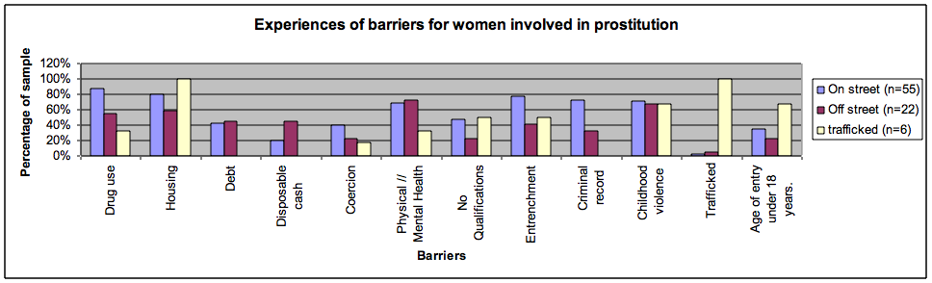
Barriers according to women’s involvement

Slide 10
STAGES OF EXITING
Stage 1: Readiness & engagement
Stage 2: Treatment & support
Stage 3: Transition & stabilisation
Stage 4: Reconstructing & rebuilding
Stage 5: New roles and identities
Lapses and reversals are
possible at each stage

Slide 11
Offering exiting as an option
‘I think not talking about it [exiting] would just be really detrimental I mean, you're already kind of with the most marginalised group and I think it’s really important to be given a voice and talking about exiting, I think even like someone asking you about exiting - it challenges, well it challenged me, in the sense of “oh well perhaps things could be different,” and it did give me that hope’

Slide 12
Practical application of research: Key components
  Motivation / reason to attempt change
  Hope and belief that exiting is a possibility
  Opportunity to exit
  Timely access to effective support

Slide 13
Motivation / Reason to change
Can present either as a gradual process of maturation or a sudden turning point.
Motivation is a fluctuating state rather than something which is “on” or “off” like a light bulb
Can be influenced and increased in a positive way
Practitioners can create a space to explore ambivalence and assist with decision making.

Slide 14
Motivation to exit:
New relationships : I couldn’t bear watching him sobbing like that, so I stopped working cos I didn’t want to hurt him no more. And its, done me the power of good, plus he gave me value for myself again…I thought if somebody else cares that you know, I’m allowing myself to be abused then obviously I do have value.
Pregnancy: When I actually saw her, and realised I could lose her. That was enough for me. I mean, I’d had enough all the way through, but there was just not that thing that makes you snap. And then when I had her it was, that was enough for me.

Slide 15
Violent incidents: a kid pulled a knife, a big knife to my throat and raped me… I think that’s when it turned, when I wanted to stop and that’s when I were really determined to get off and that’s when we got with [service 602].
Maturation: I just think one day I’d just had enough. I suppose with my partners’ help and support, obviously it’s me that decides to change it…and then I just started to weigh up the pros and the cons… I just thought you know what, they was all dropping like flies around me, you know everyone kept dying and I was like I don’t wanna be one of them, pulled out in a black body bag. And that’s sort of when I started changing.

Slide 16
Hope and belief in the possibility
Lack of hope and belief can come either from being particularly entrenched or from entering at a very young and formative age.
Not all women can imagine a life beyond prostitution
Knowledge is power – Proactively offer exiting support
Practitioner can be the holder of the hope, belief and potential
Empower women to take back control of their own lives
Discussing hopes and fears about the future.
Helping to give women hope and belief back to take with them into the future.

Slide 17
Opportunity to exit
Opportunities present in different ways including;
Removal of coercive influences
Life changing events,
Finding the right support
Finding a viable alternative, education, skills, employment.
Practitioners can look out for turning points, crisis situations which may indicate an opportunity has arisen
Allow for honest and open discussion about changes in circumstances.

Slide 18
Timely access to effective support
Skillful assessment and support to address each woman’s particular barriers to exiting is an effective use of resources
Harm minimisation alone in relation to prostitution is not sufficient to support women to exit
Proactively offering exiting is giving women real choice from a range of options available.
Practitioner confidence is vital when addressing prostitution.
Offer space and time for women to talk about the impacts.
Avoid support which is merely a paper exercise.

Slide 19
Why provide support to exit
“I don’t think I was aware that such services existed, like I knew there were quite a few services that did street outreach and harm minimisation and stuff, but in terms of support actually getting out of it… Yeah, like when I mentioned that to another agency that I had been at they were almost a bit, I don’t know, he just didn’t take it very well, it’s almost like they were quite offended.”

Slide 20
Prostitution Policy
Policy which avoids a hierarchical approach to harm due to some similarities between on-street & off-street.
Proactively offering exiting support throughout the different sectors of the sex industry
Delivering services which recognise the need for specialist support due to the gendered nature of prostitution
Consideration regarding where exiting services can be positioned.

Slide 21
CONTACT DETAILS
Julie Bindel
juliebindel@yahoo.co.uk
44 7779053490

