Slide 1







A SAFETY COMPASS:
Signposting Ways to Escape Trafficking
CHALLENGES AND OPPORTUNITIES
Roman Krõlov
NGO ELULIIN, Tallinn Estonia
Date: 26.10.2015
Place: Riga, Latvia

Slide 2


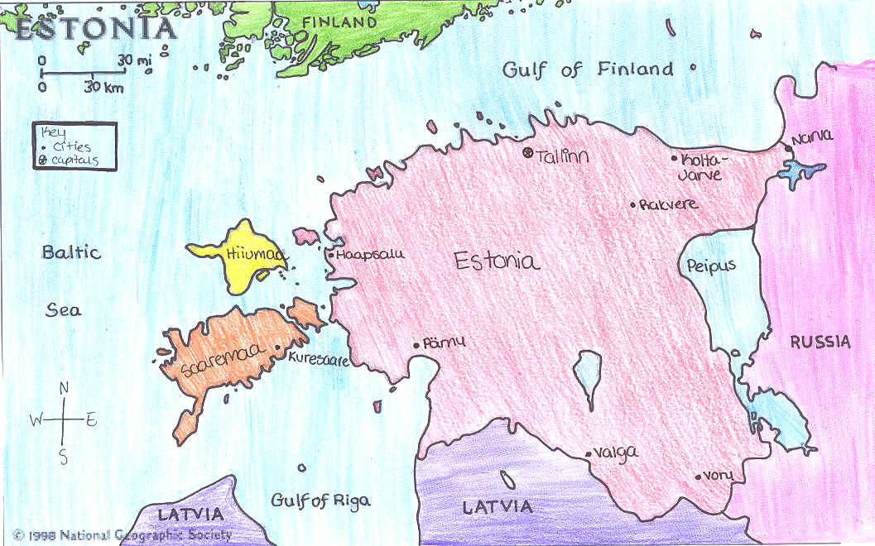

ESTONIA 2015
“With the financial support from the Prevention of and Fight against Crime Programme
European Commission - Directorate-General Home Affairs”

Slide 3
Research works implemented in frames of Safety Compass Project
“Path to prostitution” in-depth interviews with women involved in prostitution and sphere of trafficking
Internet mechanisms of recruitment to human trafficking analysis of main ways and patterns of recruitment to human trafficking using of online internet resources
Online image of women
research of representation of male and female textual and visual images in internet media
“With the financial support from the Prevention of and Fight against Crime Programme
European Commission - Directorate-General Home Affairs”

Slide 4
Path to prostitution: Psychological factors of vulnerability
Social outcasts; bullying; Effect of violence; lack of self-confidence; re-victimization; low self-esteem; negligent, indifferent treatment in childhood; dependence on a man; mental illness
“With the financial support from the Prevention of and Fight against Crime Programme
European Commission - Directorate-General Home Affairs”

Slide 5
Path to prostitution: Social factors of vulnerability
No support from social network; no support from social system; no support from family
social rejection; bad living conditions; drugs; inability to develop relationship; dependence on a man; alcohol; gambling;
“With the financial support from the Prevention of and Fight against Crime Programme
European Commission - Directorate-General Home Affairs”

Slide 6
Path to prostitution: Economic factors of vulnerability
debts;
low status job;
siblings need financial support;
sense of responsibility for children/family; debts of family members;
husband’s debts;
low wages;
satisfaction of basic needs;
earn to satisfy addictions (alcohol, drugs); satisfaction of need for luxury;
jobless;
loss of home
“With the financial support from the Prevention of and Fight against Crime Programme
European Commission - Directorate-General Home Affairs”

Slide 7
Path to prostitution: Personal factors of vulnerability
no education,
serious crisis
no skill necessary for a job
“With the financial support from the Prevention of and Fight against Crime Programme
European Commission - Directorate-General Home Affairs”

Slide 8
Path to prostitution: Cultural factors of vulnerability
Sexualisation of a woman in the media
objectification of a woman
value of a woman = presence of a man
influence of friends
“With the financial support from the Prevention of and Fight against Crime Programme
European Commission - Directorate-General Home Affairs”

Slide 9
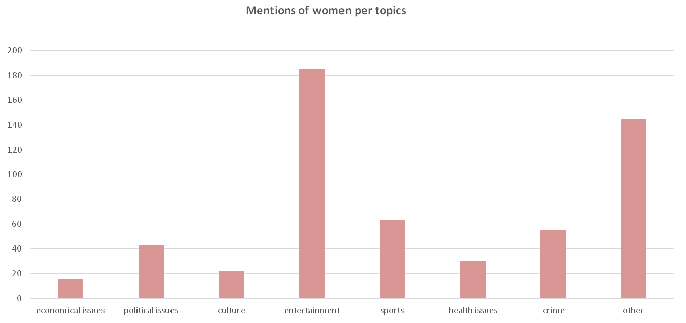
Online woman image research
“With the financial support from the Prevention of and Fight against Crime Programme
European Commission - Directorate-General Home Affairs”

Slide 10
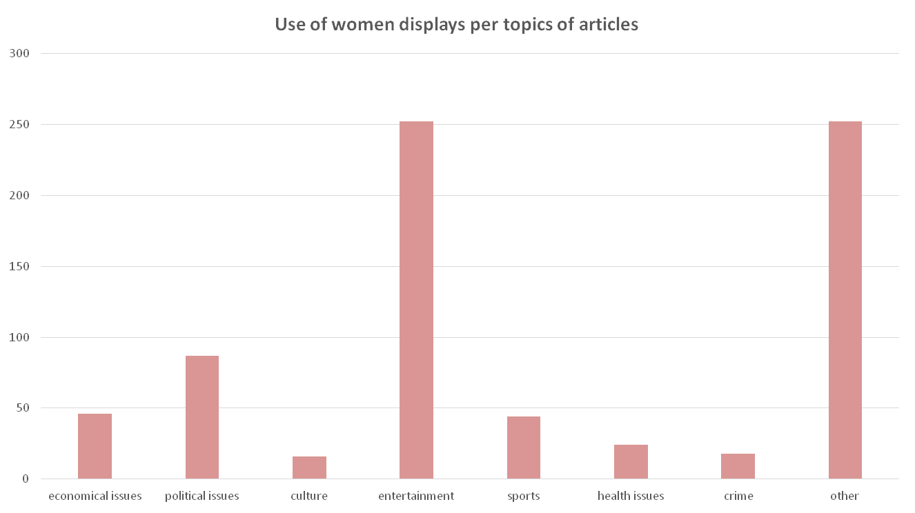
Online woman image research
“With the financial support from the Prevention of and Fight against Crime Programme
European Commission - Directorate-General Home Affairs”

Slide 11
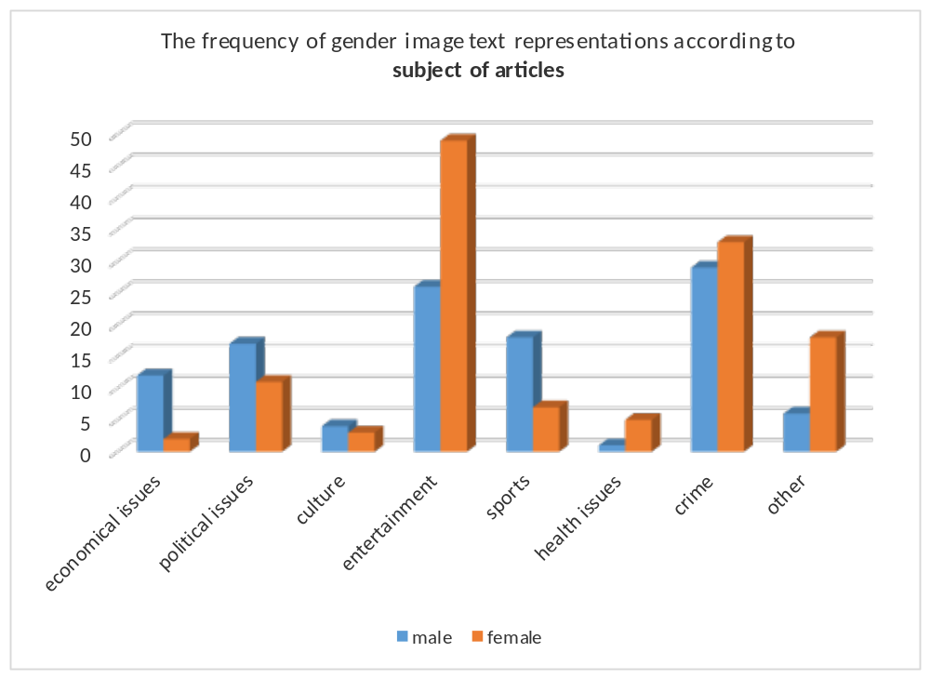
Online woman image research
“With the financial support from the Prevention of and Fight against Crime Programme
European Commission - Directorate-General Home Affairs”

Slide 12
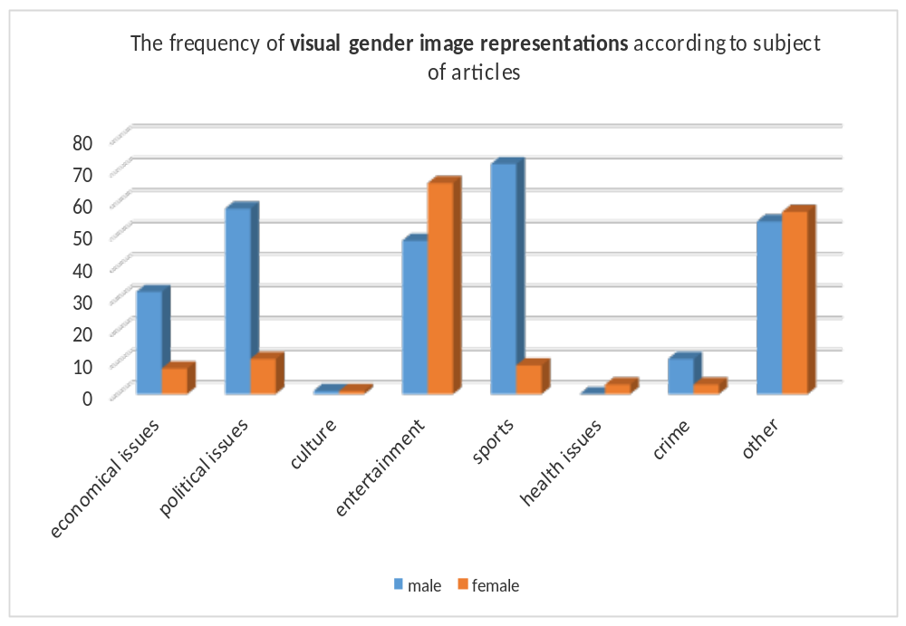
Online woman image research
“With the financial support from the Prevention of and Fight against Crime Programme
European Commission - Directorate-General Home Affairs”

Slide 13
Internet mechanisms of recruitment to human trafficking: main challenges
Involvment of private sector - business in process of prevention of trafficking
b. DarkNet
“With the financial support from the Prevention of and Fight against Crime Programme
European Commission - Directorate-General Home Affairs”

Slide 14
MTÜ ELULIIN
atoll.center@gmail.com
www.eluliin.ee
“With the financial support from the Prevention of and Fight against Crime Programme
European Commission - Directorate-General Home Affairs”

