Slide 1

Beyond Cost-Effectiveness:
Assessing the Social Impact of Health Technologies to Reduce Cancer Care Inequalities in the EU
Dr. Karla Hernandez-Villafuerte
WifOR Institute, Germany
May 2025

Slide 2
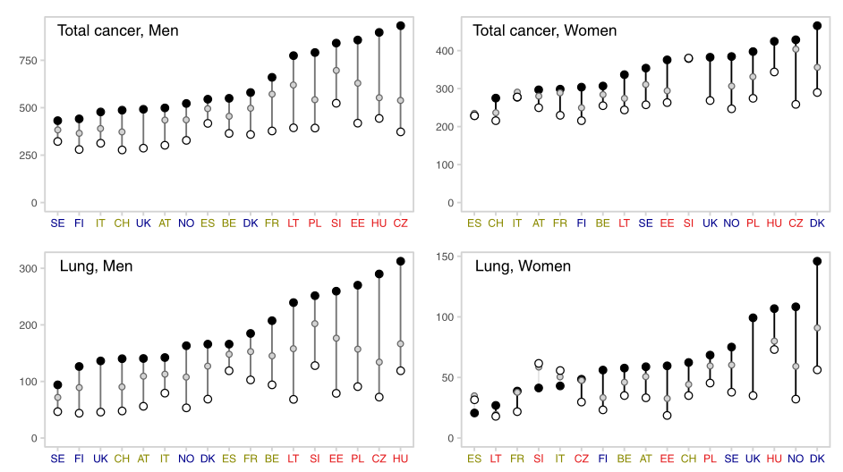
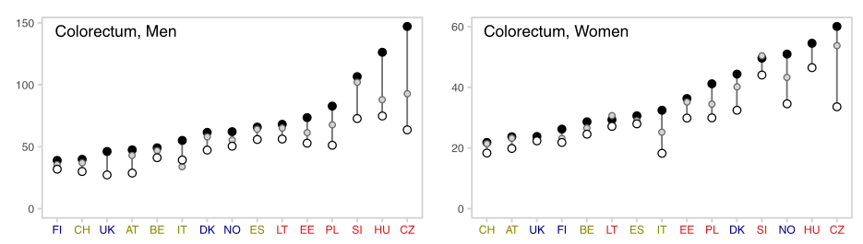
Cancer Care Inequalities
Across the EU
Cancer survival in the EU: A matter of geography
  Five-Year Survival Rates Vary Widely (Pousette et al. 2024)
    Colon Cancer
      Survival ranges from 50% in the worst-performing country to nearly 70% in the best.
    Breast Cancer:
      Survival rates span from just over 70% to around 90% across countries.
Age standardized mortality rates (per 100.000 individuals)
Fig.1 Educational inequalities between and within countries in total cancer mortality, and for type-specific cancers, in Europe.
Red = Baltic/Central/East. Blue = North. Green= West/south.
Source: Vaccarella et al., 2023
Notes:
North: Norway, Sweden, Finland, Denmark, England/Wales
West/South: Belgium, France, Switzerland, Austria, Italy (Torino department), Spain
Baltic/Central/East: Estonia, Lithuania, Poland, Czech Republic, Hungary, and Slovenia

Slide 3
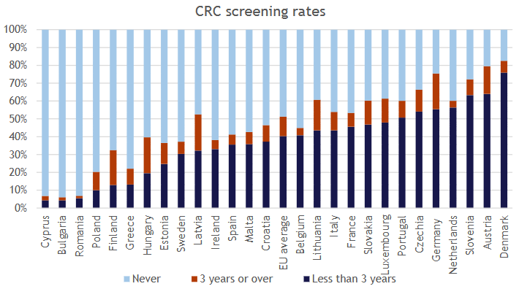
Inequalities in Cancer Care and Prevention
Pousette et al. (2024) assessed inequalities across:
  Country, Sex, Age, Education Level, Socioeconomic Status, Urbanization Level
  Significant between-country disparities across the disease pathway
    Example:
    HPV vaccination rates among girls vary from <10% in Bulgaria to >90% in Portugal.
Fig 2. CRC screening rates (self-reported) by time since last screening in people aged 50–74 in the EU (2019)
Source: Pousette et al. 2024

Slide 4
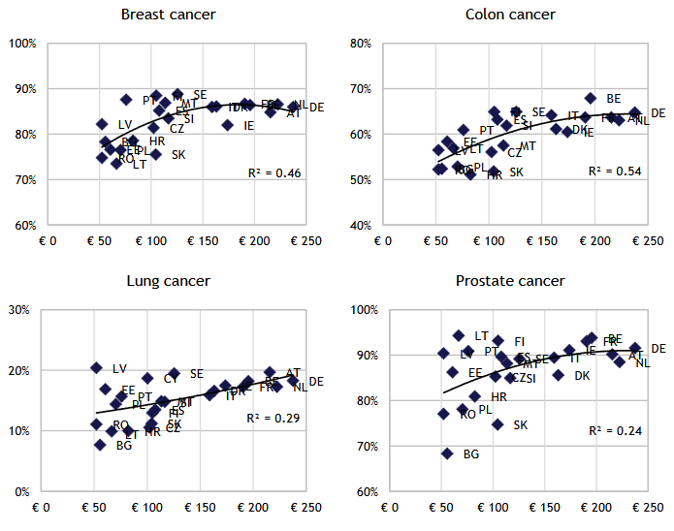
Spending and Health Outcomes
Variations in cancer control spending among EU countries significantly contribute to unequal access to prevention and treatment services, leading to divergent health outcomes.
Fig 4. Cancer expenditure per capita in year 2010 (horizontal axis) and 5-year survival rates in year 2010–2014 (vertical axis) in the EU.
Source: Pousette et al. 2024
Notes:
Country abbreviations: AT- Austria, BE- Belgium, BG- Bulgaria, CY- Cyprus, CZ-Czechia, DK-Denmark, EE- Estonia, ES- Spain, FI- Finland, FR- France, DE- Germany, HR- Croatia, IE- Ireland, IT-Italy, LT- Lithuania, LV- Latvia, MT- Malta, NL- Netherlands, PL- Poland, PT- Portugal, RO- Romania, SE-Sweden, SK- Slovakia.

Slide 5
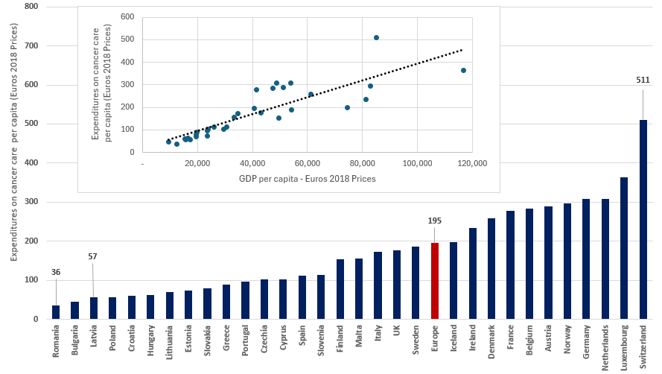
Cancer Care Spending Mirrors National Wealth
It's no surprise that high-income countries allocate more funds to cancer care
How resources within the health sector are allocated
  Efficiency and priorities
  Within the health sector, how cancer treatment, prevention and diagnosis are prioritized.
The deeper issue concerns national priorities -
  how limited resources are distributed across sectors
  the extent to which health, and cancer control specifically, are prioritized.
Fig 5. Relationship Between Cancer Care Spending and GDP per Capita (2018)
Sources: WifOR elaboration. Data Hofmarcher et al., 2020 (cancer expenditure); World Bank, 2025 (GDP per capita).
Notes:
Country abbreviations: AT- Austria, BE- Belgium, BG- Bulgaria, CY- Cyprus, CZ-Czechia, DK-Denmark, EE- Estonia, ES- Spain, FI- Finland, FR- France, DE- Germany, HR- Croatia, IE- Ireland, IT-Italy, LT- Lithuania, LV- Latvia, MT- Malta, NL- Netherlands, PL- Poland, PT- Portugal, RO- Romania, SE-Sweden, SK- Slovakia.

Slide 6
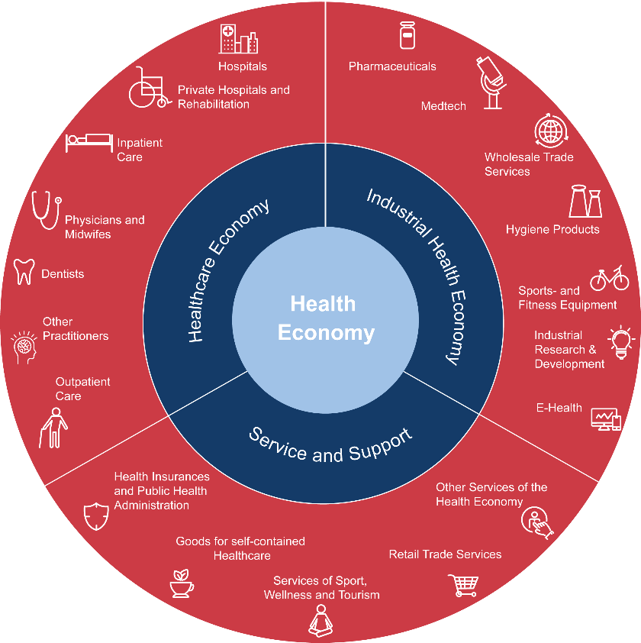

WifOR Fosters Paradigm Shift in Healthcare –
From a Cost Factor to a Driver for Growth and Employment
PAST
FUTURE
Health Economy as a driver
for growth and employment
Health Economy as a diverse sector, contribution to GDP and employment
Growth sector, increasing work force, new career opportunities
Healthcare as a
cost factor
Separate silos and fragmentation | Healthcare only | Input orientation | Increasing health expenditures
Investment in health to promote growth and productivity
Better quality, more outcome oriented
Novartis P-CVD Health ROI Assessor

Slide 7
Three Broad Mechanisms Through Which Health Investments Yield Economic Benefits
The traditional approach consider one:
  Health investments in cost-effective innovations help improve health outcomes and reduce healthcare costs in a health system.
It overlooks significant broader benefits created through health investments.
New Paradigm: Recognizing the Full Value of Health Investments
  Social Impact:
    Investments in health improve national wellbeing by reducing the socioeconomic (SoC) burden of disease.
  Health Economy Footprint:
    Health investments stimulate the broader economy by influencing both supply and demand across multiple sectors, strengthening overall economic growth and resilience.

Slide 8
2. The Social Impact of Health Investment

Slide 9




Reducing the Socioeconomic (SoC) Burden of Disease
SoC burden is understood as the decrease in human capital related to the losses in productivity derived from morbidity and mortality.
  Human capital is the combination of innate capabilities and acquired skills, knowledge, and motivation used to produce goods and services and to realize unpaid care and domestic work.
SoC burden is the extent to which a disease deteriorates individuals' capacity to use their capital, which is translated into a decrease in labor supply
Decrease in labor supply weakens economic growth.

Slide 10


Why Reducing the SoC Burden of Cancer is Key for EU Countries? (1)
Cancer affects a large proportion of Europeans, with lasting consequences for both current and future generations.
  Cancer patients play a crucial role in the economy, contributing to its overall productivity.
Productivity losses slow down economic growth, even to stagnation.
  Skills shortages hinder production and innovation.
    63% of EU SMEs struggle to find needed talent (European Commission, 2024).
  Labor supply decrease reduces economic output.
    Especially as cancer increasingly affects the working-age population (Jakubowska, 2023)
  Population aging worsens the ratio of working-age to retired individuals (Maestas et al. 2023, WHO 2023)
    Affects fiscal sustainability by putting pressure on public pension and health care systems.
    Raising pension ages alone isn’t enough; older workers must effectively replace younger ones to meet workforce needs (Nagarajan et al., 2016).

Slide 11

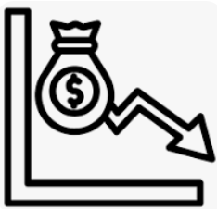
Why Reducing the SoC Burden of Cancer is Key for EU Countries? (2)
Exacerbation of inequalities in the economy
  Cancer types with higher mortality and morbidity (e.g., lung cancer, colorectal and pancreatic) affects particularly poorest income groups (Mihor et al. 2020)
    Presenteeism and absenteeism further reduce productivity and income levels, increasing workers’ vulnerability
    Spillover effects in future generation
    Income level affects access to healthcare services
    More susceptible to health crisis such as the COVID pandemic

Slide 12












Cancer also Creates a SoC Burden by Preventing Patients from Performing Unpaid Work
Lost Hours
of unpaid work
Lost Hours
of paid work
Unpaid work encompasses only the activities that
can be replaceable by another third person.
Gardening, animal care
Preparation of meals
on average per year
Unpaid work, when given a monetary valued, is estimated to exceed 40% of the GDP in some countries (ILOSTAT, 2025)
Gender Equality: Women's disproportionate share of unpaid work activities limited their ability to participate in the paid economy.
Older adults' contributions to the country's economic growth have a significant component in unpaid work.
Purchases and procurement, organization
Improvements and home repair
Maintenance of dwelling, care of textile fabrics
Informal care, childcare and voluntary work
Source: WifOR’s illustration.

Slide 13

Accurately Measuring the Soc Burden is Essential to Guide Policymakers in Setting Evidence-based Priorities
How significant is the SoC burden associated with specific disease areas?
What is the socioeconomic return on investing in health?
Social impact
  Investments in health, such as new medical technologies and prevention programs, contribute to healthier and more productive societies.
  Which healthcare strategies (prevention, promotion, treatment) most effectively support economic growth?
  Does the economic value of new health interventions exceed their implementation costs?

Slide 14
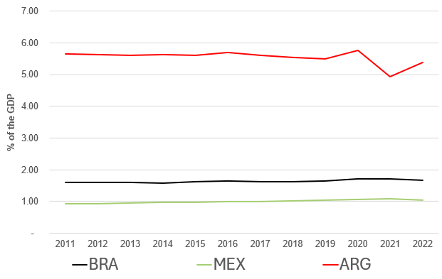
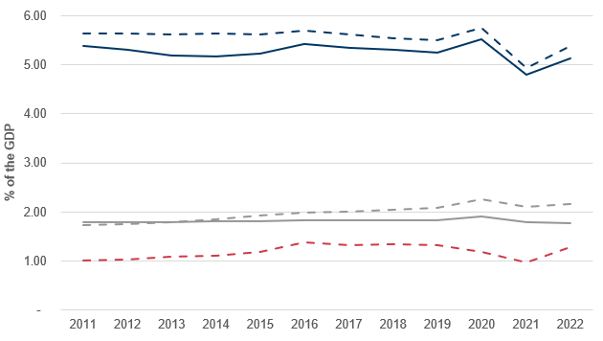
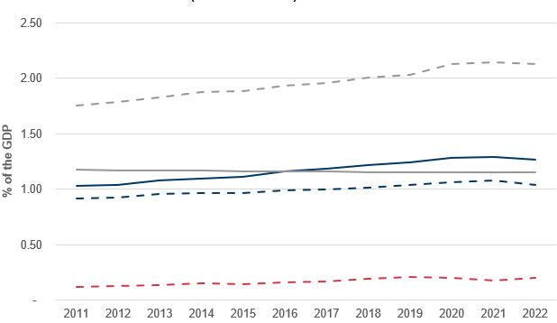
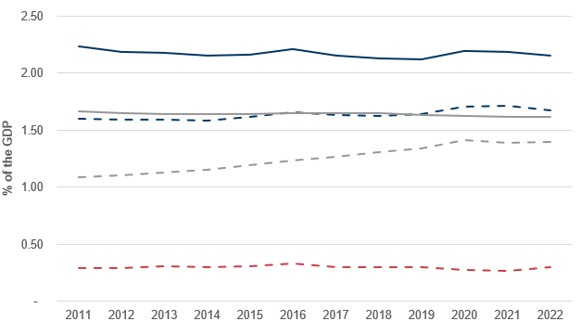



SoC Burden of Neoplasms in Comparison to Other Diseases – Latin America Example
Fig 6. Time trends SoC burden for the selected disease in four Latin American countries, – Assuming Non-substitution
*Note that given the higher values observed for Argentina, we used a different scale than for the other countries
Source: WifOR elaboration. For a comprehensive description of the methods, refer to Hernandez-Villafuerte et al. (2024).
A. SoC burden for Neoplasms
B. Argentina*
C. Mexico
D. Brazil
Lines in Panel B, C and D:

Slide 15
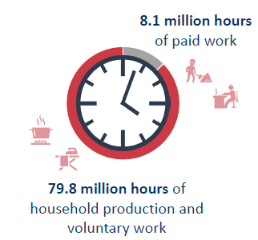
Social impact of New technologies – Examples
Social Impact of Lenalidomide for multiple myeloma patients in Germany (2007 to 2030) (Hofmann and Seddik 2019)
  64,066 progression-free patient-years are gained
  The Social Impact of lenalidomide amounts to EUR 21.1 billion vs. EUR 12.7 billion of additional costs.
Source: Hofmann and Seddik 2019.
Follicular lymphoma (Hofmann et al. 2020)
  Patients with hematological cancers are among those most likely to experience work impairment due to their condition.
  How much work productivity can be generated by treating all German patients with obinutuzumab-based therapy vs standard therapy (2017-2030)
    About 187.9 million Euros in paid work and about 535.9 million Euros in unpaid work

Slide 16
3. Health Economy Footprint

Slide 17
Health Economy Footprint of a Health Investment
Economic footprint
Households
Spillover effects
consumer
consumption
Suppliers
Immediate effects directly generated in the HE
Effects arising in the value chain triggered by procure-ment (interme-diate con-sumption), i.e. in other sectors
Effects caused by expenditure of directly and indirectly generated incomes, i.e. in the whole economy (all sectors)
wages
wages
sector
spends
Direct effects
Indirect effects
Induced effects
HE = Health Economy. Source: WifOR 2023.

Slide 18


Why is the Health Economic Footprint Important for Cancer Care
Challenges in prioritizing health in public budgets
  Ministries of Finance set national priorities aligned with broader government goals.
  With limited public funds, all sectors compete for resources — including health.
  Sectors like infrastructure or energy offer more tangible, short-term returns, measurable within a single government term.
  Advocating for healthcare funding becomes more difficult.
The pandemic exposed the consequences of chronic underfunding in health systems.
  EU countries increased public health spending to over 8% of GDP, after a decade stuck at 7% (World Bank, 2023).
  We must use this wake-up call to ensure health remains a priority — not the first target in future cuts.

Slide 19
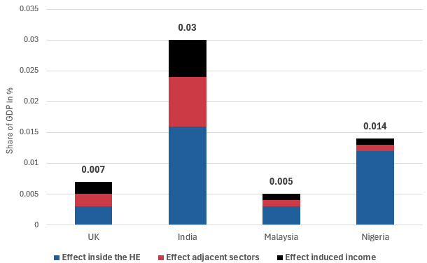
Investment in Routine Human Papilloma Virus (HPV) Vaccination – Commonwealth Countries
Table 1: GVA Creation via Health Economy Investments, results for 2022
 | Average yearly investment | GVA in mUSD (2022 Prices) created by HPV investments
 | mUSD 2022 Prices | Effect inside the HE | Effect adjacent sectors | Effect induced income | Total
UK | 134 | 107 | 62 | 78 | 247
India | 756 | 605 | 314 | 230 | 1,149
Malaysia | 16 | 13 | 5 | 5 | 23
Nigeria | 100 | 80 | 10 | 6 | 96
Fig 7. GVA creation via Health Economy Investments as percentage of the GDP, results for 2022
Source: Atun et al. 2025
HE = Health Economy, GDP = Gross Domestic Product.
GVA = Gross Value Added. It shows how much value a sector or region adds to the economy after subtracting the cost of materials and services used. For example, if a pharmaceutical firm sells a cancer treatment for 100 mUSD, and the cost of raw materials, packaging, and external services is 40 mUSD, the GVA is 60 mUSD. This reflects the value added through research, innovation, skilled labor, and production inside the company. The sum of all economic sectors is the Total GVA a country.

Slide 20
Holistic Approach
Health ROI Assessor Framework

Slide 21
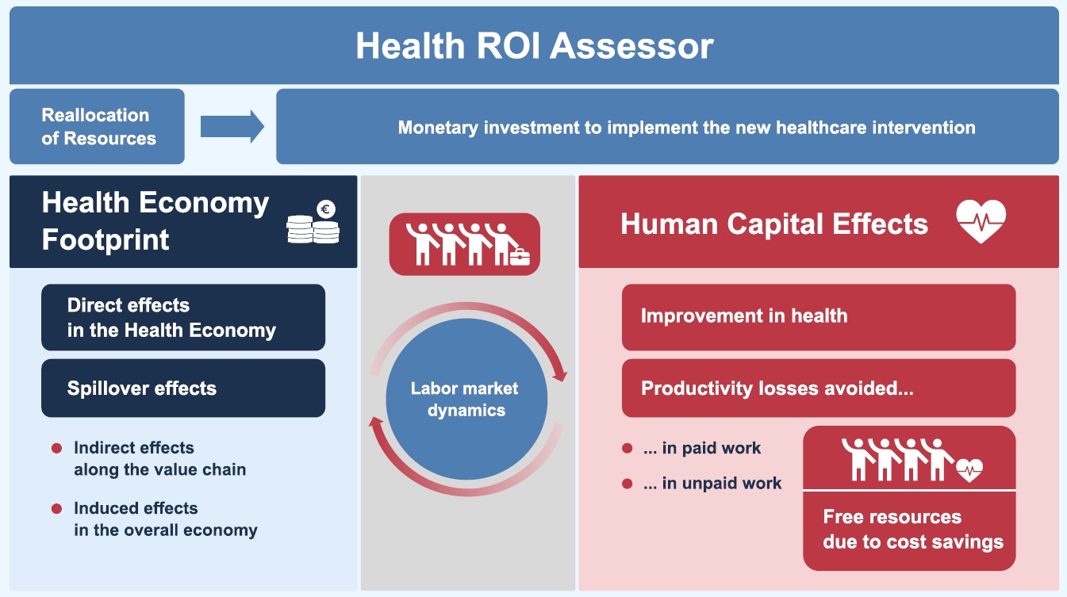
WifOR‘s Health ROI Assessor Framework
Additional details in Hernandez-Villafuerte, 2025
Notes:
Resources can come from health care sactor, other sectors or external sources outside of the country. We consider the reallocation of resources to be invested in the HE. Will be considered in final model when we implement labor market analysis. Comparison of investment in other sectors to be implemented here in final model.

Slide 22
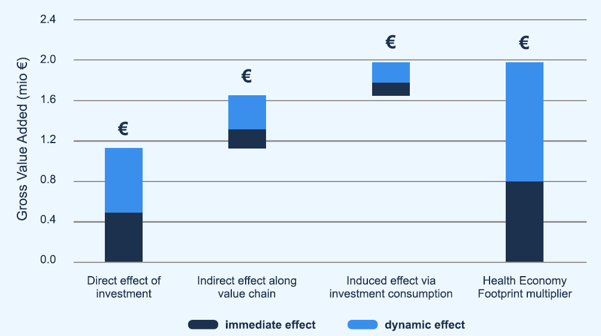
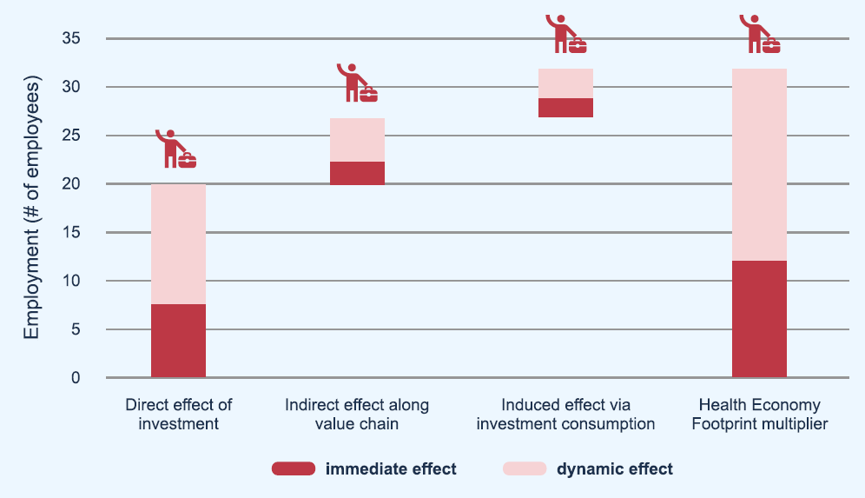
Investing in a Cervical Cancer Screening Prevention Program (Papanicolaou) in Germany (1)
Fig 8. Health Economic Footprint of
1 million Euros invested in cancer prevention in Germany
Source: Schmitt et al. 2024
For every 1 million USD invested in cancer prevention in Germany,
  In terms of GVA nearly 2 mUSD generated within and beyond the healthcare sector over 3 years:
    The immediate impact in the first year = 1.16 million Euros
    Additional dynamic effects over the following two years = 0.81 million Euros
  In terms of employment 32 jobs are generated:
    13 jobs are created in the first year
    Additional 19 jobs generated over the next 2 years

Slide 23
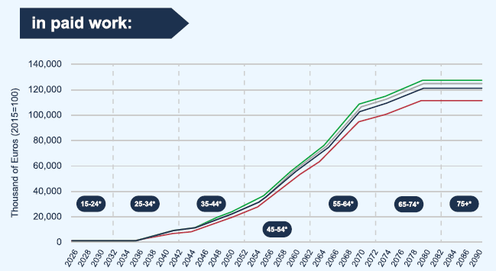
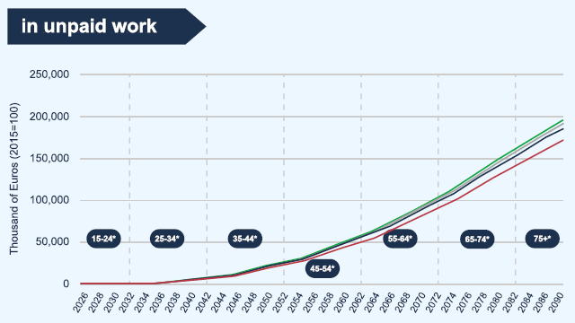


Investing in a Cervical Cancer Screening Prevention Program (Papanicolaou) in Germany (2)
Cumulative Social Impact (productivity gains) of different Papanicolaou test program strategies vs. no screening
  Cohort of 100,000 women entering at the age of 15 years
  Starting at the age of 20 years according with the German national cancer screening program
Fig 9. Cumulative Social Impact of Papanicolaou test in Germany
Source: Schmitt et al. 2024

Slide 24
Reframing Cancer Care: A Strategic Investment for Europe
Cancer outcomes and access to care remain unequal across EU countries.
A key factor is the disparity in national health spending and cancer resource allocation—closely tied to each country's economic wealth.
Health is still viewed mainly as a cost—not an investment.
We need a paradigm shift: Strategic investment in health boosts well-being, productivity, and healthcare sustainability.
Empower advocacy: Cancer patient organizations need stronger tools and metrics to drive resource allocation.
  Cancer leads to major productivity losses and slows economic growth.
  Health’s economic footprint and spillover effects should be quantified like those in energy or infrastructure.
  The economic and social impact of cancer and new health technologies must be measured and valued.
"If you measure it, you can shape it."

Slide 25
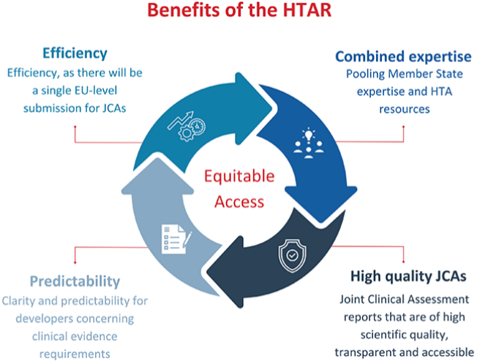
Advancing EU Health Investment Through Common Metrics & Cooperation
A common EU framework is needed to measure the impact of health investments across Member States.
The new Health Technology Assessment Regulation (HTAR), effective January 2025, shows that standardization and collaboration are achievable.
Key Components of HTAR:
  Joint Clinical Assessments (JCAs): Evaluate safety and effectiveness of new technologies across the EU.
  Joint Scientific Consultations: Guide developers in designing clinical studies that meet evidence standards.
  Early Identification: Spot promising innovations early to help health systems prepare efficiently.
Coordinated assessment boosts evidence-based decisions and maximizes value from health investments.
Source: EHA, 2025.

Slide 26
References (1)
Atun, R., Fries, J.L., Hernandez-Villafuerte, K., Müller, M., Ostwald, D. and Schmitt, M., 2025. Contribution of investment in health and cancer control to economic growth in Commonwealth countries. EClinicalMedicine, 82.
EHA, 2025. Regulation on Health Technology Assessment. https://ehaweb.org/advocacy/regulation-on-health-technology-assessment (Accessed: 29 April 2025).
European Commission, March 20, 2024. Commission sets out actions to tackle labor and skills shortages. (Accessed: 29 April 2025).
Hernandez-Villafuerte, K., Müller, M. and Ostwald, D., 2024. Socioeconomic burden of main diseases in eight Latin American countries.
Hernandez-Villafuerte, K., Schmitt, M., Ludwig Fries, J. 2025.The Health ROI Assessor: Evaluating Novel CVD Prevention Approaches in Estonia. Value & Outcomes Spotlight March/April 2025, pp 31-34
Hofmann, S. and Seddik, A., 2019. PCN216 The societal impact of Lenalidomide in the treatment of patients with multiple myeloma in Germany. Value in Health, 22, p.S478.
Hofmann, S., Himmler, S., Ostwald, D., Dünzinger, U., Launonen, A. and Thuresson, P.O., 2020. The societal impact of obinutuzumab in the first-line treatment of patients with follicular lymphoma in Germany. Journal of Comparative Effectiveness Research, 9(14), pp.1017-1026.
Hofmarcher, T., Lindgren, P., Wilking, N. and Jönsson, B., 2020. The cost of cancer in Europe 2018. European Journal of Cancer, 129, pp.41-49.
ILOSTAT (2025) Measuring unpaid domestic and care work. Available at: https://ilostat.ilo.org/topics/unpaid-work/measuring-unpaid-domestic-and-care-work/ (Accessed: 29 April 2025).
Jakubowska, A., 2023. Burden of Cancer in the Working Age Population in the Context of Economic Inequalities in the European Union. Journal ISSN, 2766, p.2276.
Maestas, N., Mullen, K.J. and Powell, D., 2023. The effect of population aging on economic growth, the labor force, and productivity. American Economic Journal: Macroeconomics, 15(2), pp.306-332.

Slide 27
References (2)
Mihor, A., Tomsic, S., Zagar, T., Lokar, K. and Zadnik, V., 2020. Socioeconomic inequalities in cancer incidence in Europe: a comprehensive review of population-based epidemiological studies. Radiology and oncology, 54(1), p.1
Mihor, A., Tomsic, S., Zagar, T., Lokar, K. and Zadnik, V., 2020. Socioeconomic inequalities in cancer incidence in Europe: a comprehensive review of population-based epidemiological studies. Radiology and oncology, 54(1), p.1.
Nagarajan, N.R., Teixeira, A.A. and Silva, S.T., 2016. The impact of an ageing population on economic growth: an exploratory review of the main mechanisms. Análise Social, pp.4-35.
Pousette, A. and Hofmarcher, T., 2024. Tackling inequalities in cancer care in the European Union (No. 2024: 1). IHE-The Swedish Institute for Health Economics.
Schmitt, M., Hernandez-Villafuerte, K., Fries, J. and Müller, M., 2024. EE108 Novel Approaches Assessing the Value of Cancer Prevention in Germany. Value in Health, 27(12), p.S75.
Vaccarella, S., Georges, D., Bray, F., Ginsburg, O., Charvat, H., Martikainen, P., Brønnum-Hansen, H., Deboosere, P., Bopp, M., Leinsalu, M. and Artnik, B., 2023. Socioeconomic inequalities in cancer mortality between and within countries in Europe: a population-based study. The Lancet Regional Health–Europe, 25.
World Bank (2023b) World Bank Open Data. Domestic general government health expenditure (% of GDP) - European Union. Available at: https://data.worldbank.org/indicator/SH.XPD.GHED.GD.ZS?end=2021&locations=EU&most_recent_value_desc=false&start=2000&view=chart (Accessed: 20 November 2023)
World Health Organization (2023) World Social Report 2023: Leaving no one behind in an ageing world. Available at: https://desapublications.un.org/file/1087/download (Accessed: 20 November 2023).

Slide 28
Thank you
Karla Hernandez-Villafuerte
karla.hernandez-villafuerte@wifor.com
WifOR Darmstadt
Rheinstraße 22
D-64283 Darmstadt
www.wifor.com

