Slide 1




Bridging the Cancer Gap: The Role of the European Cancer Organisation to Drive Equity in Cancer Care in Europe
Nicolò Matteo Luca Battisti
Consultant medical oncologist
Department of Medicine, Breast Unit
Senior Adult Oncology Programme Clinical Lead
The Royal Marsden NHS Foundation Trust
Past President of the International Society of Geriatric Oncology (SIOG)
Treasurer and Co-Chair of the Inequalities Network of the European Cancer Organisation (ECO)
Member of the Executive Committee of the European Society of Breast Cancer Specialists (EUSOMA)
2nd European Oncology Patient Congress, Riga
20th May 2025

Slide 2
Disclosures
Advisory board: Pfizer, Abbott, Sanofi, Astellas, Merck, AstraZeneca
Travel grants: Exact Sciences, Pfizer, Lilly, Novartis
Speaker fees: Pfizer, AbbVie, Roche, Sanofi, Novartis, Servier, Gilead, AstraZeneca, Lilly, Exact Sciences, Johnson & Johnson

Slide 3
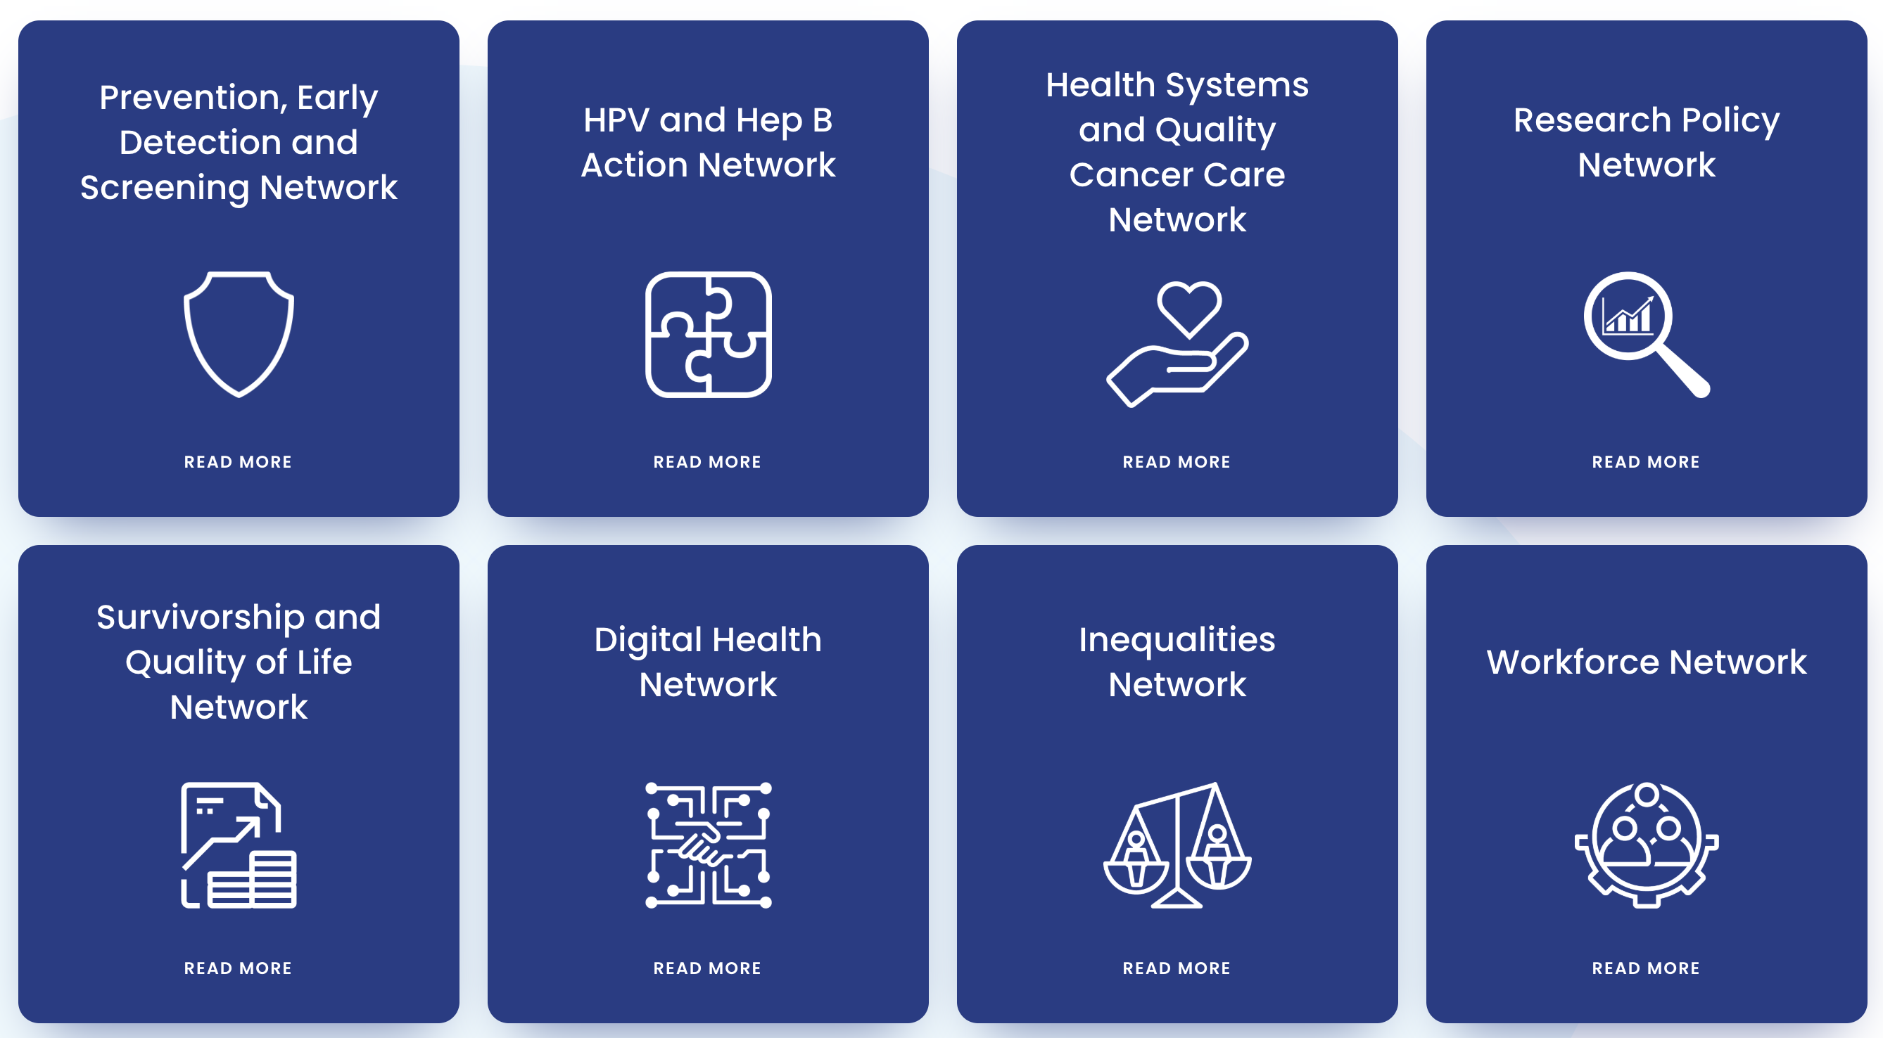
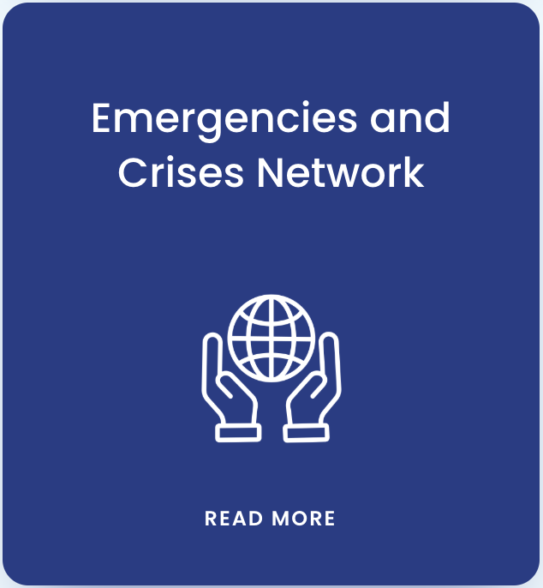
European Cancer Organisation
The 9 Focused Topic Networks

Slide 4
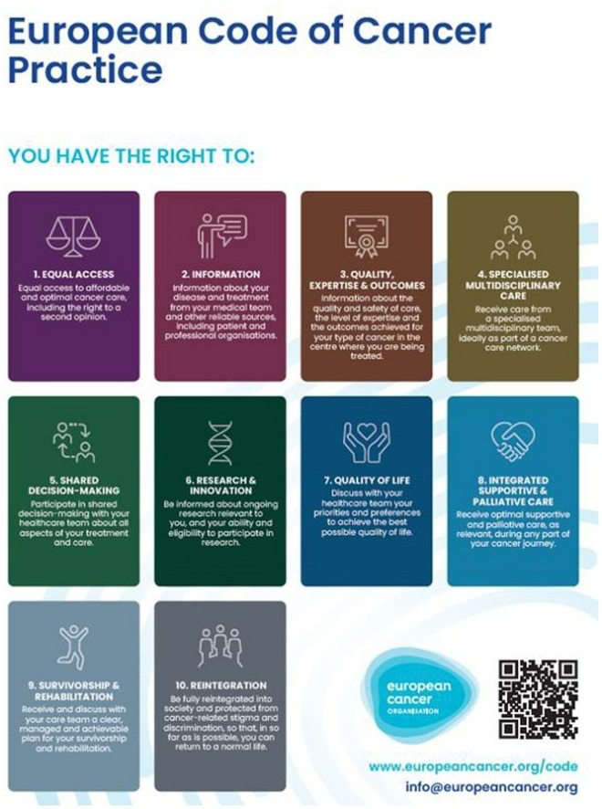
What matters to patients and caregivers
All cancer patients should have equal rights to quality cancer care as called for by the European Code of Cancer Practice
The Europe Beating Cancer Plan, published in February 2021, includes a chapter dedicated to inequalities, but also the development of a monitoring tool, the European Cancer Inequalities Registry, proving the momentum on the topic
Nevertheless, data and evidence on the topic shows that there is still a long way to go to beat cancer inequalities in Europe

Slide 5
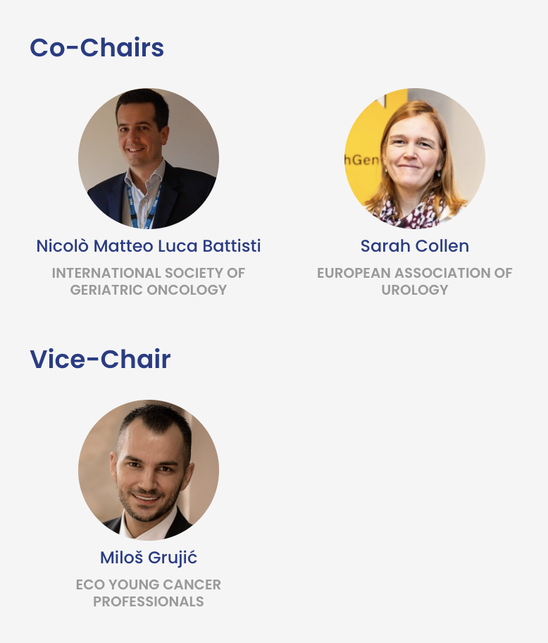
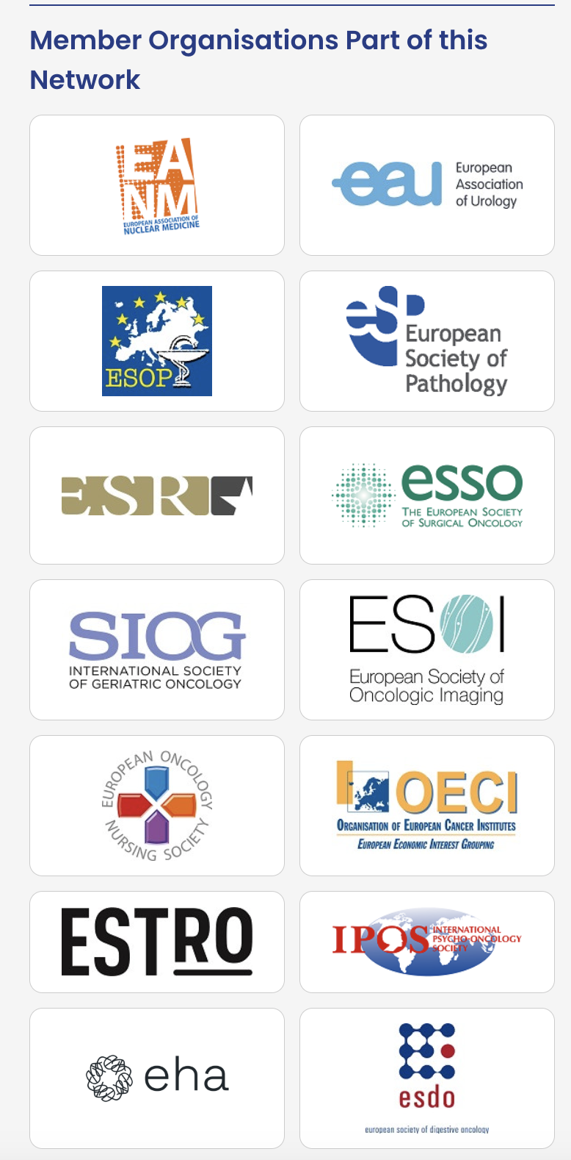
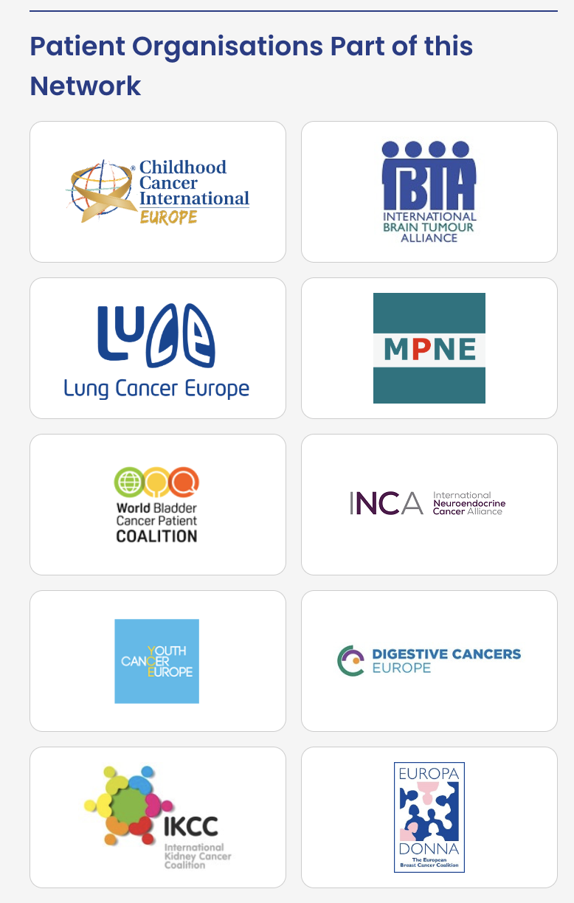
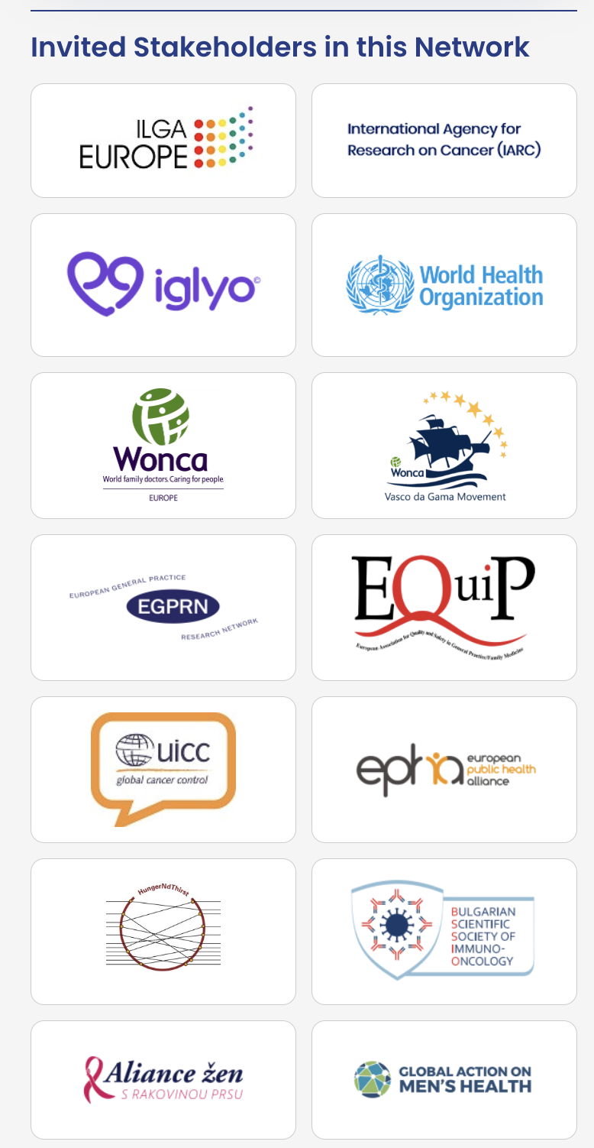
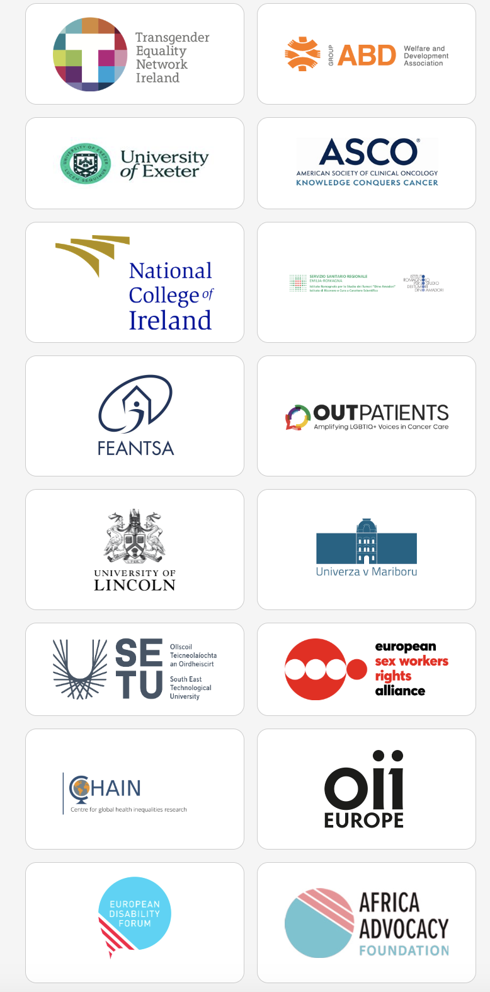
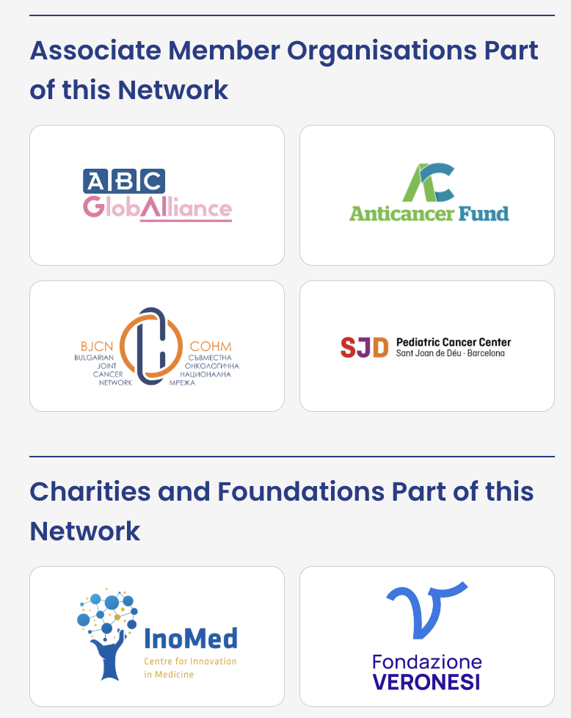

European Cancer Organisation

Slide 6
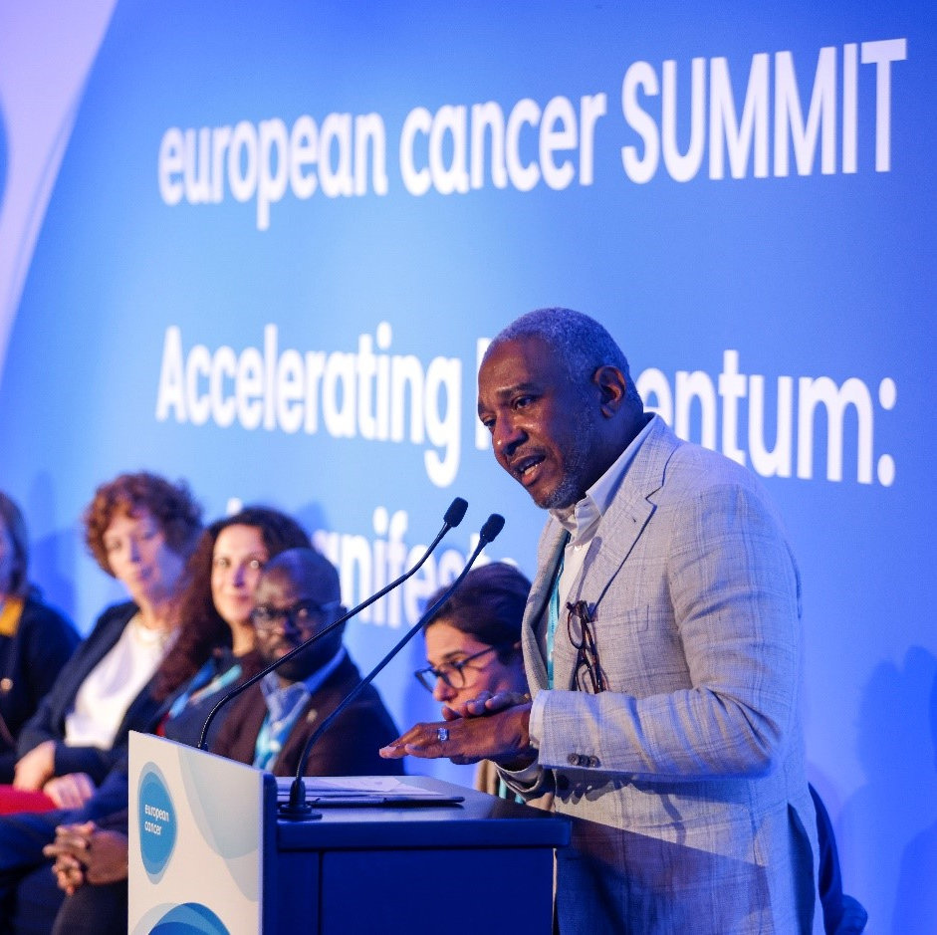
The Inequalities
Network
Aiming to achieve urgent actions to address inequalities, the Inequalities Network, is shining a spotlight on policy mechanisms to bridge gaps and reach equity in cancer care across Europe
Its work aligns with the European Code of Cancer Practice’s aspiration to ensure equal treatment to every cancer patient
The Network dedicates itself to driving consensus, presenting policy recommendations and solutions, and sharing best practices in relation to inequalities
Photo from the European Cancer Summit 2023

Slide 7
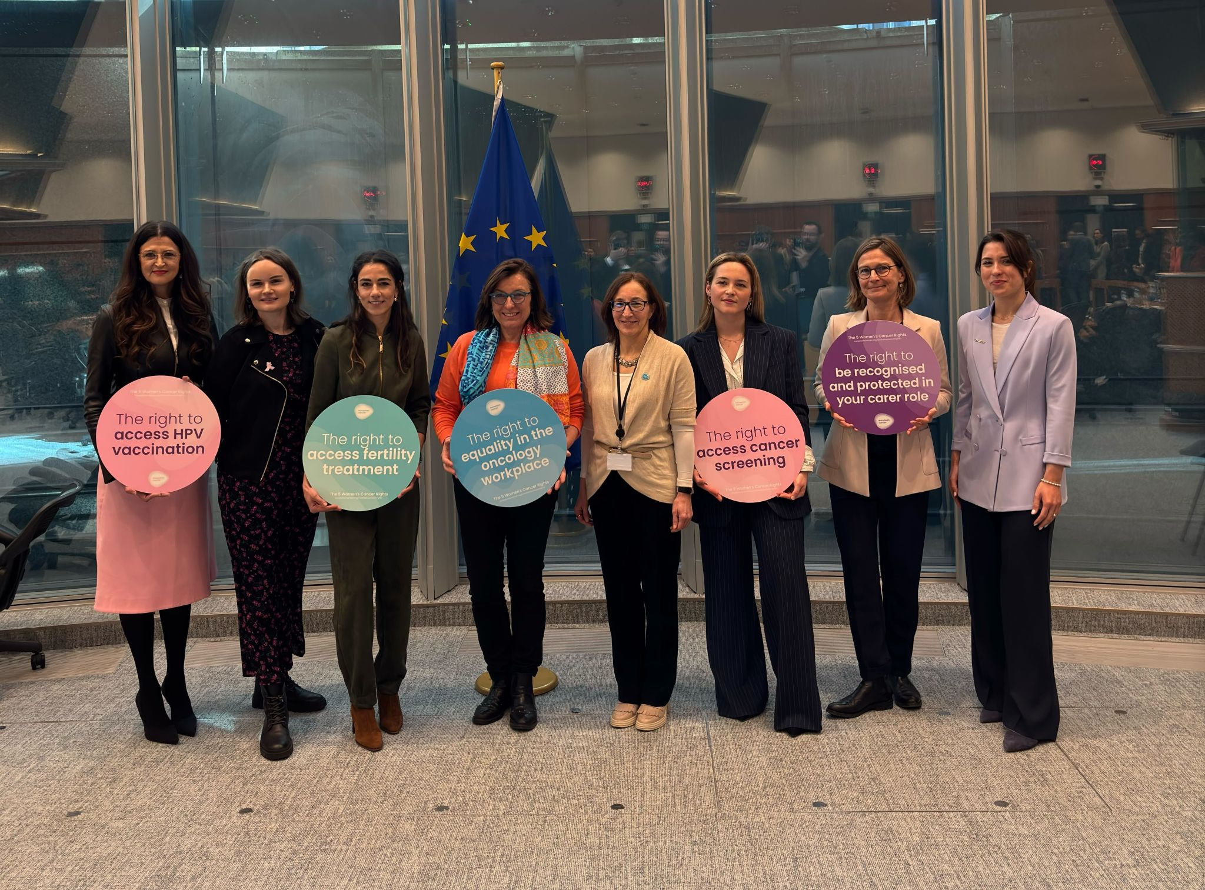
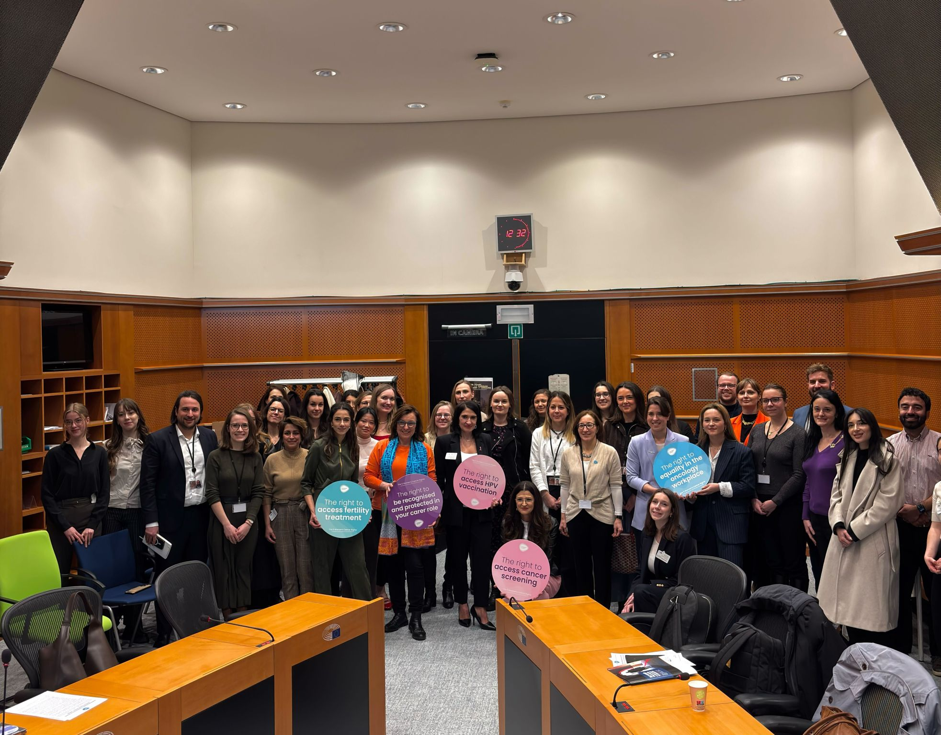
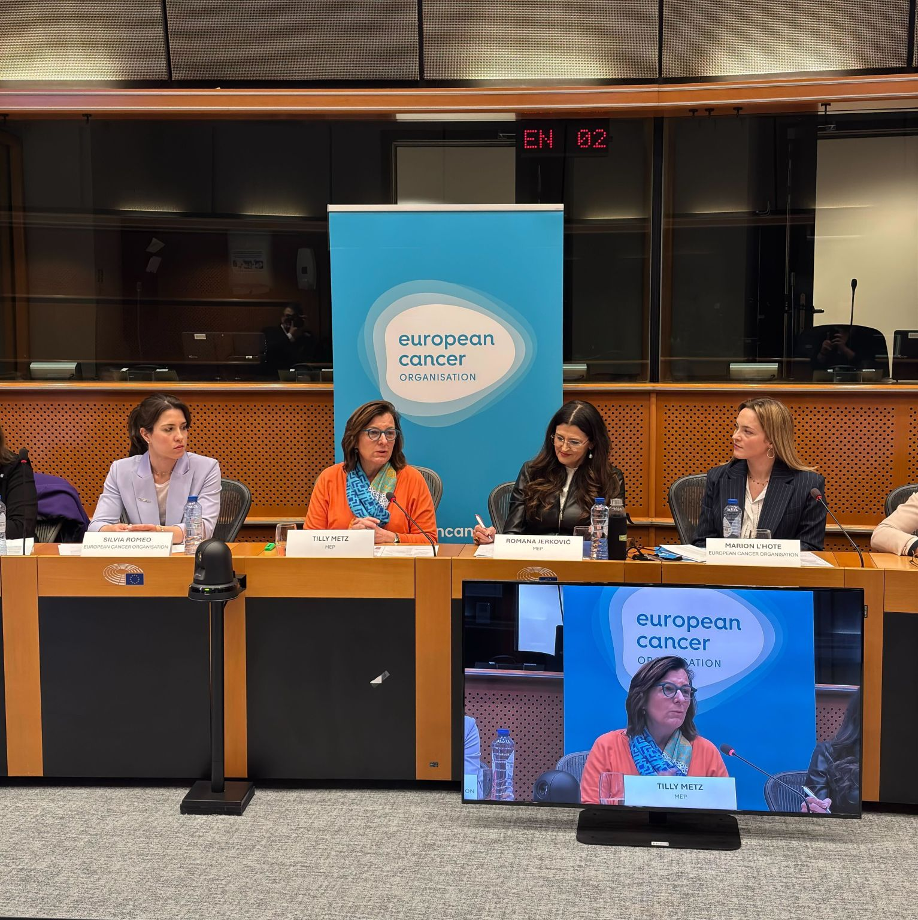
‘Women & Cancer: 12 million reasons for action’ European Parliament Event (6th March 2025)
2 vice-chairs of the SANT Committee (MEPs Jerkovic & Metz)
10 speakers including the two W&C co-chairs, European Women’s Lobby, YCE, Eurocarers, EIGE…
Over 60 participants in person
Media coverage in Politico

Slide 8
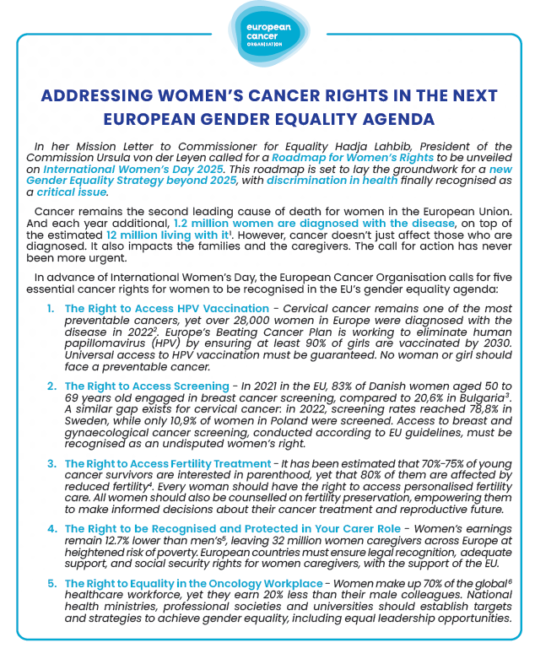
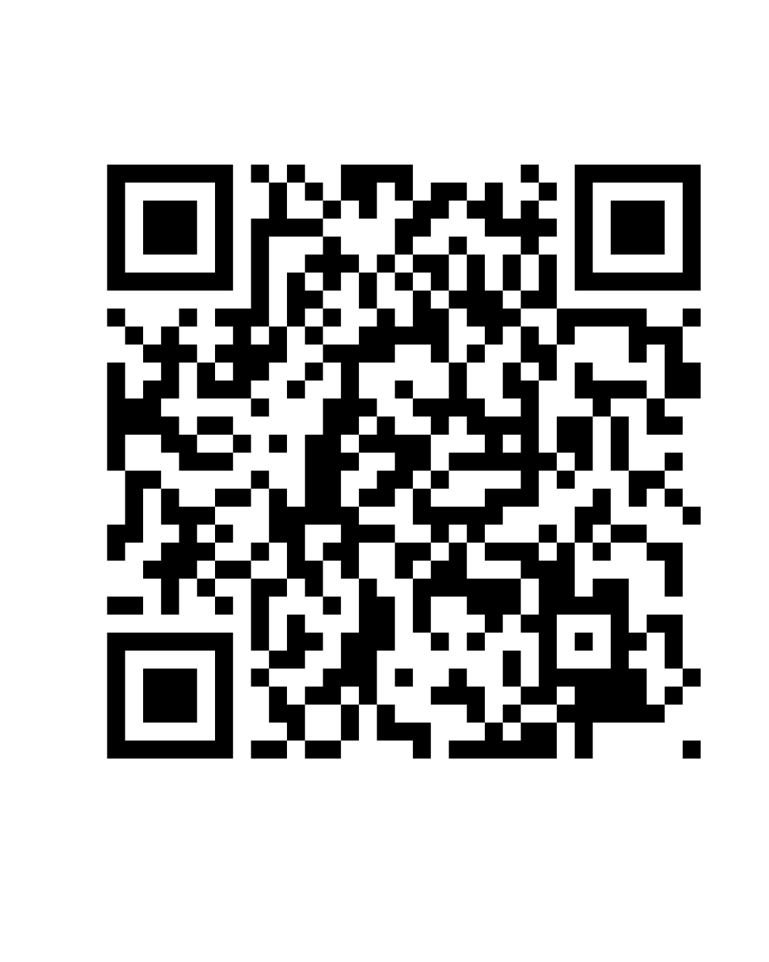
The ‘5 Women Cancer Rights’: a call for action

Slide 9


What’s next in 2025 ?
Calling out the gendered-marketing strategies of the alcohol and tobacco industries
Developing a Women & Cancer Policy Index to be unveiled at the European Cancer Summit 2025
Taking an active role in Pink October month, to shed a light on metastatic cancers
Women & Cancer Community 365 Roundtable

Slide 10
Men & Cancer Workstream
Published in December 2024, the "PROTECT-EUROPE to drive HPV vaccination across Europe" Report incorporates policy recommendations including ensuring gender-neutral HPV vaccination in all EU countries. The report also provide information on the risks of infection relevant to the young person’s sex/gender.
Looking ahead to 2025, Men & Cancer Workstream aims to address social inequalities in cancer through initiatives including:
Work with the new intergroup in the European Parliament to conduct a special hearing on men and cancer associated with Men's Health Week from 10th to 16th June 2025. The hearing will produce an official report.
Spotlight on prostate cancer in the third quarter of 2025, in support of prostate cancer awareness activities in that period, e.g. Movember. The initiative will present relevant data from the European Cancer Pulse, testimonials, best practices and policy recommendations, supported by a Europe-wide event.
In addition, continue to develop synergies and cooperation with PRAISE - U and unveil the results of the first screening programmes launched in Europe

Slide 11
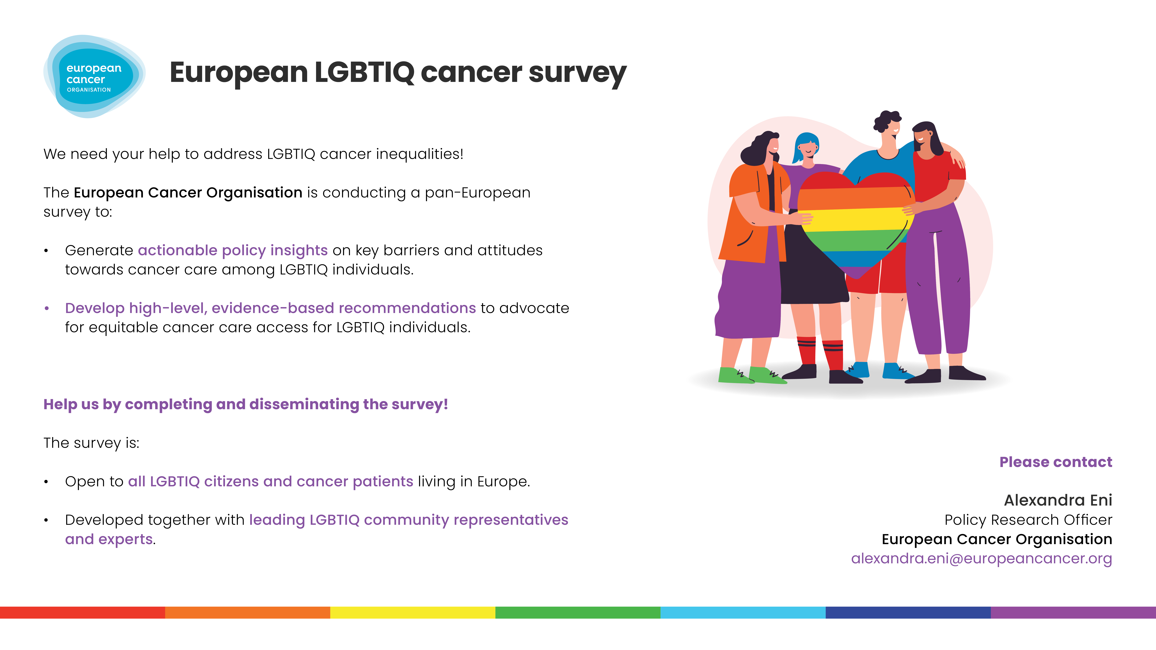

Slide 12
LGBTIQ and Cancer Survey
Why do we need this project?
The LGBTIQ workstream is starting a pan-European research project based on the fact that:
LGBTIQ individuals in Europe face discrimination and barriers in healthcare due to inadequate training, non-inclusive policies, and a lack of safe spaces.
45% of LGBTIQ people in the EU report difficulties accessing healthcare, especially trans women, men, and intersex persons (EU FRA, LGBTIQ at a crossroads, 2024).
More specific data is needed to better understand barriers to cancer prevention and care for LGBTIQ communities in Europe to ensure equitable health access.
Previous data focuses on healthcare professionals' attitudes towards LGBTIQ patients

Slide 13
LGBTIQ and Cancer Survey
The survey is available in English and other 17 European languages, including Bulgarian, Croatian, Czech, Danish, Dutch, Finnish, French, German, Greek, Hungarian, Italian, Norwegian, Polish, Portuguese, Romanian, Spanish, Swedish
The link to the survey will be accompanied by a dissemination toolkit, comprised of visuals, social media ready-to-post texts, flyer, standard presentation slide, and other materials and guidelines

Slide 14
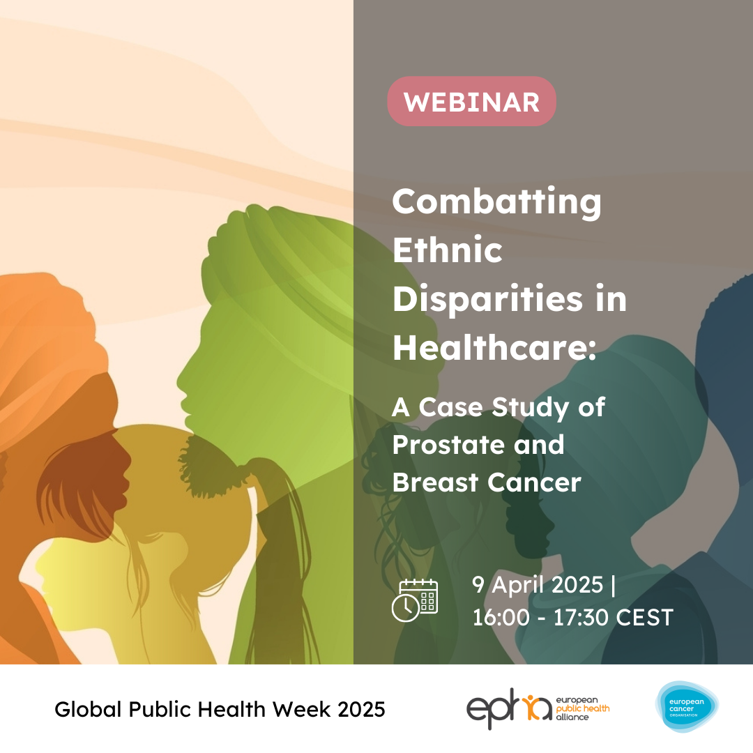
Ethnicity workstream
ECO, in collaboration with the European Public Health Alliance, hosted a webinar on 9 April 2025, as part of Global Public Health Week, titled Combatting ethnic disparities in healthcare: a case study of prostate and breast cancer
The discussion centred on sharing best practices and engaging the community, with contributions from experts in breast and prostate cancer, patient advocates, policy and stakeholder initiatives on diversity, equality and inclusion, as well as civil society representatives, all working to address ethnic inequities in cancer care in Europe and beyond.
For more information, please contact: alexandra.eni@europeancancer.org

Slide 15

Rural Cancer Care
What does cancer care look like in rural Europe?
📌 27% of Europeans live in rural areas - yet healthcare access remains unequal
📌 "Health workforce shortages are particularly severe in rural areas, further worsening healthcare access." – Health at a Glance 2024 (OECD)
Fewer specialists
Long travel distances
Workforce shortages
Economic and cultural barriers
Fragmented care (multiple appointments)
Literature shows that these challenges contribute to:
📈 Higher cancer incidence and mortality
The data gap:
🔍 Most studies on rural cancer care come from the US, Canada, and Australia
💡 Europe lacks tailored data and solutions

Slide 16
Rural Cancer Care
Closing the data and policy gap: next steps considered
STEPS
OUTCOMES
TIMELINE
(indicative)
1 | Literature review: Qualitative and quantitative data | 📖 Potential academic publication | Spring/ Summer 2025
 | Coalition-building: Stakeholder mapping and outreach | 👥 Stakeholder mapping
2 | Workshop: Cancer patients/representatives from rural areas, HCPs, researchers, regional health authorities | 👥 Creation of expert group | Summer/ Autumn 2025
3 | Policy research project Quantitative: Pan-European survey patients/citizen about rural cancer care issues Qualitative: Interviews and/or focus groups in specific regions | 📖 Potential second academic publication 🏛️Policy recommendations | Summer/ Autumn 2025- Summer/ Autumn 2026
4 | Policy report launch: at the European Cancer Summit 2026 | 🏛️Policy report 🏛️Policymakers’ engagement plan | November 2026
For more information and to be involved, please contact
juliana.desa@europeancancer.org

Slide 17
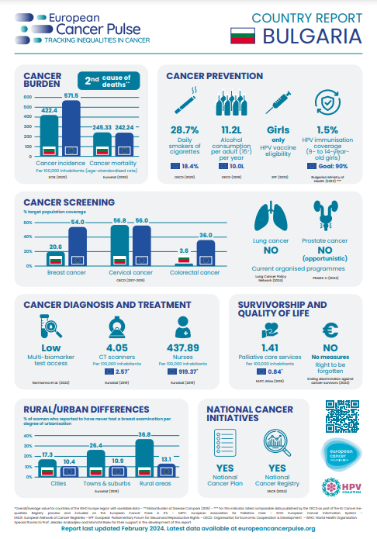
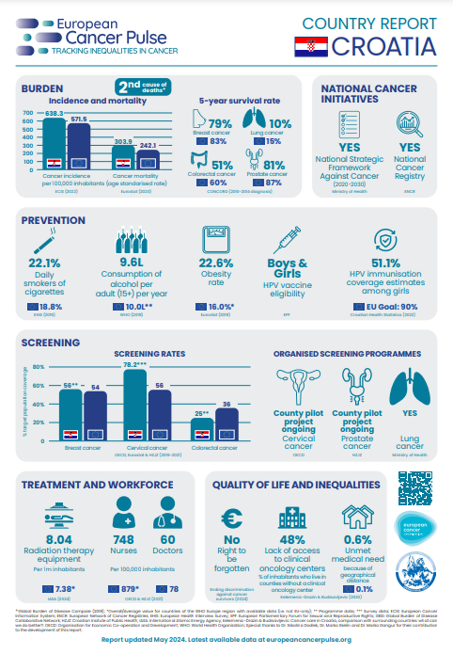
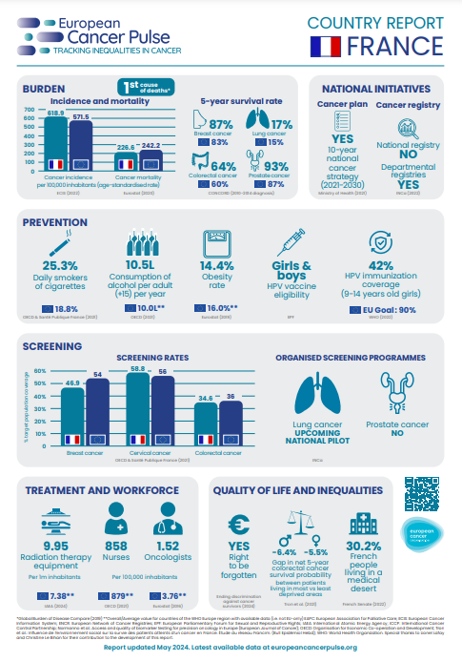
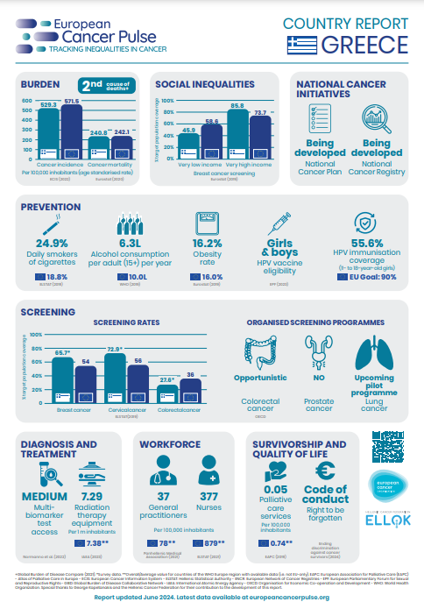
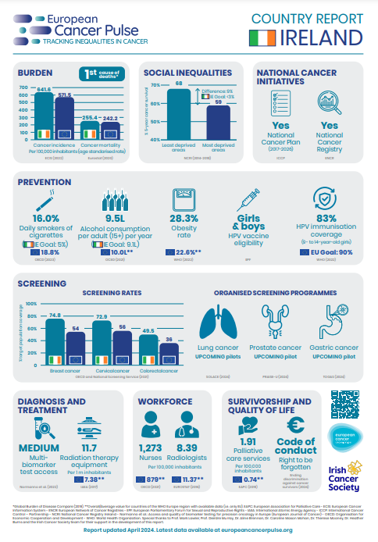
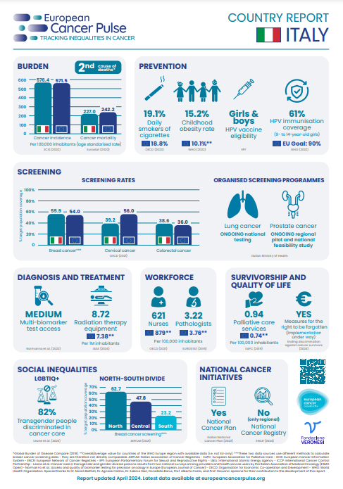
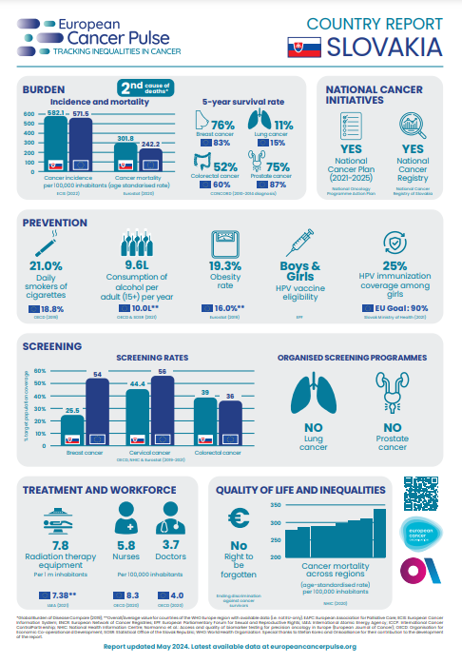
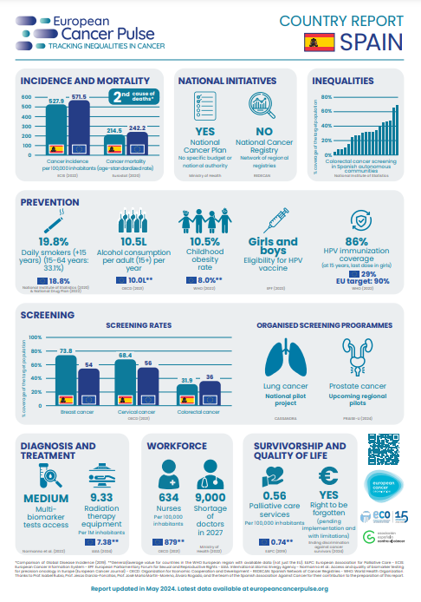
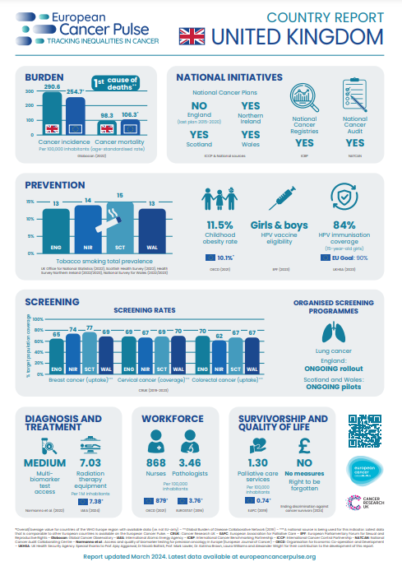
European Cancer Pulse
ECO’s data visualisation tool on cancer inequalities between and within European countries
2024 status:
  280+ indicators and 13,000+ data points included on the tool
  9 country reports developed as national factsheets of European Cancer Pulse data
  New Cancer Screening Policy Index benchmarking national progress based on European Cancer Pulse data

Slide 18
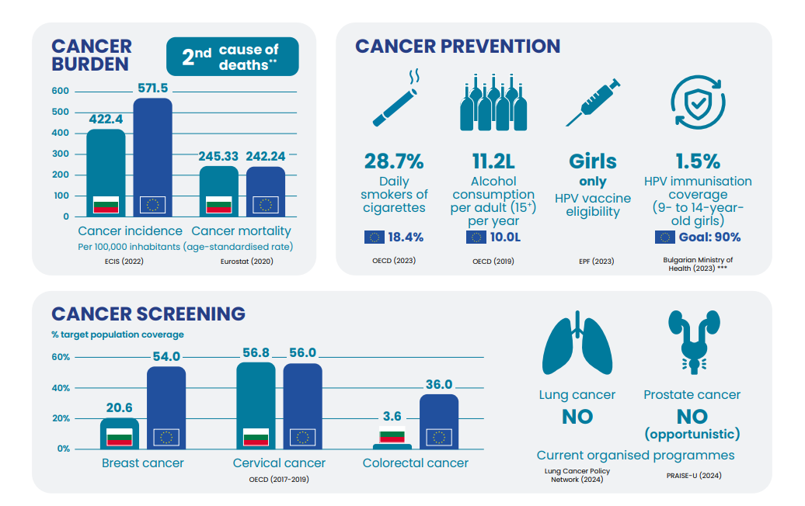
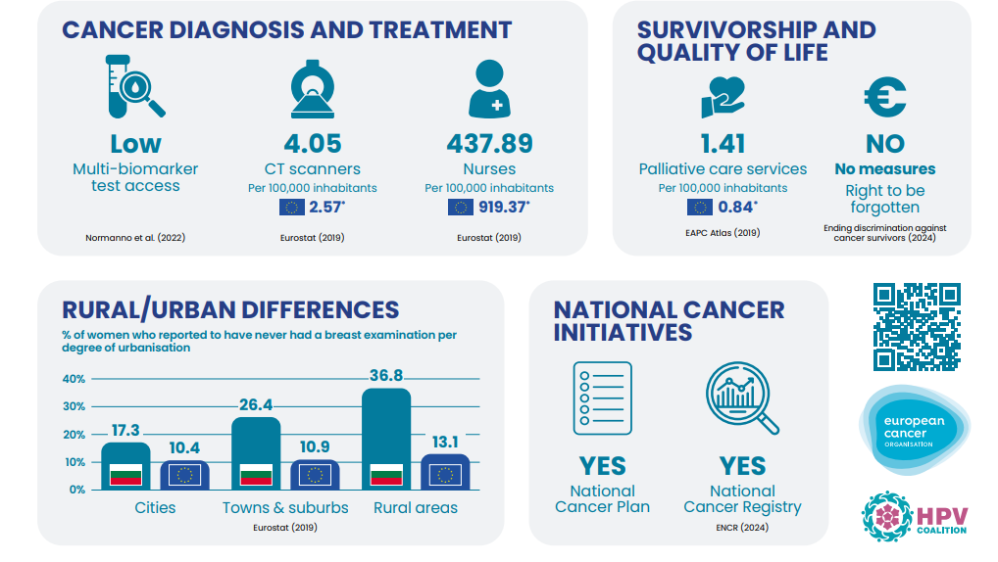
European Cancer Pulse
Country report - Bulgaria

Slide 19
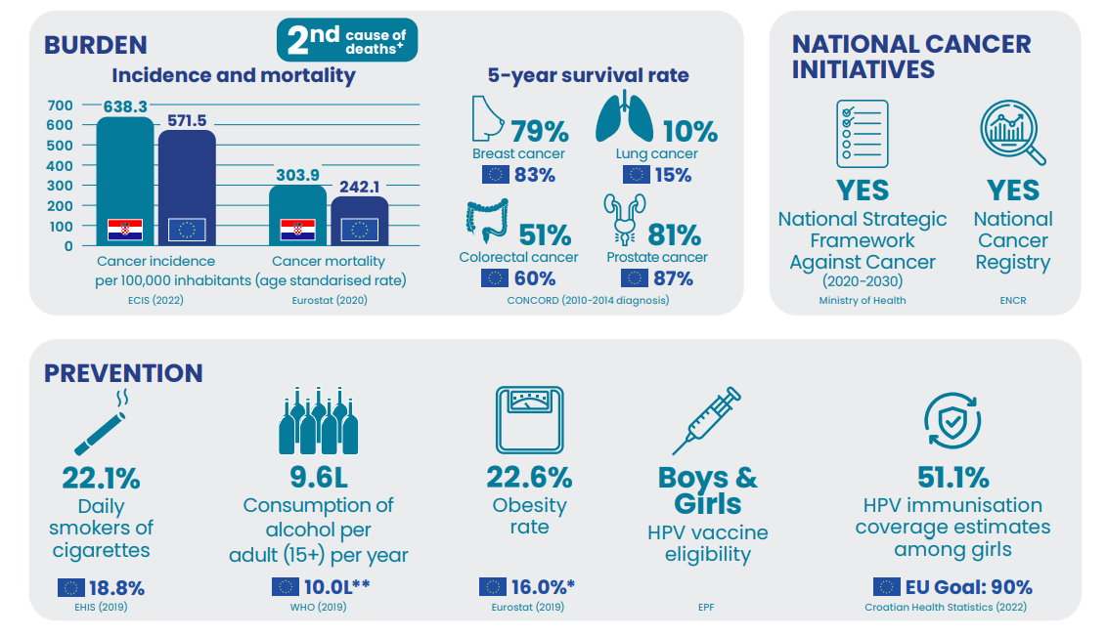
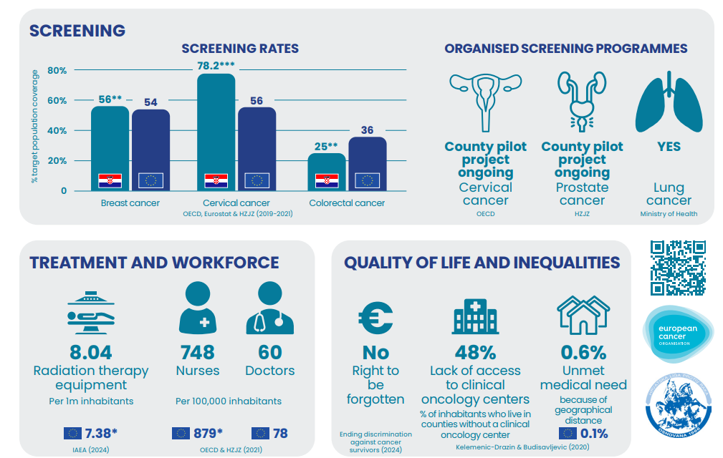
European Cancer Pulse
Country report - Croatia

Slide 20
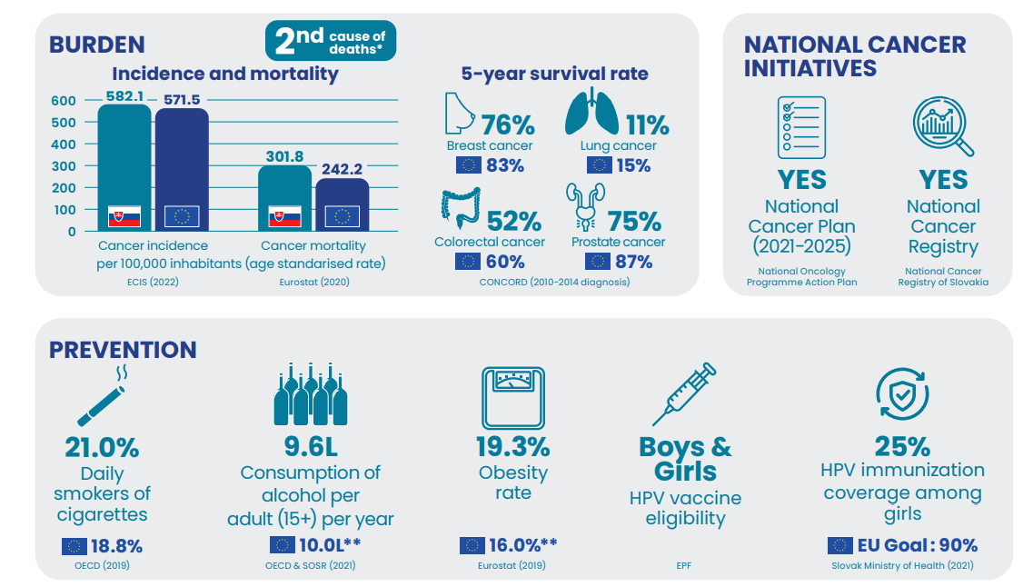
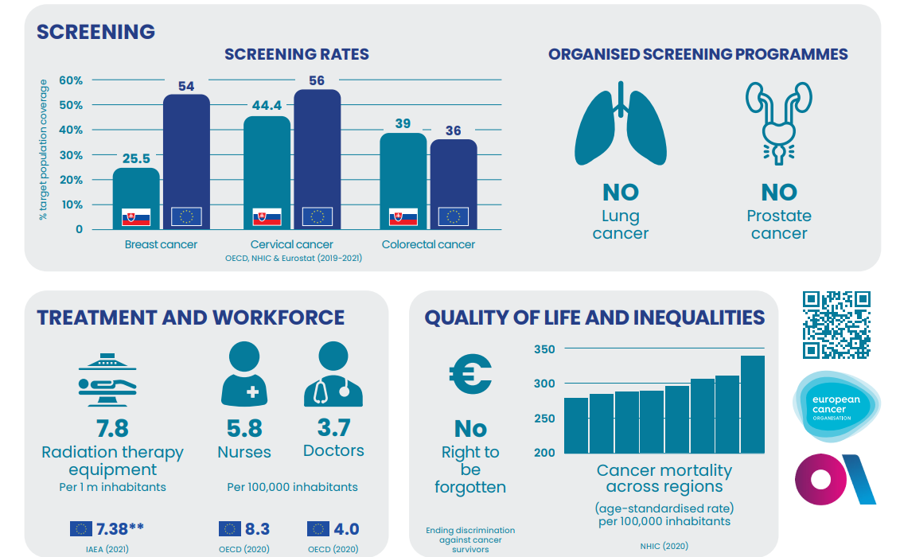
European Cancer Pulse
Country report - Slovakia

Slide 21
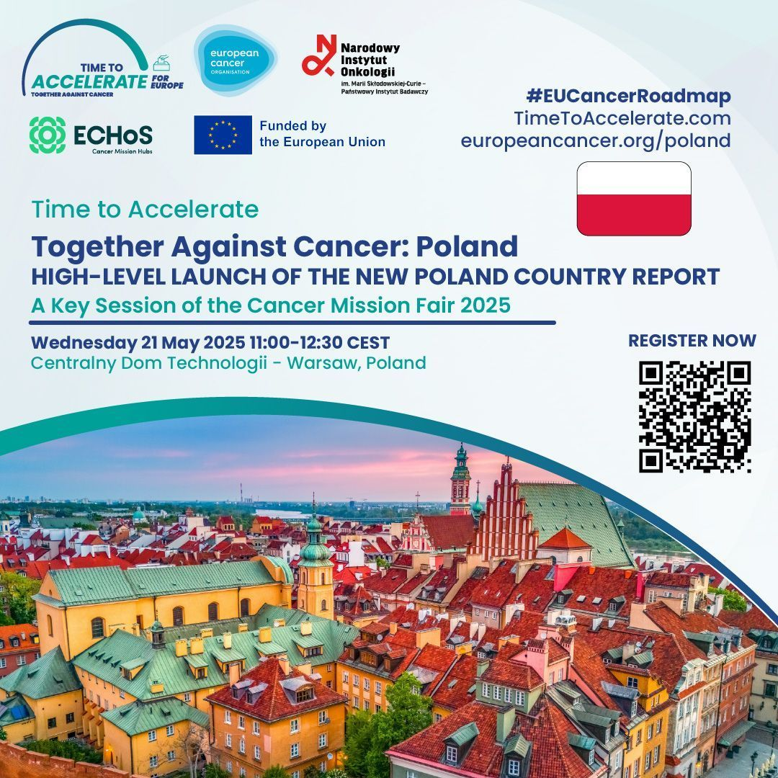
European Cancer Pulse
To be released in May - Country report - Poland

Slide 22
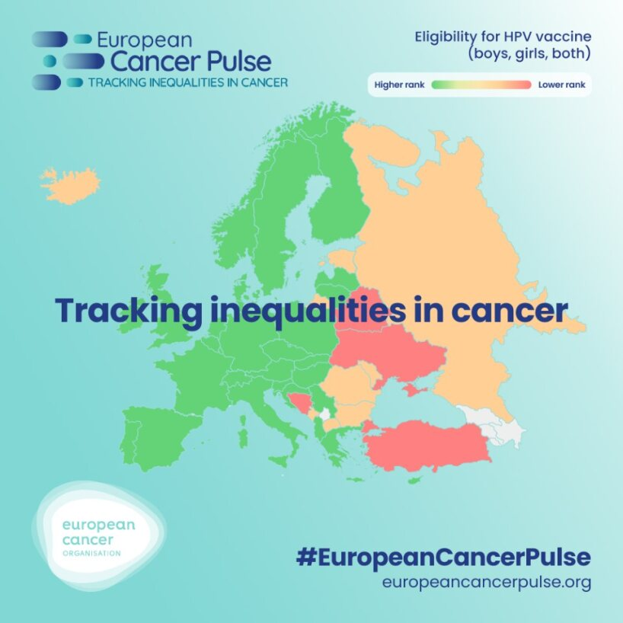
European Cancer Pulse
2025 plans:
  Update and upgrade of the European Cancer Pulse, including new functionalities (integration of policy indices, tracking indicators over-time, etc.)
  Four new country reports in connexion with ECO’s national activities
  New policy indices in connexion with ECO’s policy priorities
For more information, please contact:
juliana.desa@europeancancer.org

Slide 23



Thank you!
@nicolobattisti
nicolo.battisti@rmh.nhs.uk

