Slide 1

Hematologic Cancer Opportunities for Patient Equality (HOPE): Achieving Equitable and Timely Access to Hematological Cancer Therapies
PRACTICAL STRATEGIES FOR INNOVATING AND ENSURING EQUAL ACCESS TO NEW MEDICINES IN EUROPE
May 20th, 2025
Adam Sohn
Head of Patient Engagement Solutions
IQVIA
This study was produced independently by the IQVIA Institute for Human Data Science. Funding for this report was provided by AbbVie

Slide 2
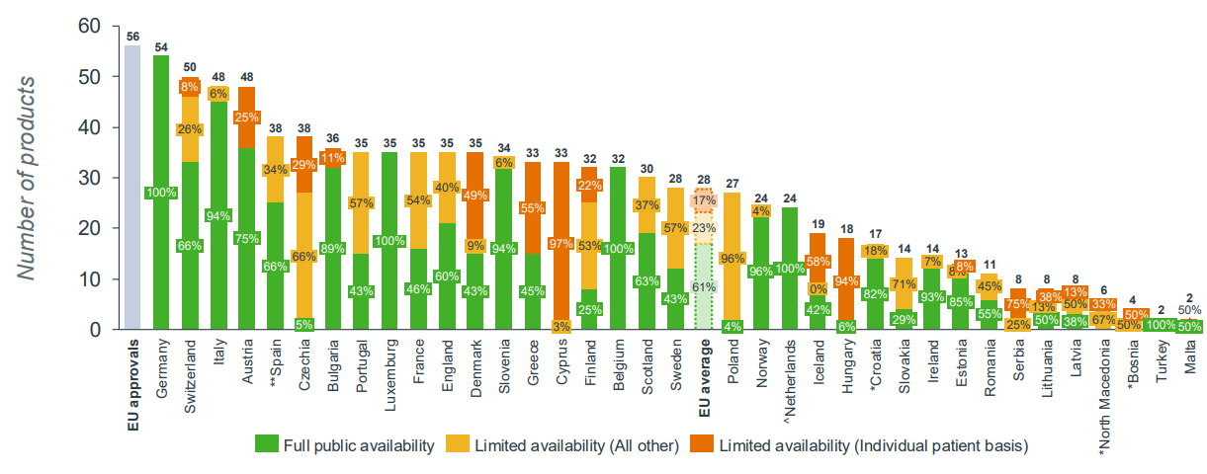
Patients W.A.I.T. (Waiting to Access Innovative Therapies) Indicator breakdown of availability, 2020-2023
Recent W.A.I.T indicator data signals persistent low availability of medicines in European countries
Source: EFPIA Patients W.A.I.T Indicator 2024 Survey, May 2025
Notes: The breakdown of availability shows the proportion of medicines available to patients in European countries as of as of 5th January 2025. For most countries this is the point at which the products gains access to the reimbursement list, with full availability, via individual patient schemes, or with other restrictions. European Union average: 80 products available (46%), Limited Availability (total) (37% of available products); ^Netherlands did not submit complete information on restrictions to available medicines meaning LA* is not captured in these countries. *Countries with asterisks did not complete a full dataset and therefore availability may be unrepresentative. **In Spain, the WAIT analysis does not identify those medicinal products being accessible earlier in conformity with Spain's Royal Decree 1015/2009 relating to Medicines in Special Situation.

Slide 3
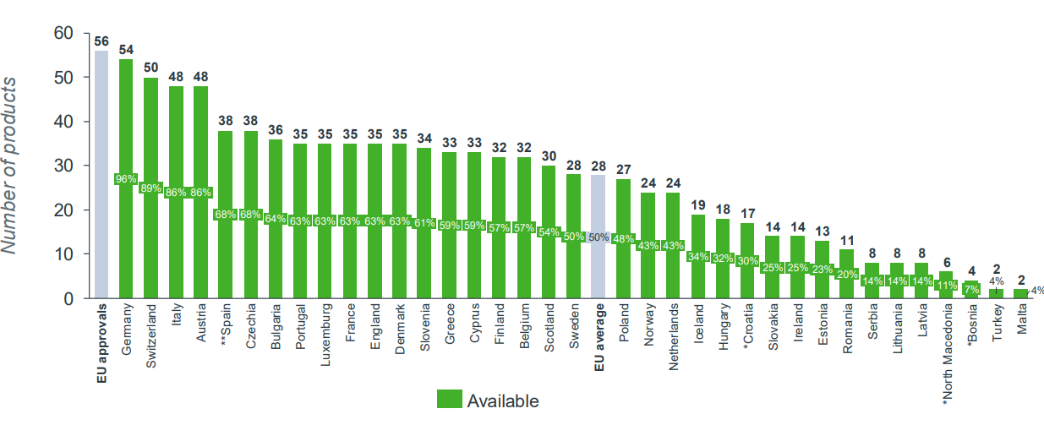
Patients W.A.I.T. (Waiting to Access Innovative Therapies) Indicator Oncology rate of availability, 2020-2023
Oncology therapy availability specifically remains below the EU average in Estonia, Lithuania, and Latvia
Source: EFPIA Patients W.A.I.T Indicator 2024 Survey, May 2025
Notes: The rate of availability, measured by the number of medicines available to patients in European counties as of 5th January 2025. For most countries this is the point at which the products gains access to the reimbursement list, including products with limited availability. European Union average: 28 products available (50%) *Countries with asterisks did not complete a full dataset and therefore availability may be unrepresentative. **In Spain, the WAIT analysis does not identify those medicinal products being accessible earlier in conformity with Spain's Royal Decree 1015/2009 relating to Medicines in Special Situations.

Slide 4
Select improvements to increase access to oncology care and reduce unmet need
Access to medicines should be top of mind for stakeholders because timely and equitable treatments impact patient outcomes
Enhancing early disease detection through improved screening technologies and broader access to preventative care
Increasing access to diagnostics to ensure eligible patients are correctly matched to the right treatments
Reducing geographical burdens by improving accessibility to medications and treatment centers
Adapting insurance and oncology therapy reimbursement processes to reduce delays in treatment authorization
Supporting additional health care system budgets geared towards increasing access to innovative medicines (where feasible)
Accelerating clinical trial enrollment opportunities to ensure broader patient access to innovative oncology therapies
Developing robust intellectual property (IP) frameworks to reward risk-taking and enable continued R&D

Slide 5

U.S. NASs in hematology-oncology launched 2014–2023 with indications including those granted after initial launch
Since 2014, more treatment modalities have become available across key hematology malignancies types and saved numerous lives
CLL/SLL
ALL
NHL
Treatment approaches have increasingly moved from broad systemic therapies / chemo
to precisely targeted interventions
AML
Hodgkin’s lymphoma
Immune checkpoint inhibitor
Antibody-drug conjugate
Bispecific antibody
Cell or gene therapy
PGx testing
Other targeted therapies
Non-targeted therapy
Full indication withdrawn
Subpopulation indication withdrawn
CML
Multiple myeloma
MDS/
CMML
Other/rare
Source: Global Oncology Trends 2024: Outlook to 2028. Report by the IQVIA Institute for Human Data Science.
Notes: US NAS launch information was used as a proxy for comprehensive global availability of therapies given market maturity. Products may be approved for more than one indication within each type of cancer but are only represented once in each tumor area.

Slide 6
Hematological cancer clinical trial starts Phase I to III, by primary tested drug type, 2014–2023
Several different modalities are being studied through clinical trials to address unmet needs in treating hematological cancers
Source: Global Trends in R&D 2024: Activity, Productivity, and Enablers. Report by the IQVIA Institute for Human Data Science

Slide 7
Regulatory approval status for hematology cancer therapies, 2014-2022
Several hematology cancer therapies that launched globally are not approved in the countries in-scope
-45%
-55%
-61%
-70%
Source: Hematologic cancer Opportunities for Patient Equality (HOPE): Geographic Disparities in Access, Reimbursement and Hematology Therapy Utilization. Report by the IQVIA Institute for Human Data Science 2024, IQVIA Institute Dec 2023
Note: Australia access data captured as reimbursed and not available only. There are 58 total globally launched NASs , 2 NASs removed from analysis given limited reimbursement information across EU

Slide 8
Reimbursement status for hematology cancer therapies with market authorization, as of 2023
POL, LVA, and LTU, have the lowest full availability rates in the EU
# of products with
market authorization
31
31
31
31
31
31
31
31
31
31
31
# of reimbursed
products
25 | 25 | 20 | 19 | 16 | 14 | 14 | 13 | 11 | 10 | 5
Full availability | Limited availability | Only available privately | Not available
Source: Hematologic cancer Opportunities for Patient Equality (HOPE): Geographic Disparities in Access, Reimbursement and Hematology Therapy Utilization. Report by the IQVIA Institute for Human Data Science 2024, IQVIA Institute Dec 2023
Note: Australia access data captured as reimbursed and not available only. * There are 58 total globally launched NASs, 2 NASs removed from analysis given limited reimbursement information across EU. In Italy,Carvykti (ciltacabtagene autoleucel) temporarily received a C(nn) reimbursement class. This reimbursement class is used for drugs which have received market access but are pending a decision on reimbursement status (Balduzzi law).

Slide 9
Hematology/oncology median time from approval to reimbursement, as of 2023
Median time to availability is the highest in EST and POL at 1046 and 1106 days respectively
average
# of reimbursed
products
25 | 25 | 16 | 20 | 17 | 14 | 14 | 13 | 5 | 10 | 11 | 19
# of products with market authorization
31
Source: Hematologic cancer Opportunities for Patient Equality (HOPE): Geographic Disparities in Access, Reimbursement and Hematology Therapy Utilization. Report by the IQVIA Institute for Human Data Science 2024, IQVIA Institute Dec 2023
Note: Time to availability is the days between marketing authorization and the date at which the product gains access to the reimbursement list. For Canada, time to availability is captured as the days between marketing authorization and availability of the product to 100% of the population.EU median is inclusive of 27 EU countries.* Only average time to availability captured for Brazil (pub) given data availability for only 2/3 products in the public channel. ^Canada only includes those products which had reimbursement for 100% of the population.

Slide 10
Difference in oncology median time to availability from solid to hematological malignancies
In ROU and POL, hematology drugs take more than 300 days longer to be reimbursed compared to solid tumor drugs on average
Time (days)
Hematology median time to availability is longer than solid
Solid median time to availability is longer than hematology
Source: Hematologic cancer Opportunities for Patient Equality (HOPE): Geographic Disparities in Access, Reimbursement and Hematology Therapy Utilization. Report by the IQVIA Institute for Human Data Science 2024, IQVIA Institute Dec 2023
Note: Time to availability is the days between marketing authorization and the date at which the products gains access to the reimbursement list. For Canada, time to availability is captured as the days between marketing authorization and availability of the product to 100% of the population. * Difference in time to availability for Brazil calculated using averages given data availability for only 2/3 products in the public channel.

Slide 11
Reimbursement rate for hematology/oncology NAS with market authorization by clinical data submission type
A higher proportion of heme drugs approved based on Phase III trials are reimbursed compared to those based on Phase I or II
# of products with market authorization
EU countries
14
17
14
17
14
17
14
17
14
17
14
17
14
17
14
17
14
17
14
17
14
17
Rate of availability(%)
# of reimbursed products
25 | 20 | 25 | 14 | 13 | 14 | 16 | 11 | 10 | 5 | 19
Full availability | Limited availability | Only available privately | Not available
Source: Hematologic cancer Opportunities for Patient Equality (HOPE): Geographic Disparities in Access, Reimbursement and Hematology Therapy Utilization. Report by the IQVIA Institute for Human Data Science 2024, IQVIA Institute Dec 2023
Note: Time to availability is the days between marketing authorization and the date at which the products gains access to the reimbursement list. For Canada, time to availability is captured as the days between marketing authorization and availability of the product to 100% of the population. * Difference in time to availability for Brazil calculated using averages given data availability for only 2/3 products in the public channel.
Notes:
This slide conveys a crucial message about the limited early (Ph1, Ph2) clinical data assessment possibilities in some countries, such as BG, LT, LV, and EE. These limitations are due to either (1) very strict or even impossible clinical data requirements or (2) manufacturers choosing not to submit the P&R dossiers, which significantly delays access to innovative treatments compared to other EU countries.

Slide 12









Factors contributing to access and reimbursement hurdles for heme drugs with most delays
Trial methodology and clinical efficacy outcome are the main factors that contribute to hematology drugs access hurdles
What are the factors influencing delays in access and reimbursement? |  | France | Spain | Greece | Lithuania | Italy | Romania | Bulgaria | Ireland | Poland
 | Clinical trial methodology | 1 | 1 |  | 1 | 1 |  |  | 1 | 1
 | Efficacy outcome | 1 |  |  | 1 |  |  |  | 1 | 1
 | HE analysis methodology | 1 |  |  |  |  |  |  | 1 | 1
 | Trial comparative data |  | 1 |  | 1 |  |  |  | 1
 | Overall budget impact |  |  |  |  |  | 1 | 1
 | ICER level |  |  |  |  |  |  |  | 1
 | Safety outcome |  |  |  | 1
 | Quality of life outcome | 1
 | Other |  |  | 1
Most influencing
Least influencing
Factors most critiqued by health authorities during the access process of drugs included in the analysis with the longest delays
Source: Hematologic cancer Opportunities for Patient Equality (HOPE): Geographic Disparities in Access, Reimbursement and Hematology Therapy Utilization. Report by the IQVIA Institute for Human Data Science 2024, IQVIA Institute Dec 2023
Note: Factors influencing delays in access and reimbursement are assessed in each markets for products with the longest time to availability
.
Notes:
Note - While Estonia and Latvia assessment not available in the report, numerous hurdles contribute to access and reimbursement delays, and the lack of budget is one of the main hurdles..

Slide 13
Hematological cancer novel active substance (NAS) defined daily dose (DDD) per capita, 2023
Wide variation exists in per capita use of novel medicines for hematological cancers
Key considerations
Despite hematological therapy reimbursement in the countries in scope, several factors may limit drug utilization
These include:
  Lack of country level clinical guidelines and proper patient referral pathways
  Lack of access to diagnostics
  Capacity and infrastructure constraints to deliver innovative therapies
  Geographical distances to appropriate treatment centers
Source: Hematologic cancer Opportunities for Patient Equality (HOPE): Geographic Disparities in Access, Reimbursement and Hematology Therapy Utilization. Report by the IQVIA Institute for Human Data Science 2024, IQVIA Institute Dec 2023

Slide 14
Key summary
Global cancer and hematologic burden is projected to increase dramatically by 2050
Advancements in lifesaving therapies are already here with further innovation expected in the near future
Without change, disparities across markets could only grow wider with time
Barriers to improving access are varied and yet many hurdles have the potential to be mitigated
Supporting innovation in oncology today and tomorrow has real potential to deliver meaningful outcomes
There is an opportunity to adopt a long-term vision that positions sustained investment in healthcare as a key to national strength
Source: Hematologic cancer Opportunities for Patient Equality (HOPE): Geographic Disparities in Access, Reimbursement and Hematology Therapy Utilization. Report by the IQVIA Institute for Human Data Science 2024,

Slide 15
A call to action to ensure access to hematology-oncology therapies in Europe and beyond
Evolve current value assessment and pricing approaches for hematology-oncology therapies
  Once tumor-relevant endpoints have been standardized, the HTA review process should incorporate and adapt these endpoints during the value assessment exercise.
Coordinate health system readiness alongside regulatory and reimbursement evaluation of hematology-oncology therapies
  As novel therapies are entering the market, it is imperative that health systems have infrastructure and capacity in place to administer these therapies to patients.
Ensure patient representation in key decision-making process
  E.g., HTA Process: Involving patients and patient organizations in the HTA process is crucial, as access to hematological cancer therapies impacts not only patient outcomes but also their overall wellbeing and ability to contribute to society.

Slide 16

Thank you
Scan QR code to access full report

