Slide 1
Media Manipulation
Indrė Makaraitytė, journalist

Slide 2
Public and Commercial Media
No pressure from business
Pressure from the Government
No pressure from public
Pressure from from business
Political impact through advertising
Readers and viewers are the main voters

Slide 3
Real Impact to the content
News: less politics, more fun
TV news starts with…
where you can buy a better coffee
Mixture of politics, investigative journalism and soft information
next to the article about NATO there is an advice about sex positions
Manipulations with the content

Slide 4
MANIPULATIONS

Slide 5
Game of headlines
High position to the topic someone thinks it is more important
Hiding important information in a flow of other information
Using informational noise

Slide 6
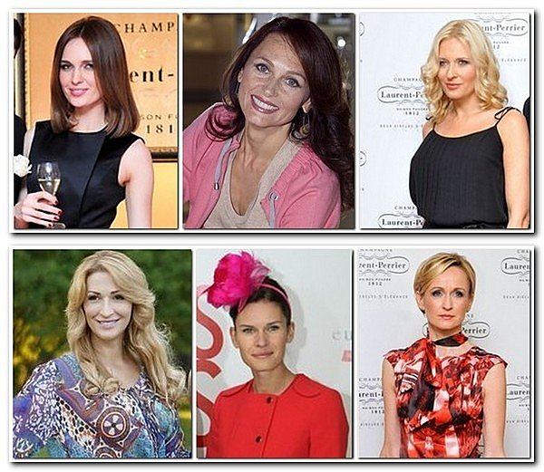
Daina Bosas – the icon of soft media
D. Bosas: „My husband wouldn‘t like me going out with girlfriends“
D. Bosas: „No compromises: either sea or sea “
D. ir A. Bosas celebrate wooden weddings

Slide 7
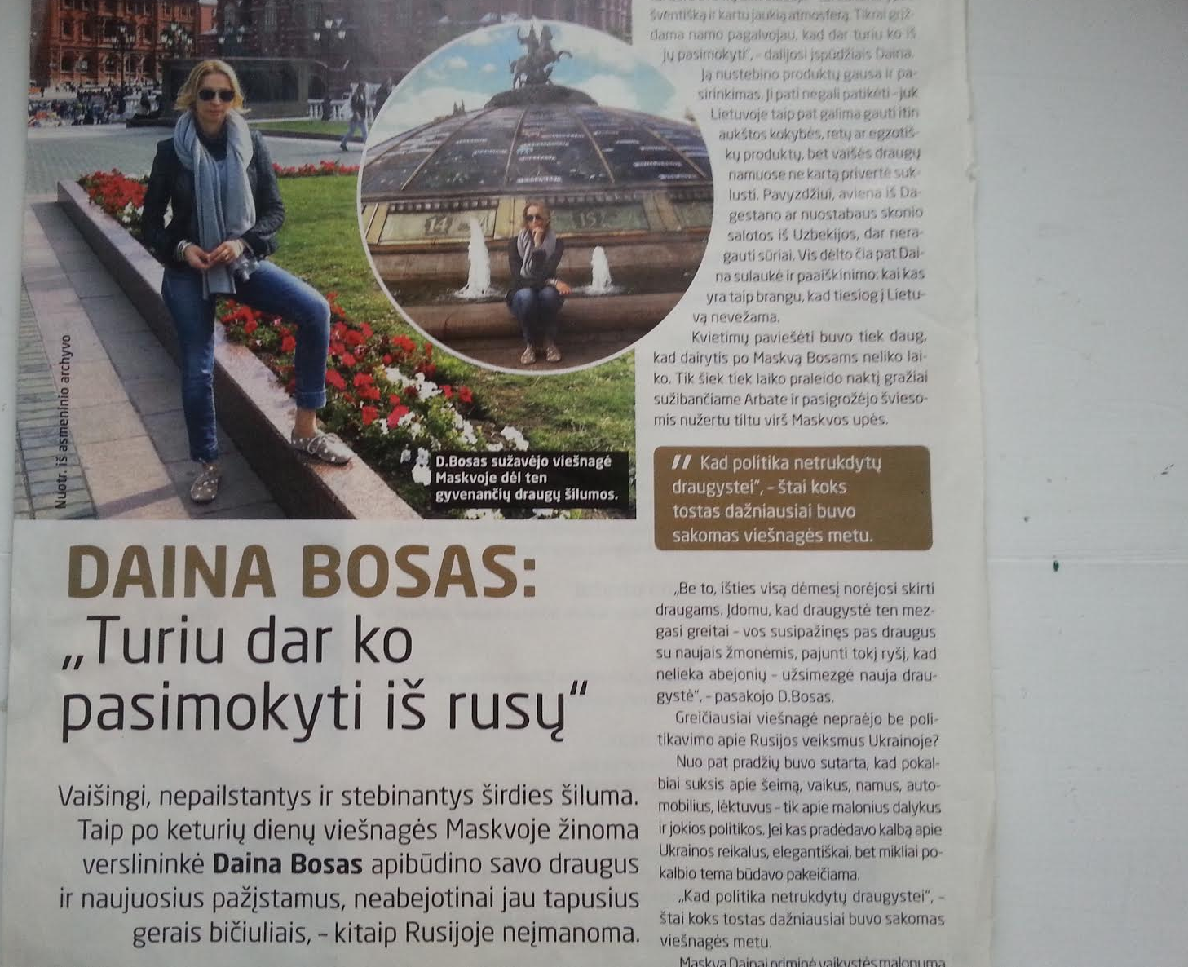
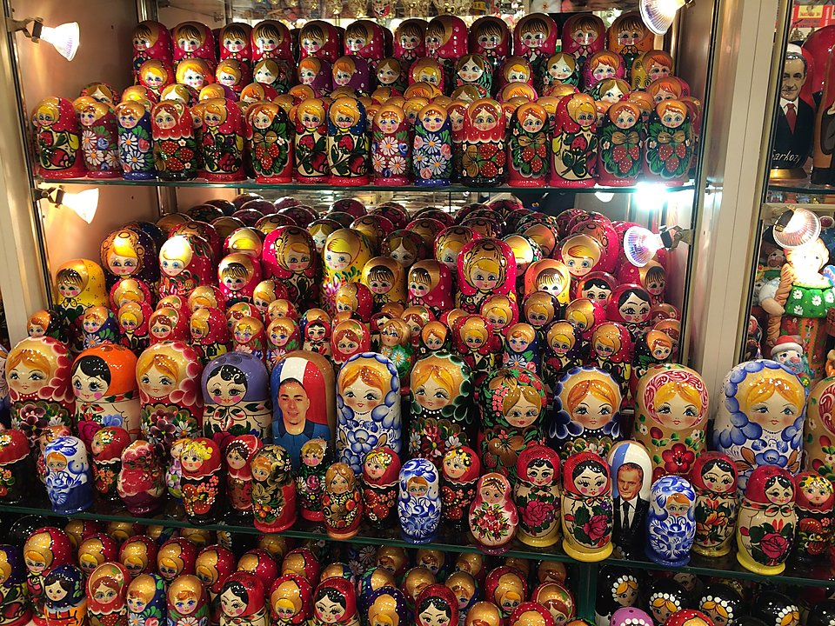
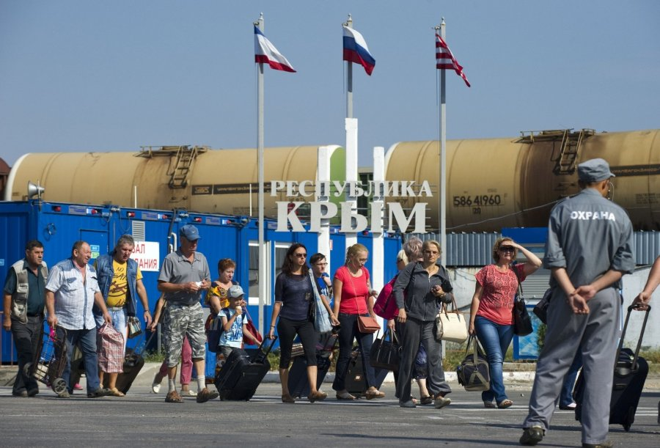
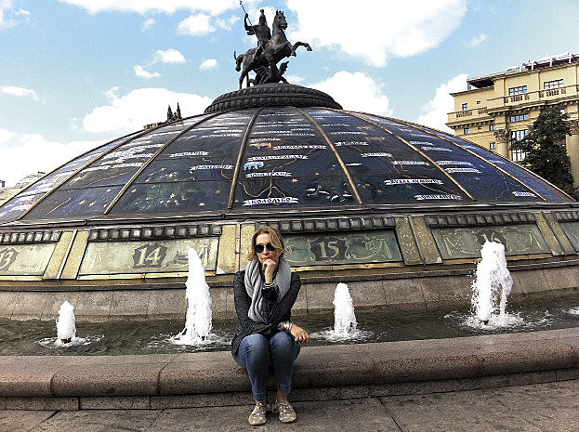
D.Bosas: „I have what to learn from Russians“
Article about visit to Moscow
April 2014
Occupation of Crimea
March 2014

Slide 8
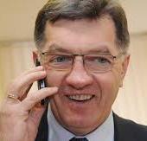
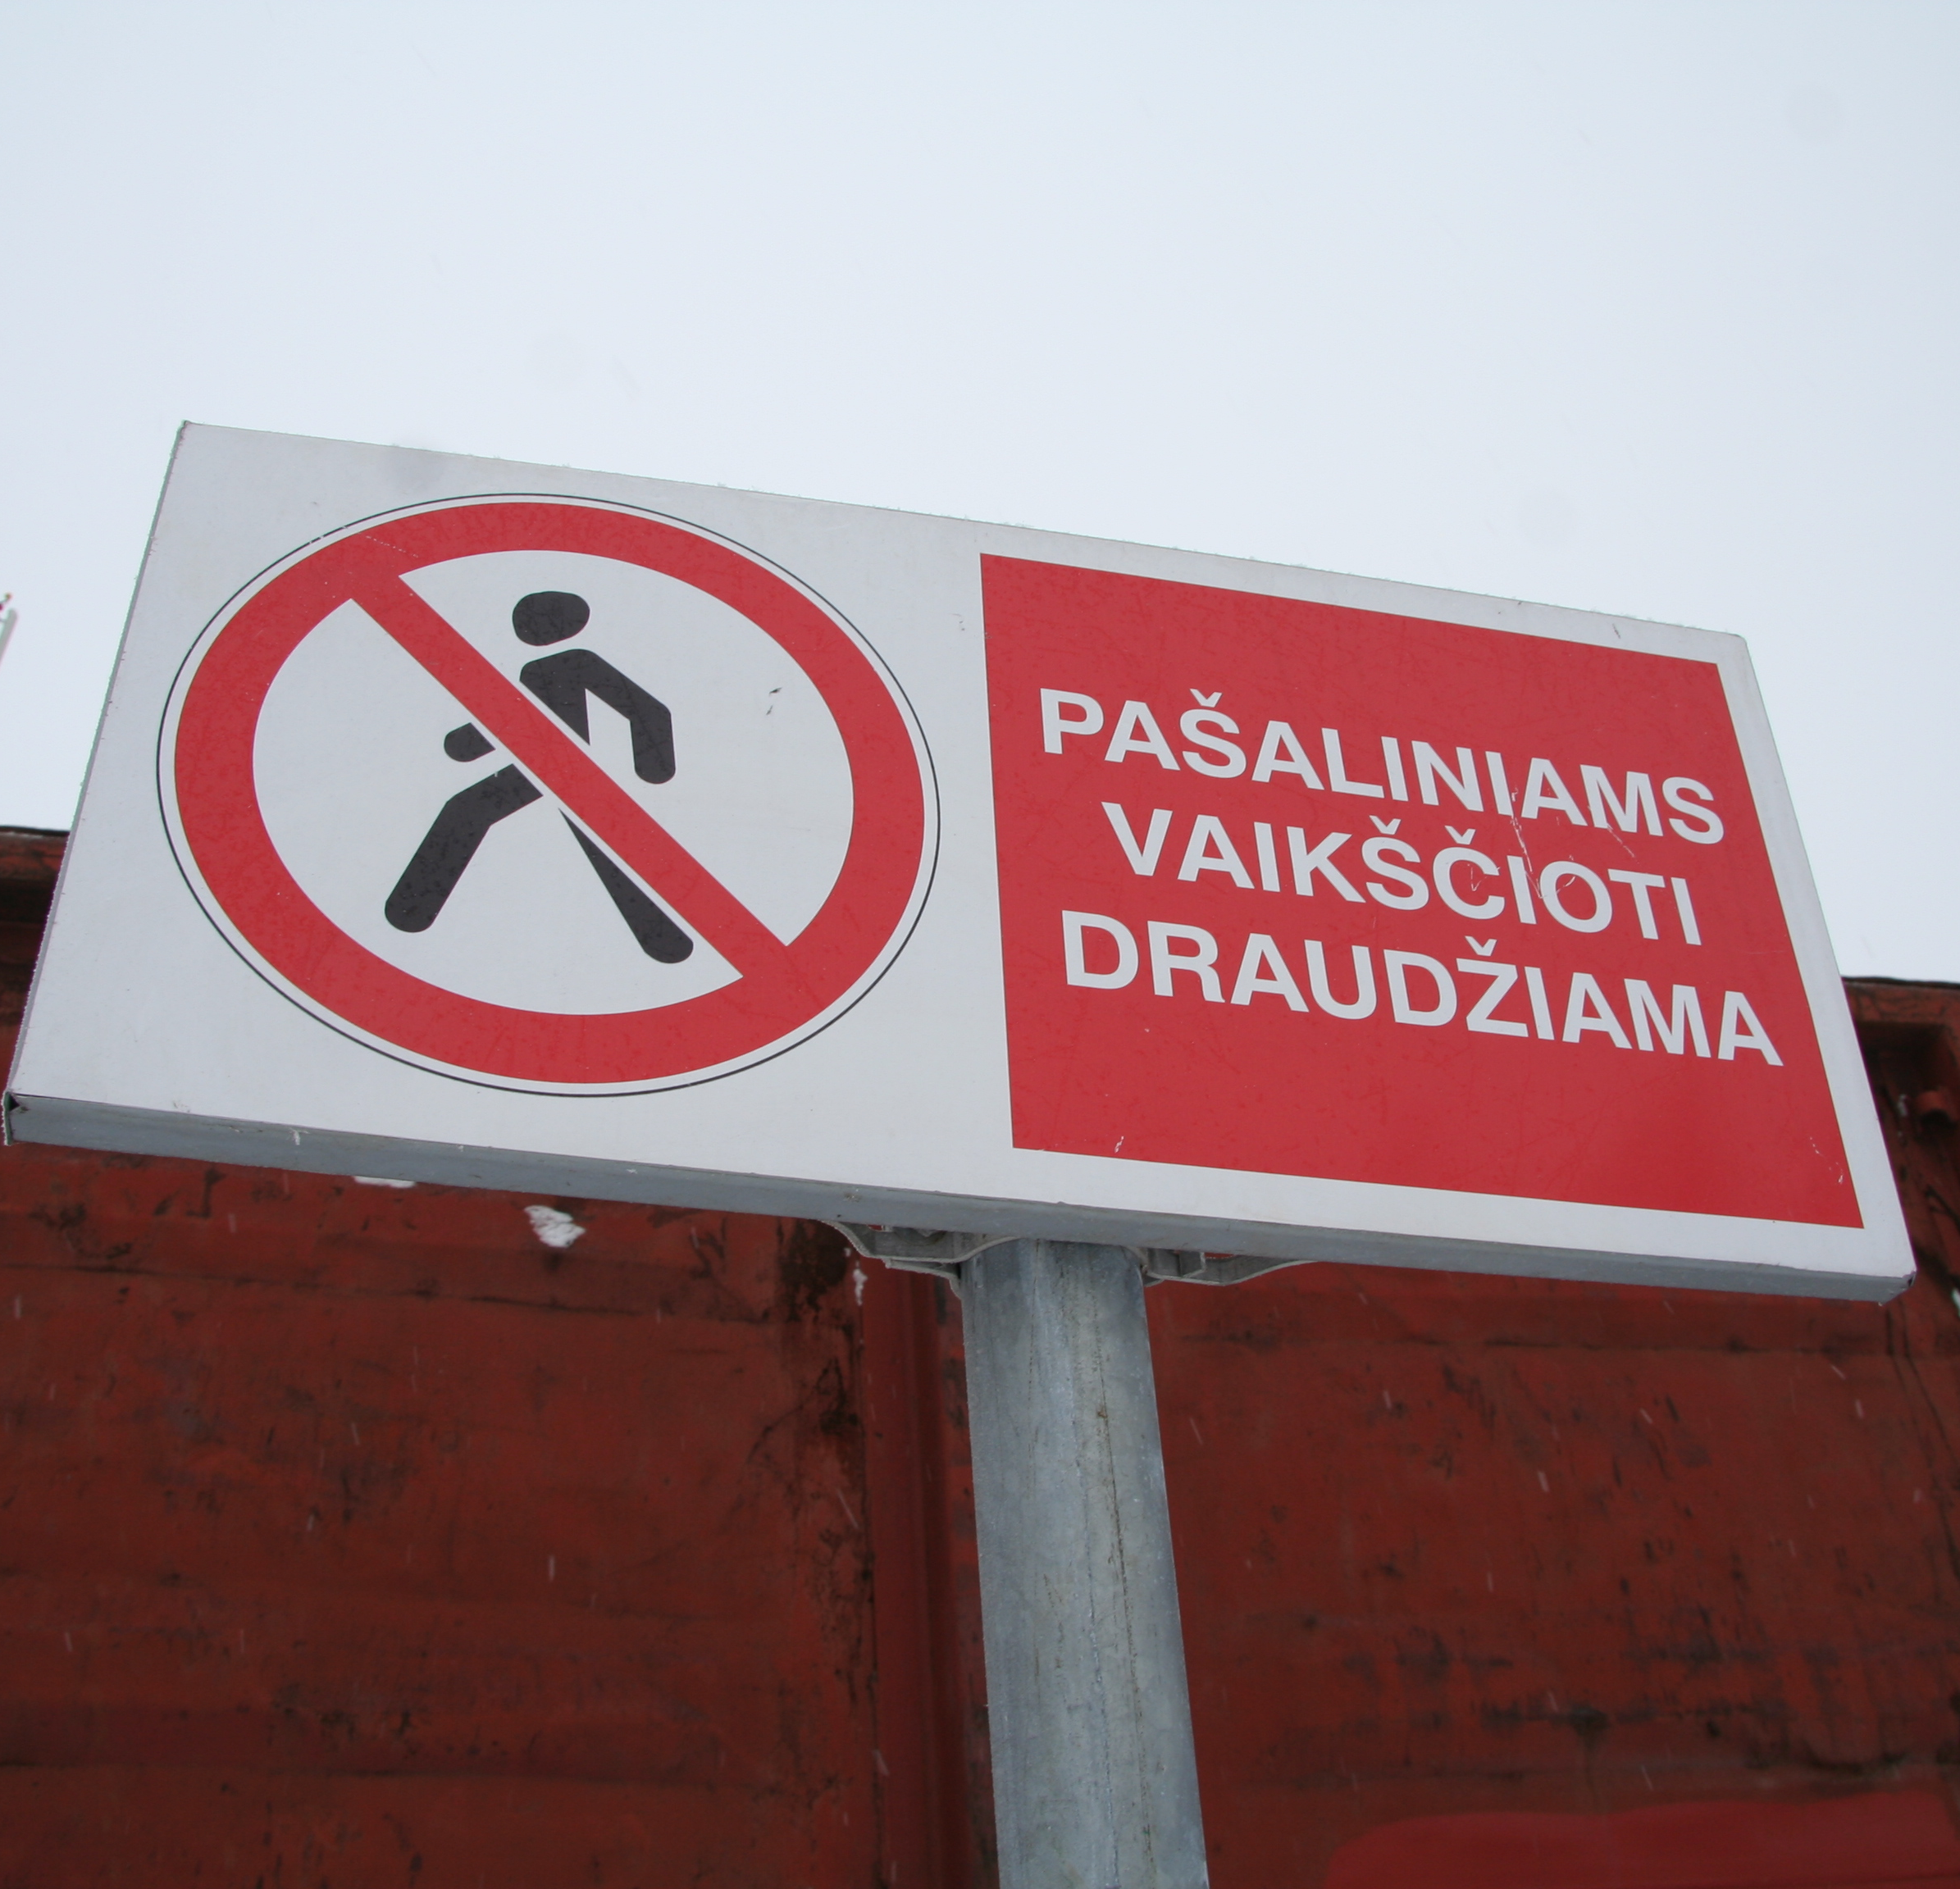
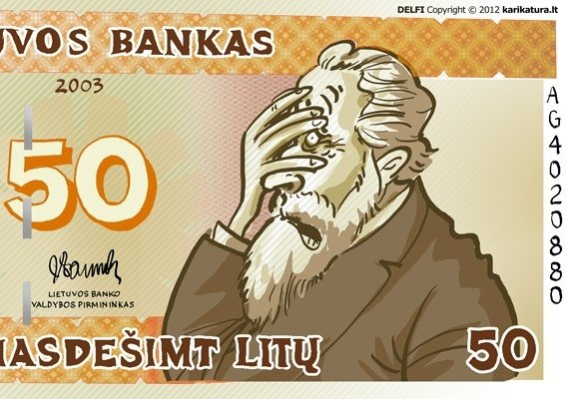
Who can change media content?
Keep calling and you will win
Control of information
EU money, business interest, media interest

Slide 9
Russian and Polish Minority
Less politics, more fun
More internet, less newspapers and TV
English is better than Russian

Slide 10
Thank YOU

