Slide 1
Transforming care for children
JAN PFEIFFER
European DI Expert Group
member of
CPT Council of Europe

Slide 2
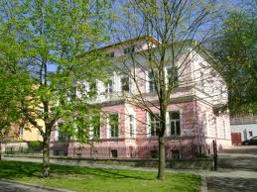
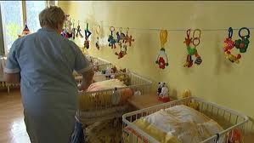
Arguments for change
Emotional neglect and lack of specific components of relations with a primary caregiver are the factors causing damage of children’s development.
Institutional care is a violation of right of children under three years of age
Institutional care for children is much more costly then its alternatives.
The harm caused to children from spending substantial parts of their childhood in care inevitably has consequences for society as a whole. The human, social and economic costs of denying children’s rights to live in family environment are enormous and unacceptable.

Slide 3

Legal framework
UN Convention on the Rights of the Child (CRC) 1989. (Articles 9 and 20 CRC) Right not to be separated from family and rights of children deprived of family environment.
UN Convention on the Rights of Persons Disabilities (CRPD).
WHO European Declaration on Health of Children and Young People with Intellectual Disabilities and their Families
Council of Europe Recommendation on deinstitutionalization and community living of children with disabilities
UN Guidelines on the Alternative Care of Children. (Adopted by 2009 when the UN General Assembly) .

Slide 4
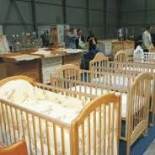
Paragraph 21:
“In accordance with the predominant opinion of experts, alternative care for young children, especially those under the age of three years, should be provided in family-based settings. Exceptions to this principle may be warranted in order to prevent the separation of siblings and in cases where the placement is of an emergency nature or is for a predetermined and very limited duration, with planned family reintegration or other appropriate long-term care solution as its outcome.”

Slide 5
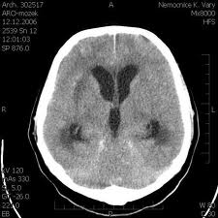
Damaging effects of early institutional care
Goldfarb (1945) and Bowlby (1951)
The pioneering publications about the damaging effects of early institutional care for the social and behavioral development of children as well as for their cognitive development.
Johnson, Browne and Hamilton-Giachritsis (2006) Quality of development of structures of the human brain is closely related with the quality of human relations in early childhood.
The Bucharest Early Intervention Programme (2009)
Compared the developmental capacities of children raised in large-scale institutions with non- institutionalized and fostered children

Slide 6

Cost effectiveness
Analyses of children of all ages in Romania, Ukraine, Moldova and Russia show that institutional care is:
6 x more expensive than providing social services to vulnerable families or voluntary kinship carers.
3x more expensive than professional foster care
2x as expensive as community residential/small group homes.
Analyses of data from 13 countries in Western and Central Europe demonstrated:
Institutional care was twice as expensive as foster care for young children with disabilities.
Three times more expensive than foster care for young children without any disabilities.

Slide 7
Basic principles of care
Best interest of the child has to be always on a first place.
Family is only natural environment for a grow of human being.
All children have to live with their family, if not it is extreme exception and family links has to continue.
Parents are primary responsible for care of their children.
State is responsible to support a family to be capable to care.

Slide 8
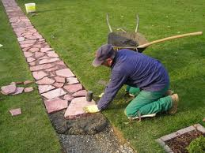
Steps on a way to a change
Experiments alternatives
Neglection of the problem
Scandals
Natipnal platform for change
DI pilot projects
National policy
National action plane
General condition for the change
Pilot project
National vide change of the system

Slide 9
De-institutionalization initiatives
EU Ad Hoc Expert Group
Report on Transition of institutional to Community Based Care (2009)
Trainings of DGRegio- DG Empl
Intervention in the countries
Guidelines and toolkits on DI
EU Office HCHR
Forgotten Europeans – Forgotten Rights(2010)
Structural Funds and Human Right. April-May 2012. Brussels.
Sub-Regional Workshop on Rights of Children Aged 0-3 Years. 22 November 2011. Prague
UNICEF
Report At Home or in a Home (2011)
UNICEF and OHCHR Call to Action: End placing children under three years in institutions together with( 28 June 2011)

Slide 10

    UNICEF’s Call to Action: END PLACING CHILDREN UNDER THREE YEARS IN INSTITUTIONS
The 5 core interventions:
Legislative changes limiting to last resort, and setting strict conditions for, the placement into institutional care of children below three years;
Allocation of resources giving priority to the development of appropriate local services allowing alternative solutions for children below three with special attention to the needs of children with disabilities;
Proper budget allocation for supporting vulnerable families through the development of appropriate family-based responses and services;
Capacity-building and standards of practice for maternity ward and paediatric hospital staff to support parents of newborns with a disability and parents from most vulnerable groups, in order to discourage institutionalisation;
Partnership with media and civil society to promote social inclusion of children deprived of parental care and children with disabilities.

Slide 11

Crossroad
Changing a view
Gate keeping system
Cat pipelines to institution.
Close down institutional capacity

Slide 12
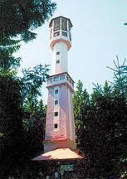
Changing a view on
What is “Best interests of the child”.
Parents’ ability to care for and ‘keep’ their children.
People with certain lifestyles
Myths about foster care
Defectology model
Myths of “Good” institutions

Slide 13

Gate-keeping system
Comprehensive methods for assessment and diagnostic tools .
Objective multi-disciplinary decision-making process.
Referral to appropriate services .
Regular review of cases.

Slide 14

Cat pipelines
Policies promotes family life and helps parenting
Access to quality general service as health, housing.
Services which helps to overcome short-term difficulties in parenting
Services tailored to the specific needs
To target at-risk groups or individuals with particular care problems.
Improving early intervention to mitigate the effects of a disability
Contact between the pregnant woman and the care system
Development of child-centered and family-focused services

Slide 15
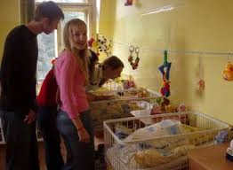
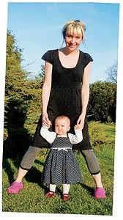
Elements of transformation of institution
Awareness of all stakeholders
Analysis of the existing general situation, needs and resources
Planning of needed alternative services
Preparation staff and children for moving on
Moving staff and children to new services
Monitoring and evaluation
Logistic

Slide 16
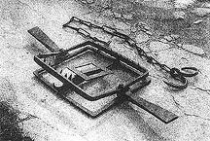
Traps
Investment to institution
Parallel services
Closure without alternative
Alternatives with institutional culture

Slide 17
Shift from de-institutionalization to child care reform
REGULATORY FRAMEWORK
BUDGET
EDUCATION
HEALTH
SOCIAL WELFARE
SECURITY
JUSTICE / COURTS
CAPACITIES
RESPONSE, REINTEGRATION – ALTERNATIVE CARE
PREVENTION
FAMILY SUPPORT / EARLY INTERVENTION
GATE KEEPING
ADMINISTRATION OF JUSTICE
DETECTION - REPORTING
SUPERVISORY BODIES
RESEARCH AND DATA ANALYSIS

Slide 18
Deinstitutionalisation
Requires a number of general actions to support the strategic approach at national level involving all stakeholders.
Deinstitutionalisation being a long-term process, a well-planned and structured transition process is necessary.
The planning should involve government representatives covering all policy areas that affect the lives of children with disabilities.

Slide 19
Main obstacles in DI of children
Renovation of buildings
Low political will for DI
Strong lobby of institutions, professionals
Not enough awareness in general public
Social and schooling problems as reason of I
Most vulnerable group are Roma families
Misconception of foster care
Gaps and fragmentation in the service system
Gate keepers / SW, L/ do not understand new approach

Slide 20
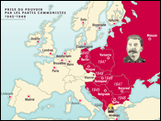
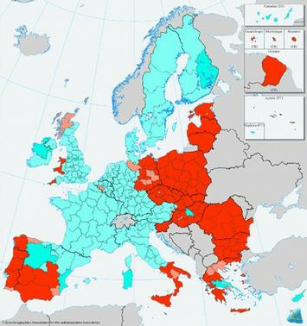
History counts
Europe and the Cold War
(1947-1991)
Structural Funds allocation
(2007-2013)

Slide 21
Importance of SF in DI process
Wrong use of SF can fixed institutional care and block development for many years.
Right use of SF can bring a changes which will most likely without it did not happened.
SF can help to start process more massively and can play a role of bridging fund.

Slide 22

Everybody needs
Think creatively
Act pragmatically
Feel as human being
Thanks for your attention

