Slide 1

Eloise Todd, Brussels Director, ONE
Development Cooperation: The Baltic Response
10 May 2013, Rīga
E

Slide 2
Key messages
Well spent aid, and other investments, are working: MDG progress is being made
2. EU aid, spent well, gets results
3. Despite this, overall aid levels have fallen, aid to Africa and SSA has plummeted and EU aid has been frozen
4. Baltic states increased aid between 2011-2012

Slide 3
EU development
ODA:
EU27+EU = world’s biggest donor
NON-AID: EU27+EU institutions create policy
EU 27:
Individual donors; 19% of aid via EU
EU institutions

Slide 4
MDG progress
ONE’s forthcoming Data Report (28 May) will show that investments in health, agriculture and education bring dramatic, positive progress towards MDGs
Ethiopia: 10 million lifted out of poverty
This progress is threatened by decreasing investment from EU partners

Slide 5
Baltic countries
Global ODA (EURm, 2012 constant prices)*
 | 2004 | 2011 | 2012 | Change 2004-12 | 2012 Global ODA/GNI
Estonia | 6 | 17 | 18 | 12 | 0.11%
Latvia | 8 | 13 | 16 | 8 | 0.08%
Lithuania | 9 | 36 | 40 | 31 | 0.13%
Average DAC EU12 |  |  |  |  | 0.10%
* Taken from EC press release on 3rd April 2013, on the "Publication of preliminary data on Official Development Assistance, 2012". Figures are inclusive of debt relief; for most EU 12 member states debt relief figures are negligible apart for the Czech Republic

Slide 6
EU as a whole

Slide 7
EU15 aid to Africa

Slide 8
Opportunities: EU development policy
Transparent, effective aid; improving results;
Strong % to Africa and increased poverty focus;
Increasing focus on catalytic interventions: Global Fund, GAVI, nutrition, agriculture
Efficient investment in multilateral mechanisms
Non-aid instruments

Slide 9
Challenges: EU development policy
Lack of DAC data
Frozen MFF: Member States must do more
Need to track more EU aid and map results
Euroscepticism
Do more of what works, especially GAVI, Global Fund, nutrition, agriculture

Slide 10
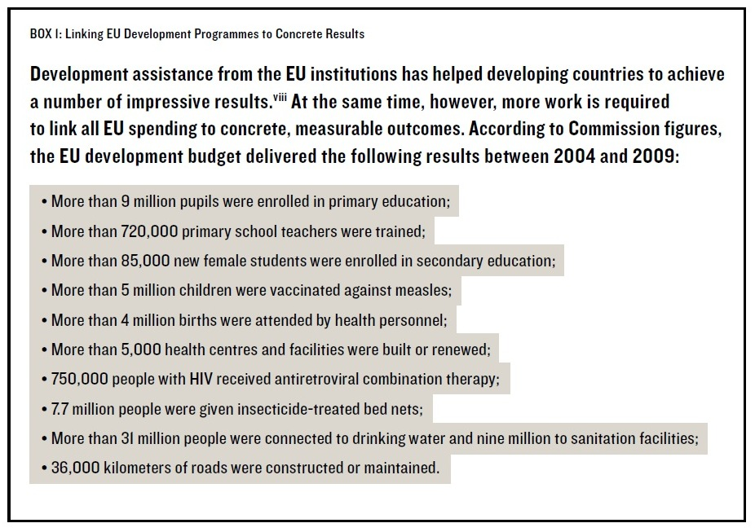
Results of EU aid

Slide 11
Recommendations
Baltic Member States:
  Use leadership on aid to shape EU agenda
  Keep up the positive trend on aid
  Report more information to DAC
  Support the Commissioner to invest in catalytic sectors
European Commission:
  Overhaul DG DEVCO (and EEAS) to focus on results
  Invest ambitious annual amounts in the Global Fund, GAVI and in nutrition: they get results
Notes:
Increase to Africa promise: Progress by EU as a whole
The EU has met only 22.5% of the collective target increases promised to the African continent by 2015. The EU15 will need to increase ODA by €20.62 billion between 2011 and 2015.
Between 2004 and 2011, the EU15 provided 36.2% of global ODA increases to Africa, whereas the non-European members of the DAC provided 55.8% of global ODA increases to the continent.

Slide 12
Thank you
Join us
one.org
DATA Report, 28 May: one.org/data

Slide 13
SSA drop for EU15
 | 2004 | 2005 | 2006 | 2007 | 2008 | 2009 | 2010 | 2011 | 2012 | Change 2004-12 | 2012 SSA ODA/GNI
a. EU 15 member states ($ millions, 2012 constant prices)
Austria | 214 | 229 | 292 | 276 | 283 | 349 | 351 | 318 | 293 | 78 | 0.07%
Belgium | 646 | 733 | 812 | 766 | 984 | 1,013 | 1,029 | 1,020 | 764 | 118 | 0.16%
Denmark | 972 | 1,017 | 1,081 | 1,139 | 1,092 | 1,142 | 1,097 | 1,086 | 966 | - 7 | 0.30%
Finland | 265 | 300 | 365 | 380 | 399 | 457 | 502 | 469 | 456 | 191 | 0.18%
France | 3,115 | 3,023 | 3,659 | 3,880 | 3,746 | 4,442 | 4,399 | 4,021 | 3,061 | - 54 | 0.12%
Germany | 2,707 | 2,167 | 2,833 | 3,020 | 3,396 | 3,348 | 3,477 | 3,749 | 3,354 | 647 | 0.10%
Greece | 78 | 86 | 124 | 109 | 148 | 124 | 120 | 94 | 91 | 12 | 0.04%
Ireland | 366 | 387 | 536 | 554 | 630 | 529 | 503 | 475 | 453 | 87 | 0.27%
Italy | 869 | 1,673 | 817 | 1,326 | 1,445 | 1,080 | 1,073 | 1,137 | 1,102 | 233 | 0.06%
Luxembourg | 139 | 147 | 166 | 174 | 182 | 192 | 175 | 159 | 168 | 30 | 0.39%
Netherlands | 1,954 | 1,924 | 1,630 | 1,839 | 1,951 | 1,616 | 1,394 | 1,582 | 1,323 | - 631 | 0.17%
Portugal | 187 | 202 | 222 | 199 | 232 | 223 | 380 | 449 | 341 | 154 | 0.16%
Spain | 666 | 721 | 920 | 1,157 | 1,462 | 1,609 | 1,346 | 1,012 | 484 | - 182 | 0.04%
Sweden | 1,047 | 1,463 | 1,493 | 1,612 | 1,701 | 1,679 | 1,538 | 1,871 | 1,599 | 553 | 0.30%
United Kingdom | 2,645 | 2,717 | 3,917 | 3,645 | 3,995 | 4,397 | 5,398 | 5,393 | 5,011 | 2,366 | 0.21%

