Slide 1

Euro adoption:
Has Latvia done its homework?
Conference: Experience with and preparations for the euro
EU Commission Representation in Latvia, 22 February 2013
Morten Hansen
Head of Economics Department
Stockholm School of Economics in Riga
morten.hansen@sseriga.edu

Slide 2

Latvia’s road towards EMU
- joining the Eurozone is a logical step, given developments and political decisions in the past ten years
12-13 December 2002:
The Copenhagen Summit of the European Council invites 10 countries to join the EU
20 September 2003:
Referendum on Latvian membership of the EU → 67.5% in favour
21 September 2003:
Bank of Latvia announces that the lat will be repegged to EUR at the end of 2004

Slide 3

Latvia’s road towards EMU, II
1 May 2004:
Latvia joins the EU
31 Dec. 2004/2 Jan. 2005:
LVL is repegged to EUR at the prevailing market value (parity rate),
0.702804 LVL/EUR
29 April 2005:
Latvia is admitted to ERM II
2008 → 2012 → 2014

Slide 4
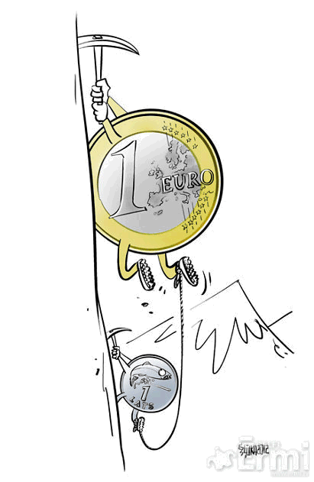
Does Latvia belong in EMU?
Fulfils the OCA criteria better than most existing members
Very flexible labour market
LVL not as credible as DKK or SEK
Was always the goal – what is the alternative?
Latvia highly euroized already
“Hands tied” may be a good approach for Latvia

Slide 5
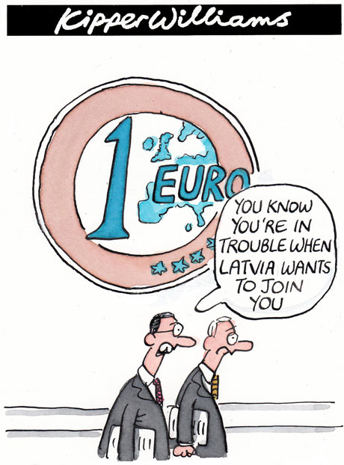
Anything missing?
Law on Fiscal Responsibility
Competitiveness
“Selling” the project

Slide 6
General government expenditure, quarterly, mill. LVL
Budget seasonality…. Law on Fiscal Responsibility

Slide 7
Competitiveness: Real Effective Exchange Rate, 2005 = 100
Monitoring needed; 2006-08 must not be repeated

Slide 8

“Selling” a monetary union is a difficult project
Some 30% want to join the Eurozone by 1 January 2014
But some 80% want to maintain a fixed exchange rate to the euro…..
Danish experience:
  Don’t oversell the project
  “Irrational” values important

Slide 9
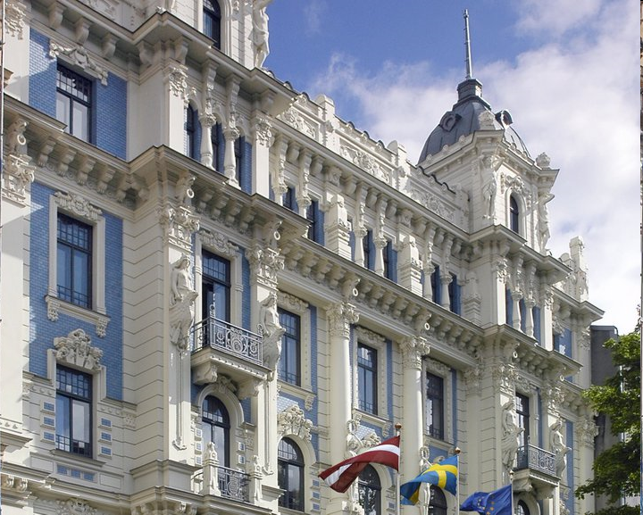
Thank you for your attention!
Questions and comments are welcome

