Slide 1
Preparation for and experience with the euro – an Austrian view
Riga, February 22, 2013
Ewald Nowotny
Governor, Oesterreichische Nationalbank

Slide 2
Overview
Part 1: Why EMU?
Part 2: Austria’s experience with euro adoption and economic effects
  Part 3: Meeting convergence criteria in a difficult economic environment
  Part 4: Challenges after euro adoption
  Part 5: Conclusions

Slide 3
1. Why EMU?
Economic and political motivation
Support the EU in its pursuit of peace and prosperity.
Create a common currency as a symbol for a united Europe .
Accelerate the process of European integration. Complete the creation of the common market.
Sustain a more stable economic environment:
  Elimination of exchange rate instability and reduction of transaction costs;
  Increased price transparency;
  Price stability thanks to supranational monetary policy.
  Euro protects from currency crises – EMS crisis 1992-1995.
Foster economic convergence among member states
THESE ARGUMENTS ARE AS VALID NOW AS IN 1998!

Slide 4
2. Austria’s experience with euro adoption
Austria was one of the eleven founding Member States that formed the euro area as of January 1999.
Austria’s practical experience is hardly comparable to Latvia today, because in 1999 the euro had not existed before:
  Euro area governance structure, in particular the ECB and the ECB Governing Council, had been newly established. From 1995 to 1998, the OeNB had been involved in preparing /shaping this structure!
  Cash changeover was an enormous logistical challenge, transition period between irrevocably fixing the exchange rate and cash changeover was three years!
By contrast, Latvia can join a monetary union that has been existing for more than a decade, so that:
    Latvia’s representatives can join a well-established governance structure
  Latvia can draw upon recent experience with cash changeover in other EU Member States, with a transition period of six months

Slide 5
2. Economic effects of the euro for Austria (I)

Slide 6
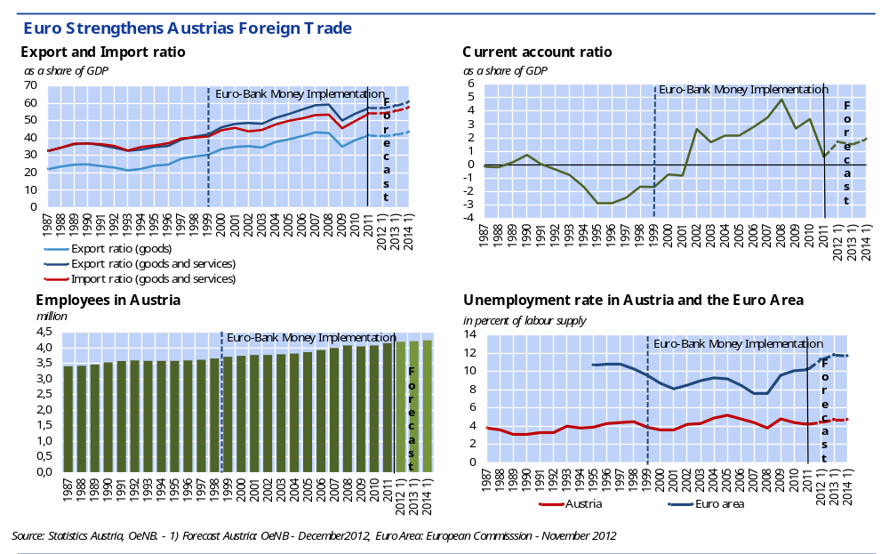
2. Economic effects of the euro for Austria (II)
November 2012: AT has the lowest unemployment rate (4.5%) in the EU and at 9.0% the 2nd lowest youth unemployment rate (15-24Y) in the EU.

Slide 7
3. Meeting convergence criteria in a difficult economic environment
All EU Member States have to join the euro area once the necessary conditions are fulfilled.
Economic entry criteria are enshrined in the Treaty and have not been changed since 1999:
  Price stability criterion
  Government budgetary position criterion
  Exchange rate criterion
  Interest rate criterion
Convergence Reports apply these criteria and aim at ensuring continuity and equal treatment over time and across countries.
Fulfilment of convergence criteria in a sustainable manner is crucial!
Lesson from the current economic and financial crisis: sustainable convergence is key for the smooth functioning of the euro area as a whole!
  → increased focus on sustainability!

Slide 8
3. Meeting convergence criteria – Challenges ahead
Fiscal criteria: strengthened economic governance rules apply
Convergence Reports review fiscal criteria against the background of the enhanced Stability and Growth Pact (SGP)
Convergence Reports monitor ratification and implementation of „Fiscal Compact“, though no formal convergence criterion
New macroeconomic imbalances procedure is important
no formal convergence criterion, but strictly monitored already by Convergence Reports 2012
Alert Mechanism Report of European Commission (Nov. 2012): Latvia was not recommended for in-depth review in 2013, no (potential) imbalances found!
Recent challenges from rapid growth of non-resident deposits
viewed as potential source of vulnerability
it remains to be seen whether measures taken will be successful

Slide 9
4. Challenges after euro introduction (I)
Facing strengthened economic governance
Upon euro adoption, a Member State becomes subject of the enhanced economic governance of the euro area within the European Semester:
…in the area of fiscal policies (enhanced SGP, “Fiscal Compact”), including the possibility of sanctions in case of non-compliance.
…in the area of macroeconomic imbalances, including the possibility of sanctions in case of non-compliance.
Furthermore, joining the euro area implies that the Member State
…participates in, but also potentially benefits from the newly established European Stability Mechanism (ESM).
…fully participates in the Single Supervisory Mechanism (SSM).

Slide 10
4. Challenges after euro introduction (II)
Communication policies remain key!
On the national level, communication policies are key not only before, but also after euro adoption in order to ensure people‘s trust in the euro.
Public sentiment indicators in Austria from 2002 to 2011:
First phase = period following the introduction of euro banknotes and coins (from 2002 to 2009): satisfaction with, and acceptance of the euro.
Second phase = sovereign debt crisis and its consequences (from 2010 to 2011): pro-euro sentiment declined
However, although the euro faces great challenges, a clear majority of Austrians (and of other euro area citizens) are convinced that the euro is here to stay:
European Commission’s Standard Eurobarometer (Nov. 2012): 66% of Austrian population support the euro (only 28% against)!

Slide 11
5. Conclusions
Meeting the convergence criteria in the current difficult economic environment poses enormous challenges.
After euro adoption, there is no room for complacency. New challenges arise, both on the European and on the national level.
It is in the responsibility of euro area Member States to comply with the enhanced economic governance framework and to contribute to the long-term success of the euro!

Slide 12
Preparation for and experience with the euro – an Austrian view
Riga, February 22, 2013
Ewald Nowotny
Governor, Oesterreichische Nationalbank

