Slide 1
Use of risks analysis for detection and prevention of VAT fraud cases (Latvian approach)
Irina Andrejeva
State Revenue Service of Latvia
27th September 2013
Riga, Latvia

Slide 2
Vulnerability of VAT system
VAT significantly differs from other taxes:
Trader is granted possibility to benefit by getting VAT refunds from the state budget (real money) even when the invoice of supplier was not paid and no VAT payment was made ever to the state budget
From tax administrations side high emphasis is placed on VAT

Slide 3
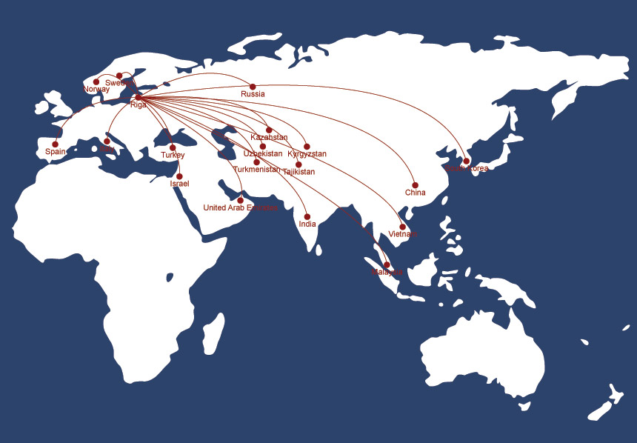







SOLUTION – Automation of tax administration procedures
SPEED AND RAPID REACTION ARE NECESSARY

Slide 4
Early warning system
The aim of the Early warning system is to help identifying timely traders and persons whose purpose probably is not to perform economic activity but tax avoidance and/or tax evasion
Registration data of newly registered legal persons and changes in registration data of already registered legal persons received by State Revenue Service from Registry of Enterprises are electronically analyzed in IT systems of State Revenue Service daily
Factors special attention is paid to during electronic analysis:
persons
groups of persons
addresses
countries

Slide 5
Explanations registry
Explanations given by officials (directors) of risky traders on their connections with these traders
Are received:
during operational activities of Financial Police Department of SRS
during tax controls performed by Tax Control Department of SRS
information submitted to Registry of Enterprises by natural persons
Information is collected and stored electronically – in Explanations registry
Note on received explanation is made in information systems of State Revenue Service allowing use of this information for risk analysis → tax control → limitation of economic activities of the traders

Slide 6
Registry of fictitious companies
“Black list” of traders which is set for State Revenue Service internal use and information from this “black list” may not be used as basis for decision-making without any additional evidences or actions
Fictitious companies are traders meeting certain criteria, e.g.
traders that are registered using documents of third persons
explanation is received from trader‘s official (director) denying connection with the trader and performance of any economic activity in the name of the trader (information from Explanations registry)
“missing trader”

Slide 7
Interaction of information sources
Early warning system
Risky addresses
Risky persons
Explanations registry
Registry of fictitious companies

Slide 8
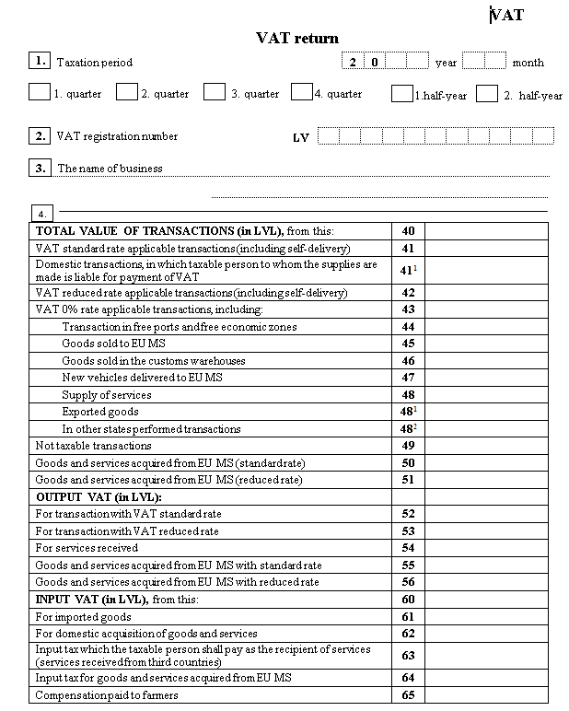
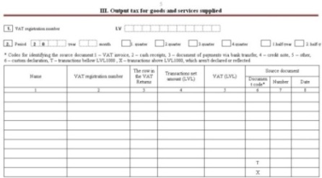
VAT return
Integral part of Latvian VAT return are annexes on input tax and output tax included in VAT return:
domestic sales
domestic acquisitions (input tax)
intra-community acquisitions
intra-community sales (recapitulative statement)
Annexes contain detailed information on:
  counterparties’ (clients, suppliers) name and VAT registration number
  transaction date
  transaction value

Slide 9
EU information
VIES – VAT information exchange system
Information on intra-community acquisitions from Latvian taxpayers declared by other EU member states’ taxpayers
bilateral agreements on exchange of information with Bulgaria, Romania and Hungary
EUROFISC
information on risky taxpayers identified by other EU member states
feedback on Latvian taxpayers and on counterparties of Latvian taxpayers in other EU member states
Information from public databases of Registries of Enterprises of other EU member states
identification of Latvian persons behind traders in other EU member states

Slide 10
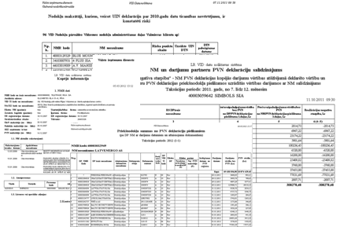

IT systems of SRS
VIES
DATA
WAREHOUSE
Information exchange system
Queries
Information system for state officials declarations
State Land Service
Central Customs information system
Tax information system (TIS)
Other information sources
State Forest Service
Ministries
Others

Slide 11
Risk analysis of VAT returns
VAT return
EU information
Early warning system
Registry of fictitious companies
Explanations registry
Risky traders
Risky suppliers and clients
Other SRS sources

Slide 12
VAT system protection methods
Preventive tax administration measures
De-registration from VAT registry
Suspension of economic activity
  immediate de-registration from VAT registry
  prohibition for suppliers/clients to cooperate with trader ^{new!!!}
  actions for limitation of economic activity
Tax and customs controls – repressive measures
  thematic check, inspection, observation, desk audit, audit
Administrative penalties
  ban to hold a position in the company ^{new!!!}

Slide 13
Problems (1)
Non-compliant taxpayers are always one step ahead of the tax administration, therefore tax administration work is fighting with consequences nevertheless it is necessary to prevent the possibility of tax fraud at the very early stage
Legislation is fragmentary adjusted to tackle certain type of VAT fraud, but exemptions and derogations from regular rules gives opportunity to non-compliant taxpayers to use bottlenecks and loopholes of the system

Slide 14
Problems (2)
Mechanisms of international cooperation and mutual assistance within EU have heavy and time-consuming procedures
  VAT system in EU is harmonized still the work of the tax administrations is not harmonized
  quality of the responses is not always satisfactory and responses not always comply with set deadlines
  taxpayers in other EU member states provide to tax administrations coordinated responses
Weak cooperation and information exchange with third countries
SPEED AND RAPID REACTION ARE NECESSARY

Slide 15
Conclusion
IT solutions allow to speed up the reaction time needed but does not solve the existing problems on the merits
VAT system with given right of deduction allow non-compliant traders getting unreasonable fiscal benefit
Existing VAT system with growing number of amendments creates loopholes that with are used by non-compliant taxpayers
VAT system by itself causes problems the consequences of which need to be dealt by tax administrations

Slide 16

Thank you for
your attention!
Ms. Irina Andrejeva
Chief tax inspector
State Revenue Service of Latvia
Tax Control Department
Tax control planning and analysis division
Risk analysis methodology unit
 +371 67028861
 Smilsu iela 1, Riga, LV-1978, Latvia
@ Irina.Andrejeva@vid.gov.lv

