Slide 1
Estonia 2018
Jorma Sarv
Head of International Programme of Estonia 100 / Presidency of EU
Government Office of Estonia

Slide 2

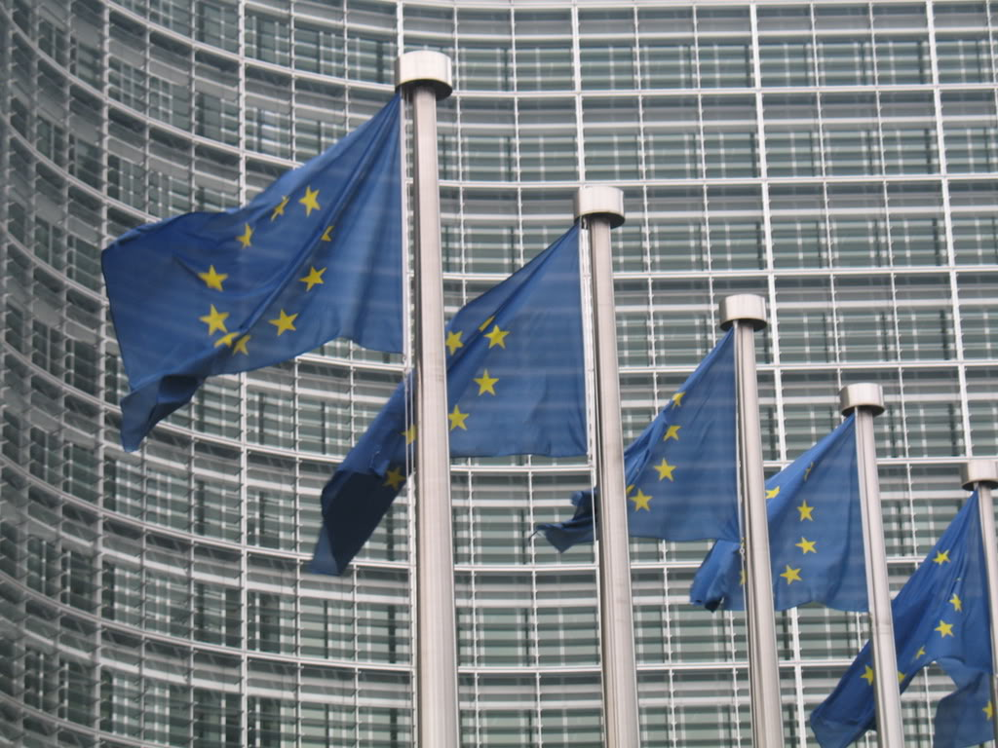
2018: Two major events in the same year

Slide 3
Timeline
2014-2018: process based initiatives, preparations etc
Apr 2017: prologue
Jan – Dec 2018: Estonia 100 celebrations
Jan – Jun 2018: Estonian Presidency of EU
2019 – 2020: number of events related to the important historical milestones 1919-1920

Slide 4
General concept
Estonia 100 is a celebration that involves everybody who wishes to come along.
The programme is not only focusing fine arts – although they carry an important role – but wishes to portrait Estonia and its life in a diverse and natural way.
Estonia 2018 “TREE”: past, present, future.

Slide 5
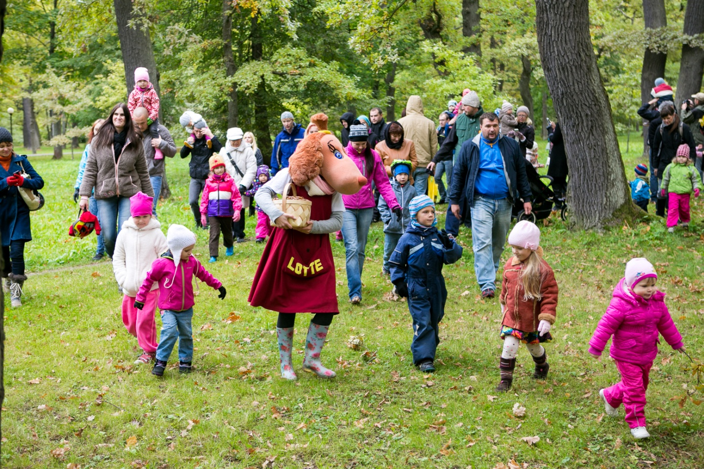
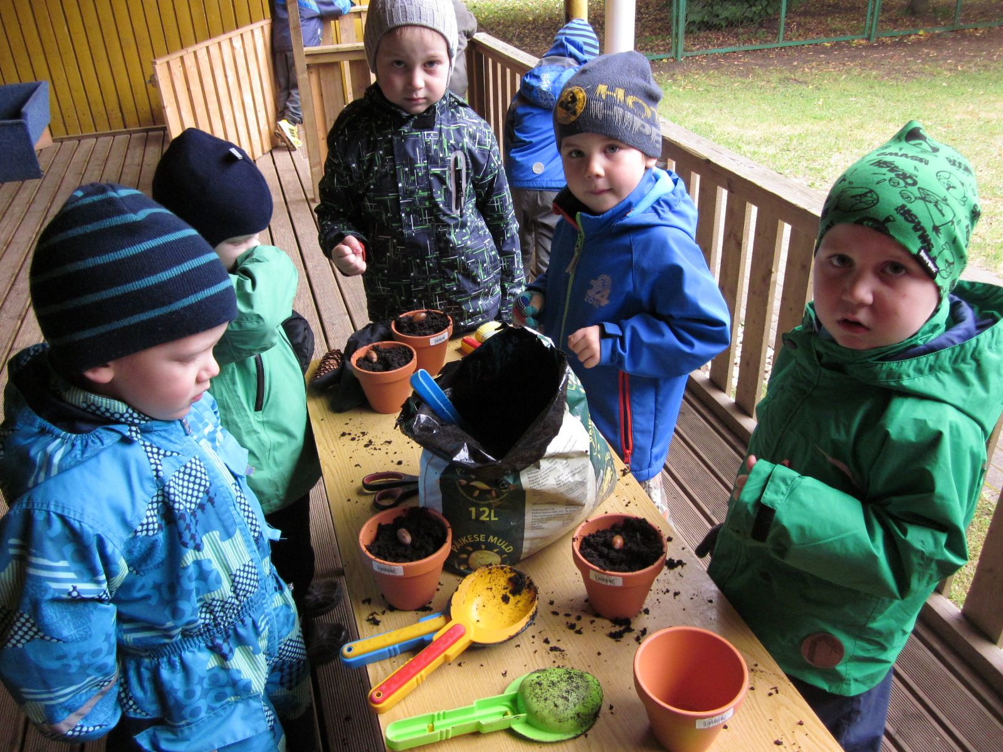

“Estonia’s100 oaks”

Slide 6
“ROOTS”
History and cultural heritage including museums and archives, libraries, national heritage, traditional culture etc.
    Public environment, architecture, living environments
    Nature, wildlife, sea culture traditions
    Religious movements

Slide 7
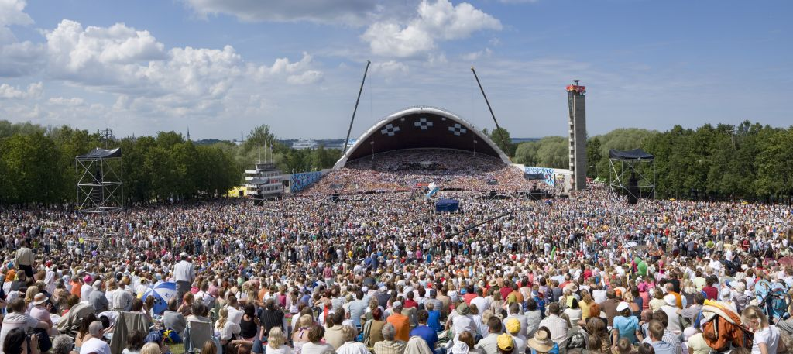

Slide 8
“BOLE”
Major events including legal holidays, 100 anniversaries of various events, opening and closing ceremonies etc
Fine arts: music, theatre, film & audiovisual, visual arts, literature, design
International Programme of Estonia 100 / EU Presidency 2018

Slide 9

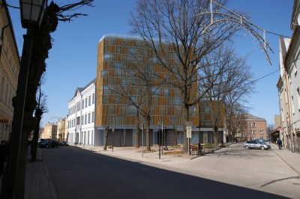
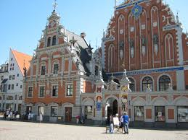
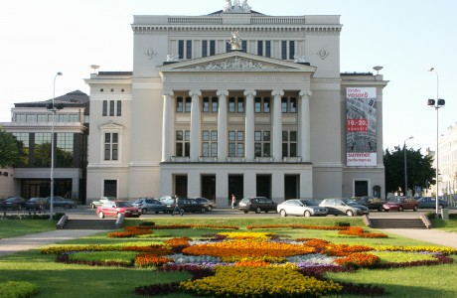


Slide 10
“TREE-TOP”
Creating the future
Education (children & youth, lifelong learning)
Community organisations, volunteers
Residencies
Science and innovation
Entrepreneurship & PPP
New Media & IT
Healthy nation & sports

Slide 11
International Programme
Target: Awareness (including Estonian society)
Focus 1: Estonia 100
Focus 2: Presidency of EU

Slide 12
Thank you!
jorma.sarv@riigikantselei.ee
Tel +372 502 3343

