Slide 1
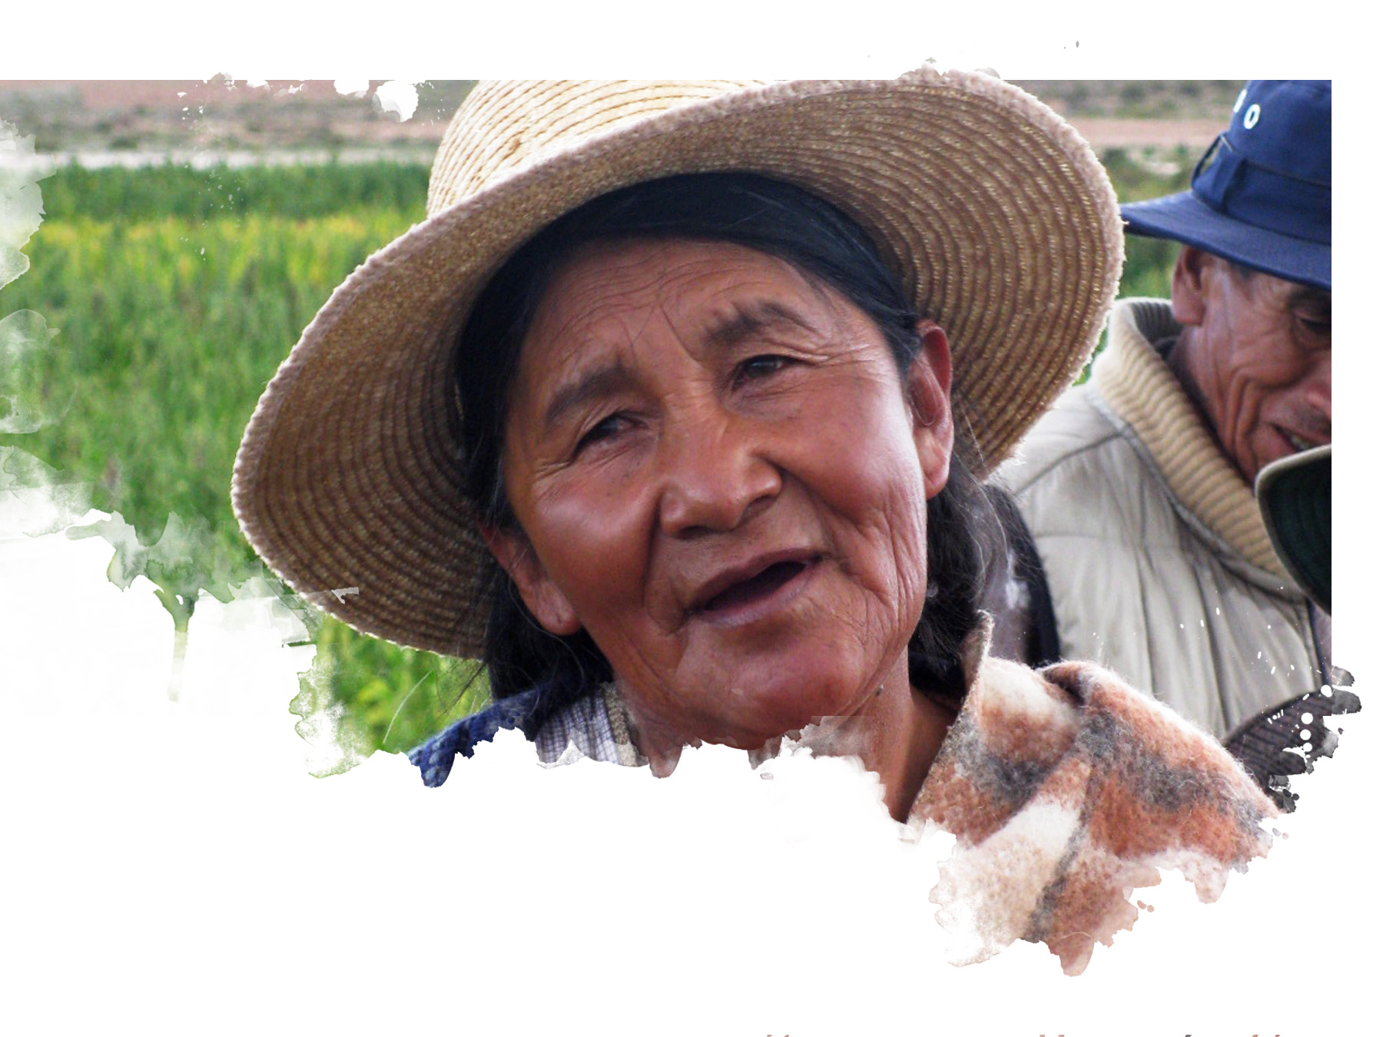

Danish development cooperation – and views on EU collaboration
Mrs. Nathalia Feinberg, Head of the Department for Development Policy and Global Cooperation Ministry of Foreign Affairs, Denmark

Slide 2
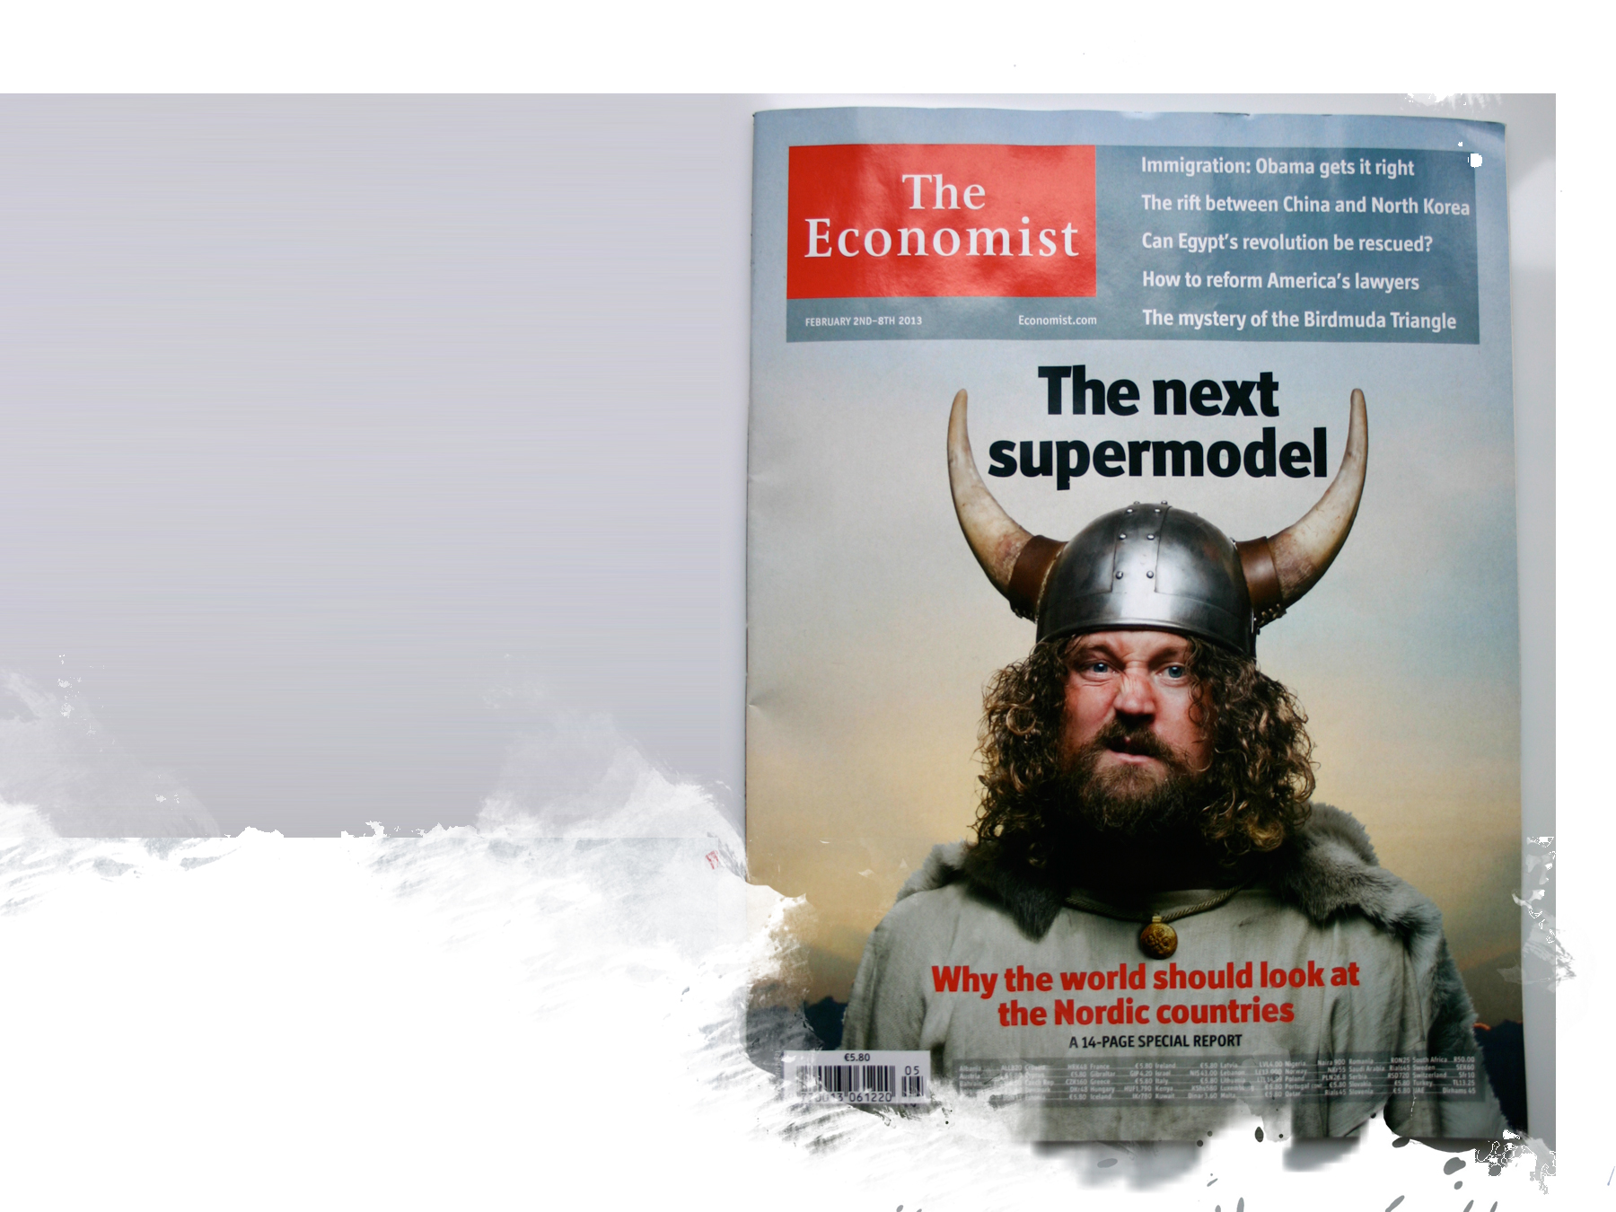

Danish development co-operation – lessons learned
Notes:
HVIS MAN HAR EVNEN SÅ HAR VI PLIGTEN

Slide 3
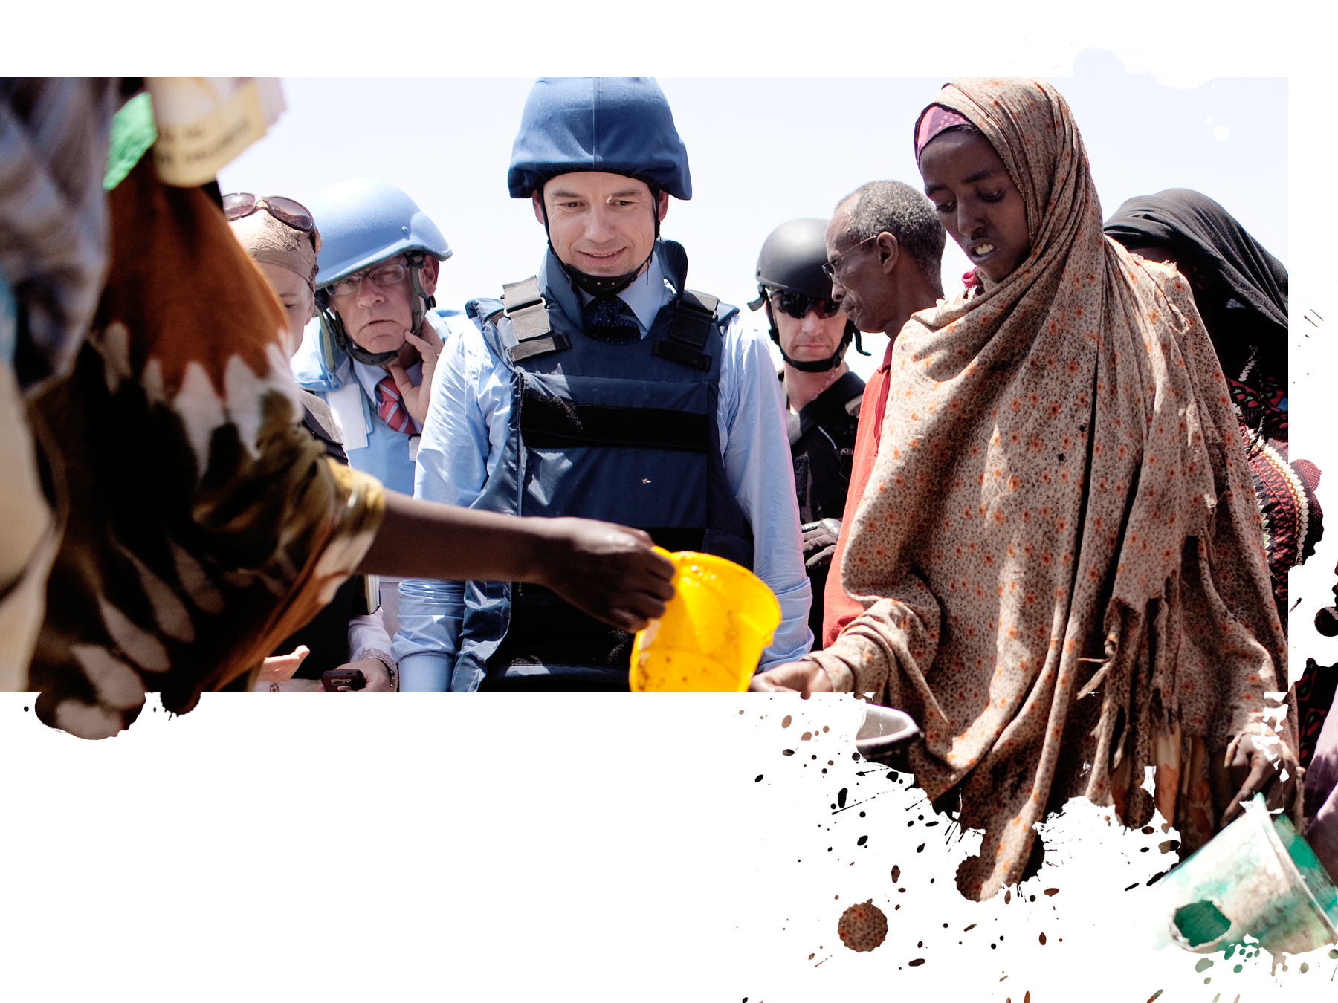
From chairty to poverty reduction, stability and sustainable development in a globalized world

Slide 4
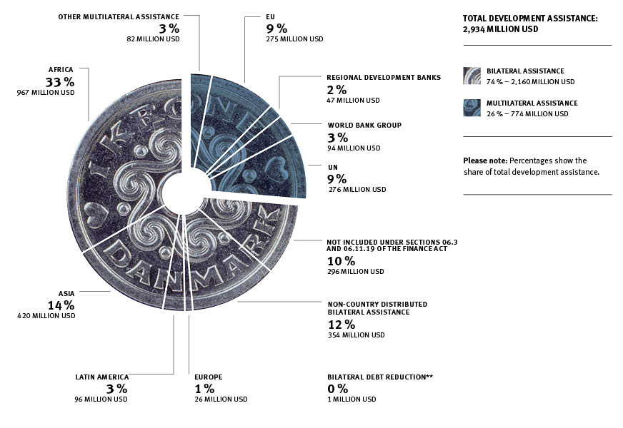

How much?
Notes:
Ca. 70 pct. af udviklingsbistanden (11,4 mia. kr.) gives bilateralt, oftest direkte til programmer i modtagerlandene eller tematiske programmer i multilaterale organisationer (øremærket).
Ca. 30 pct. (4,7 mia. kr.) gives som bidrag til multilaterale organisationer (ikke øremærket).
Lande i Afrika modtager mest bistand, næsten 60 pct. (4,6 mia. kr.) af den landespecifikke bilaterale bistand (8 mia. kr.).
De danske folkelige organisationer forvalter ca. 16 pct. (1,8 mia. kr.) af den bilaterale bistand (11,4 mia. kr.).

Slide 5
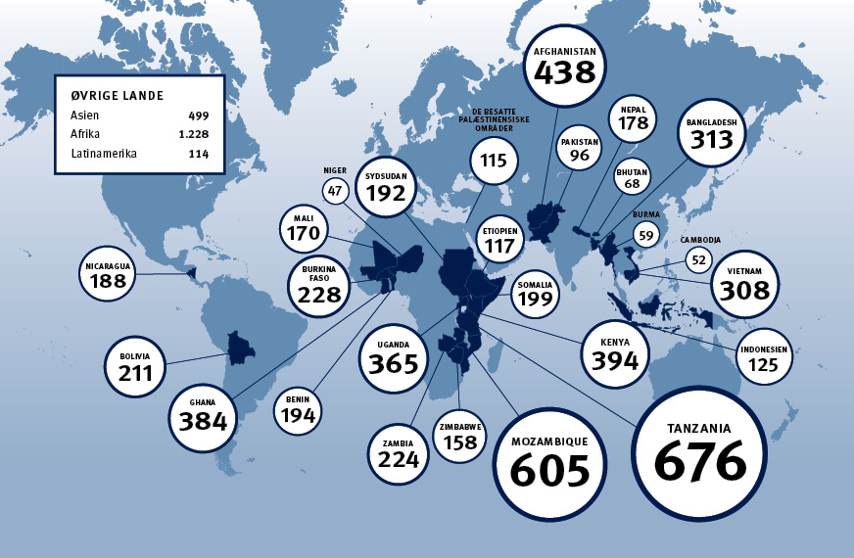
Where?

Slide 6
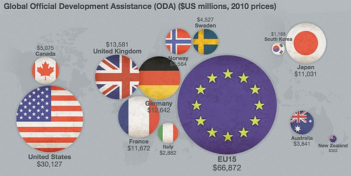

The EU – a key actor in international development
Together we make a difference!

Slide 7
Scope:
Identify areas where Denmark can add value and influence EU policies and programmes as well as support EU policy objectives (unleash synergy).
Strategy for Denmark’s participation in the EU’s development cooperation
Common priority areas:
Human rights based approach
Green growth
Fragile states
Instruments:
Policy Coherence for Development
Joint Programming
Budget support

Slide 8
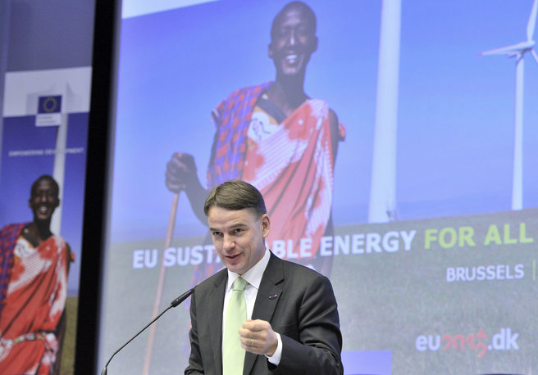

Lessons learned from the Danish EU-presidency
Focus on a few policy dossiers in pipeline – no national priorities
Invest in being a good facilitator btw. EU institutions and EU MS
Relations with the EEAS is key – comprehensive approach

